Slide 1
Click Trajectories: End to End Analysis of the Spam Value Chain
By Aishwarya Nayak

Slide 2
Based on the paper:
Kirill Levchenko, Andreas Pitsillidis, Neha Chachra, Brandon Enright, Mark Felegyhazi, Chris Grier, Tristan Halvorson, Chris Kanich, Christian Kreibich, He Liu, Damon McCoy, Nicholas Weaver, Vern Paxson, Geoffrey M. Voelker, Stefan Savage. Click Trajectories: End to End Analysis of the Spam Value Chain (2011). In SP’11 Proceedings of the 2011 IEEE Symposium on Security and Privacy , Pages 431-446.

Slide 3
Introduction
Spam based advertising is a business which fuels a profitable enterprise.
We lack a solid understanding of this enterprise’s full structure and thus most anti-spam interventions focus on only one facet of the overall spam value chain.
This paper presents a holistic analysis that quantifies the full set of resources employed to monetize spam email.

Slide 4
Goals
The motivation of this paper is to guide decisions about the most effective mechanisms for addressing the spam problem.
This paper develops a methodology for characterizing end to end resource dependencies behind individual spam campaigns and then analyze the relationships among them.

Slide 5
How Modern Spam Works
While the user experience of spam is limited to emails, these constitute only one visible part of the whole chain.
As an advertising medium, spam ultimately shares the underlying business model of all advertising.
This paper divides this large chain into three distinct stages: advertising, click support and realization.

Slide 6
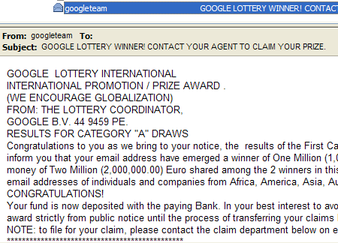
Advertising
Advertising constitutes of all activities focused on reaching potential customers and enticing them into clicking on a particular URL.
This includes the bulk messages sent by email advertising different products. The three main categories of products studied in this paper are pharmaceuticals,replica luxury goods

Slide 7
Click Support
Having delivered their advertisement, a spammer depends on the recipients to respond, usually by clicking on an embedded URL.
In order to get the recipients to the website of interest a spammer orchestrates a sequence of services:
i)Redirection sites - Many spammers advertise URLs that when visited, redirect to additional URLs

Slide 8
Click Support(contd.)
ii)Domains- At some point a click trajectory will usually require domain name resources managed by the spammer or their accomplices.
iii)Name servers -Any registered domain must in turn have a supporting name structure infrastructure.
iv)Web servers- The address records specified by the spammers must in turn specify servers that host web content.

Slide 9
Click Support(contd.)
v)Stores and affiliate programs - The affiliate program typically provides the storefront templates, shopping cart management , analytics support and even advertising materials.

Slide 10
Realization
Finally, having brought the customer to an advertised site and convinced them to purchase some product, the seller realizes the latent value by acquiring the customer’s payment through conventional payment networks and in turn fulfilling their product request.
At the end, a store arranges to fulfill an order in return for the customer’s payment.

Slide 11
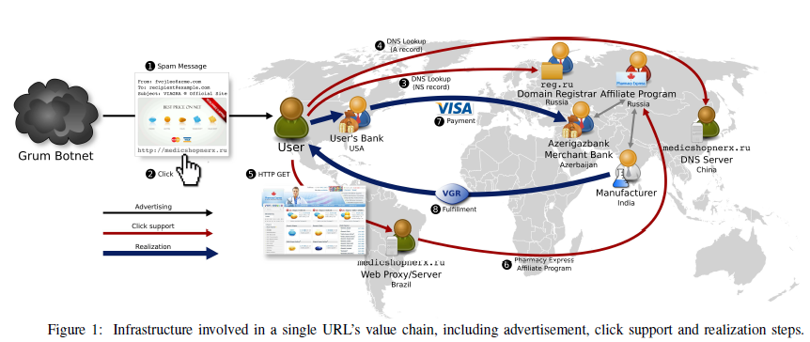
An example of spam value chain

Slide 12
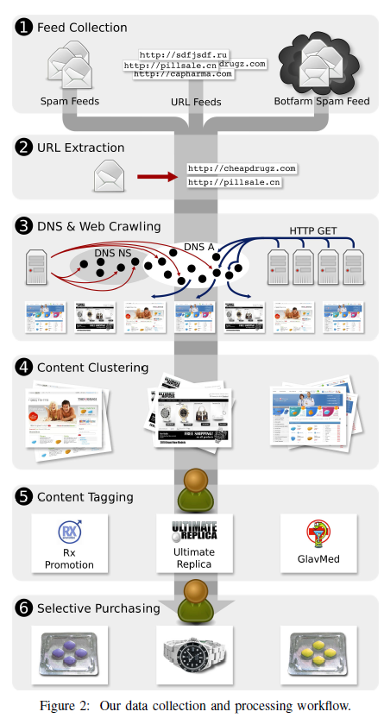
Data Collection/Processing Workflow
They have followed the following
methodology in order to collect data,
process and validate them.
- collecting spam advertised URLs
- crawler data
- content clustering and tagging
- purchasing

Slide 13
Collecting spam advertised URLs
They collected 1 billion URLs from third party partners and harvested URLs from their own botfarm environment.
From these feeds they extract and normalize embedded URls and insert them into a large multi terabyte Postgres database. The resulting feed tables drive virtually all subsequent data gathering.

Slide 14
Crawler data
The URL feed data subsequently drives active crawling measurements that collect information about both the DNS infrastructure used to name the site being advertised and the web hosting infrastructure that serves site content to visitors.
They use
- DNS crawler
- Web crawler

Slide 15
Crawler data(contd.)
DNS Crawler
- it identifies the name server infrastructure used to support spam advertised domains and the address records they specify for hosting those names.
Web Crawler
- the web crawler replicates the experience of a user clicking on the URLs derived from the spam feeds.

Slide 16
Content Clustering
In this stage the crawler output is processed and the information is associated with higher level spam business activities.
A clustering tool is used that uses the HTML text of the websites to classify them.
It generates a fingerprint for the page being crawled.

Slide 17
Tagging
Category Tagging
- it broadly separates the clusters into three categories - pharmaceuticals, replica and software.
Program Tagging
- it identifies the set of distinct clusters that belong to the same affiliate program.

Slide 18
Purchasing
Finally, for a subset of the sites with program tags, goods that were offered for sale , were purchased.
Purchases were placed via VPN connections to IP addresses located in the geographic vicinity to the mailing address. This is done to avoid failing common fraud checks.

Slide 19
Results
The data was analysed explicitly from the standpoint of the defender.
The defender may choose to intervene by either by blocking its advertising, disrupting its click support or interfering with the realization step.
It was found that the payment infrastructure has far fewer alternatives and a far higher switching cost.

Slide 20
Conclusion
This paper describes large scale empirical study to measure the spam value chain in an end to end fashion.
It has described a framework for conceptualizing resource requirements for spam monetization.
Finally, the data is used prove that payment tier is by far the most concentrated and valuable asset in the spam ecosystem.

