Slide 1
The Postman Always Rings Twice:
Attacking & Defending postMessage in HTML5 Websites
Ankur Verma
University of Central Florida, Orlando

Slide 2
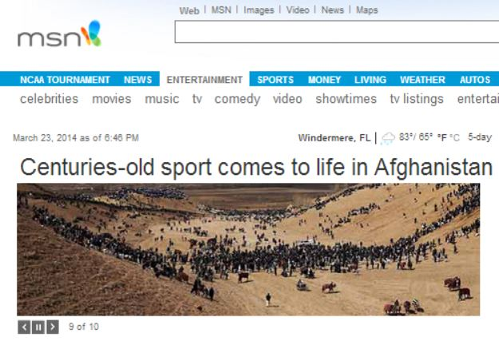
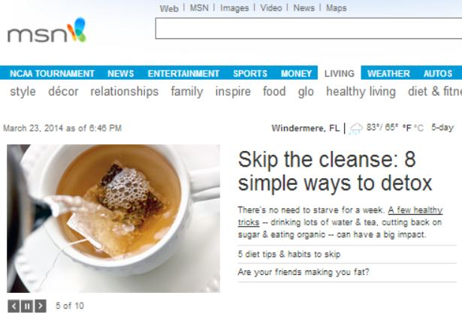



Prior/After HTML5
Same Origin Policy communication
Cross Site Communication
Protocol + Host + Port
postMessage
Notes:
Same Origin Policy: Permits scripts running on pages originating from the same site to access each other DOM with no specific restrictions.
Same Origin Policy: Web Browser can implement this policy to prevent XSS. Same origin defined by combination of:
Domain ,Port Number and Protocol.
Cross Site Communication: postMessage implementer’s responsibility to prevent XSS.
URL: when we try to send message from twitter to facebook.
https://www.facebook.com/login.php?skip_api_login=1&api_key=2231777543&signed_next=1&next=https%3A%2F%2Fwww.facebook.com%2Fdialog%2Foauth%3Fredirect_uri%3Dhttps%253A%252F%252Fs-static.ak.facebook.com%252Fconnect%252Fxd_arbiter%252FLEdxGgtB9cN.js%253Fversion%253D40%2523cb%253Df33403fdc4%2526domain%253Dtwitter.com%2526origin%253Dhttps%25253A%25252F%25252Ftwitter.com%25252Ff1476edda8%2526relation%253Dopener%2526frame%253Df393f172cc%26display%3Dpopup%26scope%3Duser_birthday%252Cpublish_actions%252Cpublish_stream%26response_type%3Dtoken%252Csigned_request%26domain%3Dtwitter.com%26client_id%3D2231777543%26ret%3Dlogin%26sdk%3Djoey&cancel_uri=https%3A%2F%2Fs-static.ak.facebook.com%2Fconnect%2Fxd_arbiter%2FLEdxGgtB9cN.js%3Fversion%3D40%23cb%3Df33403fdc4%26domain%3Dtwitter.com%26origin%3Dhttps%253A%252F%252Ftwitter.com%252Ff1476edda8%26relation%3Dopener%26frame%3Df393f172cc%26error%3Daccess_denied%26error_code%3D200%26error_description%3DPermissions%2Berror%26error_reason%3Duser_denied%26e2e%3D%257B%257D&display=popup

Slide 3
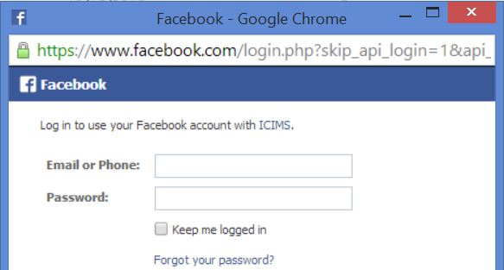
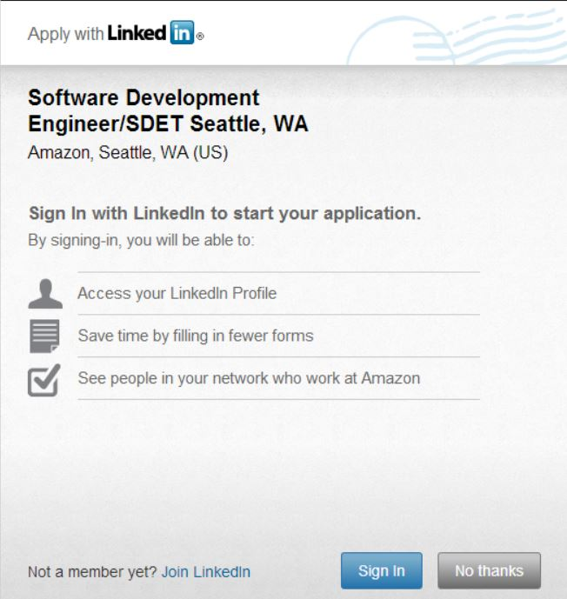
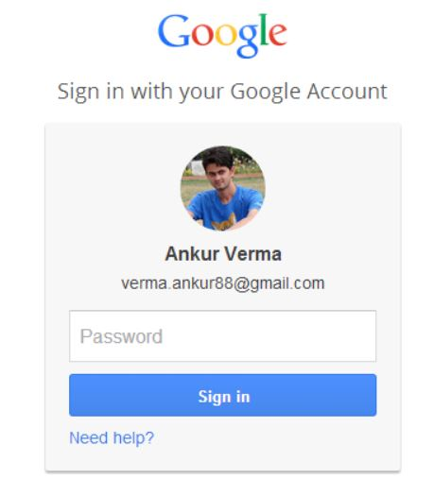
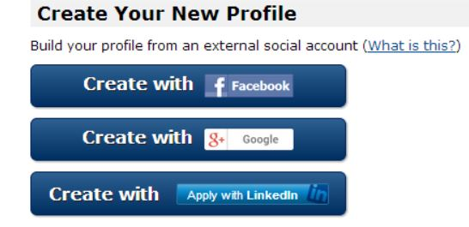
New Web Approach
postMessage enhance user experience

Slide 4
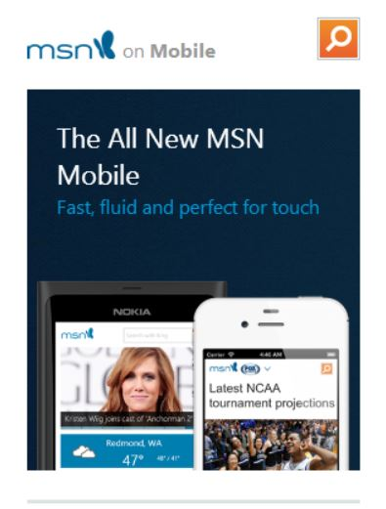


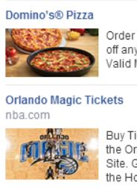

postMessage: Inter-frame Communication
Different Frames

Slide 5

What Worries?
Changing Web Landscape: Inclination on Client Side
Greater
Functionality
JavaScript
Application Logic
Fast Query
Response
Extended
Functionality
Notes:
Extended Functionality: Manipulating the web page using add-ons like GreaseMonkey.

Slide 6

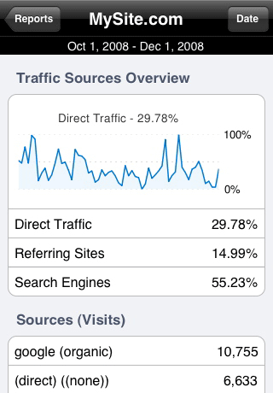
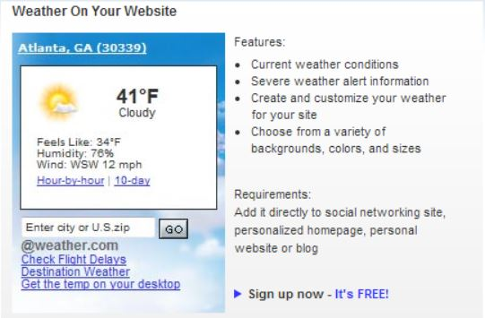
Usage
Message
Target Origin
Usage: targetWindow.postMessage(<Traffic Data Request>, <Google Analytics>)
Third Party
Notes:
Message could be a SCRIPT, which could be dangerous.

Slide 7
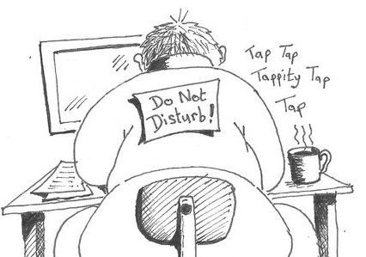
Security Perspective
postMessage guarantees confidentiality and authenticity
    Sender specifies recipient’s origin, specifying URL(Target Origin)
    Recipient origin can also be ‘*’
  Developer’s responsibility.
  To be used Cautiously!
  68% websites vulnerable to XSS

Slide 8
Cause of Concern
25% of top 10,000 websites use postMessage: Alexa
Over 70% of websites do not perform origin check.
Nearly 12% perform semantically incorrect checks

Slide 9
Sample Demonstration (I)
Origin Check: Failing which enables XSS attacks.
Window.addEventListner(“
message”, GetMsg, false);
function GetMsg(event) {
if (event.origin == “
http://www.abc.com")
return;
event.source.postMessage(“Hi ABC”, event.origin);
}
Var newWin=window.open
(http://www.xyz.com);
newWin.postMessage(“Hi”, http://www.xyz.com);
http://www.xyz.com
http://www.abc.com
Origin
Check
targetOrigin
Notes:
Malicious user can have unlimited access to DOM, cookies and local storage.

Slide 10
Sample Demonstration (II)
Semantically Incorrect Checks
Window.addEventListner(“
message”, GetMsg, false);
function GetMsg(event) {
Var w=/abc\.com(:[0-9])?$/;
if (!event.origin.match(w))
return;
event.source.postMessage(“Hi ABC”, event.origin);
}
Var newWin=window.open
(http://www.xyz.com);
newWin.postMessage(“Hi”, http://www.xyz.com);
http://www.xyz.com
http://www.abc.com
Origin
Check
targetOrigin
Evilabc.com

Slide 11

Defense from Attacker Website
For third party content providers like Facebook
  Based on Pseudo Random Token
    Frame with 3rd party content accepts messages only from the origin of the page that loads this frame.
    Or (More Restrictive)
    Frame with third party content accepts
    messages only from the parent frame.
  XSS can’t be prevented, if attacker includes 3rd party frame
X.com
Y.com
X.com
attacker.com
X.com
Notes:
Pseudo Random Token is shared between the communicating origins.
If third party frame, do not contain security-critical function, there is then no immediate threat. Unfortunately, most 3rd party frames includes local storage or cookie information.

Slide 12
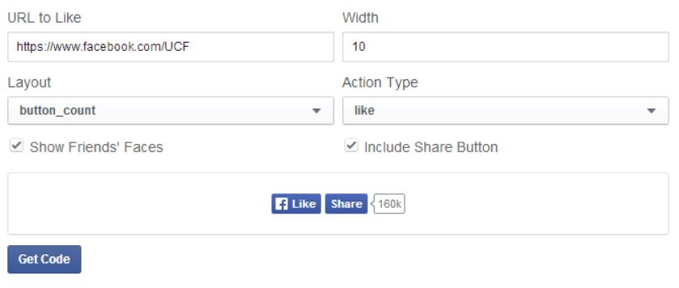


Defenses
Attacker including 3rd party frame.
  Frame with 3rd party content accepts messages only from content provider’s scripts running in any origin.
  Example: www.facebook.com
  https://developers.facebook.com/docs/plugins/like-button/
www.attacker.com
www.facebook.com
Receivers

Slide 13
Defense from Third Party Content
For website that use untrusted third party content
  Based on Content Security Policy (CSP) extension
    Restricts origin of messages sent to X.com from attacker.com.
    Requires browser support, no cooperation
    From third party content provider.
X.com
attacker.com

Slide 14
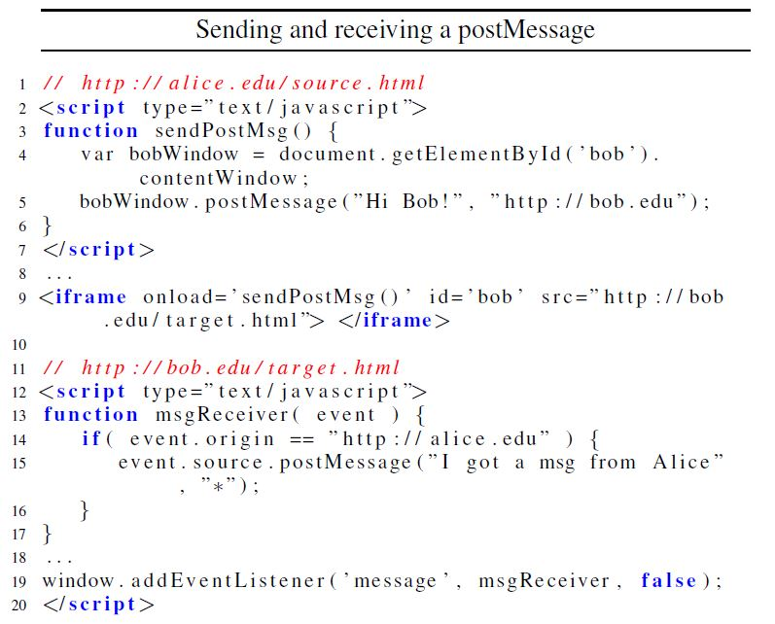
Using postMessage: Simple Example
Data
Origin Check
Sender Origin Check
Target Origin

Slide 15
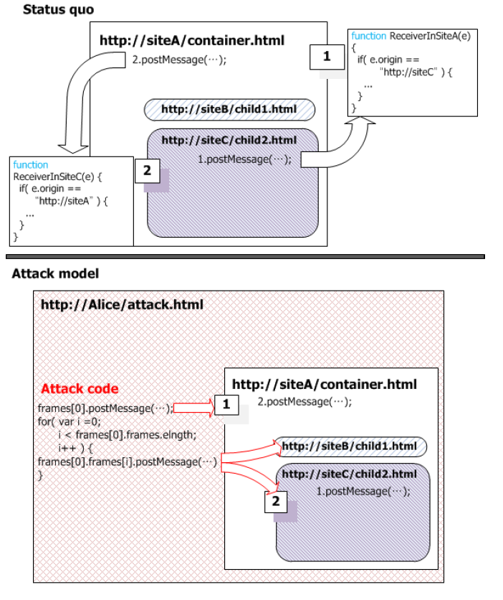
“Light” Threat Model
Child C sends
message to B via A
Third Party Frames
Attacker
Honest
Notes:
B and C run in website A’s origin.
Attacker can send messages to A, B and C.
Prevention way: Need to check true origin of every message.

Slide 16
“Heavy” Threat Model
Attacker directly included third party frame
attacker.com
Attacker can put any script or data in local storage
novice.com
novice.com
Provided Script
Can cause session hijacking if website stores user’s identity
Can cause also steal stored cookies
Notes:
This case is similar to one which discuss in previous slide. Facebook does a check of origin of postMessage.

Slide 17
X-Frame-Options Header
Allows/ disallows rendering of the document when inside an iframe.
It may have three possible values:
  SAMEORIGIN: The document will be rendered in an frame only if the frame and it’s parent have the same origin.
  DENY: Document may not be rendered inside a frame.
  ALLOW-FROM: Document can be frame in specific uri
Needs to be added to web server’s config file.
3% of websites posing serious threat, do not use this feature

Slide 18

Defense Techniques
Pseudo Random Token
Protect against “Light” threat model
  Guarantees only the origin that loaded a third-party frame
  can send messages to this frame. Shared secret pseudo
  random token between site owner and inner frame
  Web-Kit browsers, provide crypto.getRandomNumber API
  http://random.org via an XMLHttpRequest
  Outer script attaches token to src attribute of frame it create
Content Security Policy
Enforce security policy on 3rd party scripts. Require
structural changes, by removing inline JavaScript
CSP is HTTP header starting with X-Content-Security-Policy
Only 3 out of Alexa top 10,000 websites use this
Notes:
Pseudo Random Token to authenticate source of messages and is intended for the implementers of third party content.
Content Security Policy extension is intended for website owners.
These techniques are independent of each other, and can be implemented jointly or separately.
Inner Frame belongs to third party content provider.
Token is generated for each of third party frame.
Random Number API seeds value from the OS.
CSP defense is used for Web Site owners.
Example of CSP: X-Content-Security-Policy: script-src ‘self’ http://apis.valid.com
And X-Content-Security-Policy: script-src ‘*.com; msg-src http://www.valid.com *.edu

Slide 19







Questions ?

