Slide 1
An analysis of
Social Network-based Sybil defenses
Bimal Viswanath§ Ansley Post§
Krishna Gummadi§ Alan Mislove¶
§MPI-SWS ¶Northeastern University
SIGCOMM 2010
Presented by Junyao Zhang
Many of the slides are brought from the author’s original

Slide 2

About Sybil attack
Fundamental problem in distributed systems
Attacker creates many fake identities (Sybils)
  Used to manipulate the system
Many online services vulnerable
  Webmail, social networks, p2p
Several observed instances of Sybil attacks
  Ex. Content voting tampered on YouTube, Digg

Slide 3
Sybil defense approaches
Tie identities to resources that are hard to forge or obtain
RESOURCE 1 Certification from trusted authorities
  Ex. Passport, social security numbers
  Users tend to resist such techniques
RESOURCE 2 User trust (links) in a social network?

Slide 4
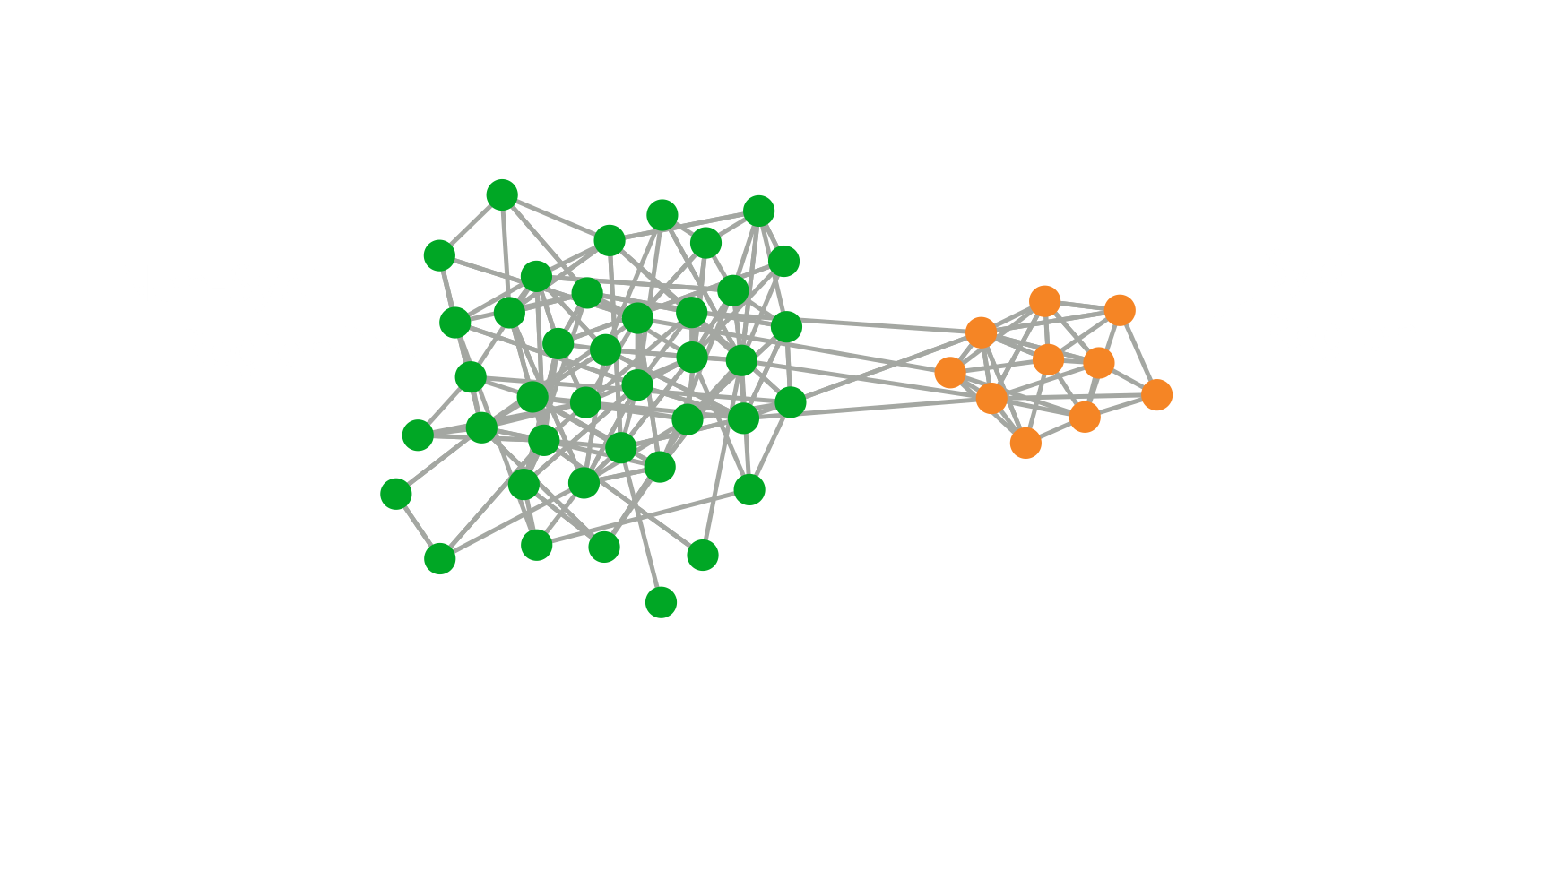
New approach: Use social networks
Assumption: Links to good users hard to form and maintain
  Users mostly link to others they recognize
Attacker can only create limited links to non-Sybil users
Leverage the topological feature introduced by sparse set of links

Slide 5
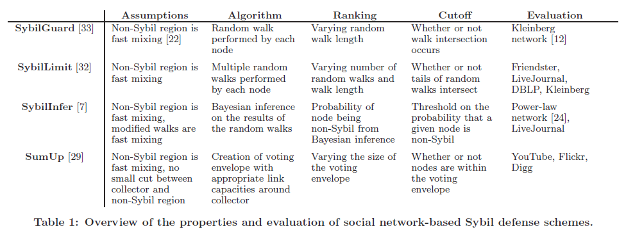
Social network-based schemes
Very active area of research
  Many schemes proposed over past five years
Examples:
  SybilGuard [SIGCOMM’06]
  SybilLimit [Oakland S&P ’08]
  SybilInfer [NDSS’08]
  SumUp [NSDI’09]
  Whanau [NSDI’10]
  MOBID [INFOCOM’10]

Slide 6
But, many unanswered questions
All schemes make same assumptions
  Use only social network
But, schemes work using different mechanisms
  Unclear relationship between schemes
Is there a common insight across the schemes?
  Is there a common structural property these schemes rely on?
Understanding relationship would help
How well would these schemes work in practice?
  Are there any fundamental limitations of Sybil defense?

Slide 7
This talk
Propose a methodology for comparing schemes
  Allows us to take closer look at how schemes are related
Finding: All schemes work in a similar manner
  Despite different mechanisms
Implications: Hidden dependence on network structure
  Understand the limitations of these schemes

Slide 8
How to compare schemes?
Straightforward approach: implement and compare
  Treat like a black-box
But, only gives one point evaluation
  Output dependent on scheme-specific parameters
We want to understand HOW schemes choose Sybils
  Interested in underlying graph algorithm
Thus, we had to open up the black-box
  We analyze SybilGuard, SybilLimit, SumUp and SybilInfer

Slide 9
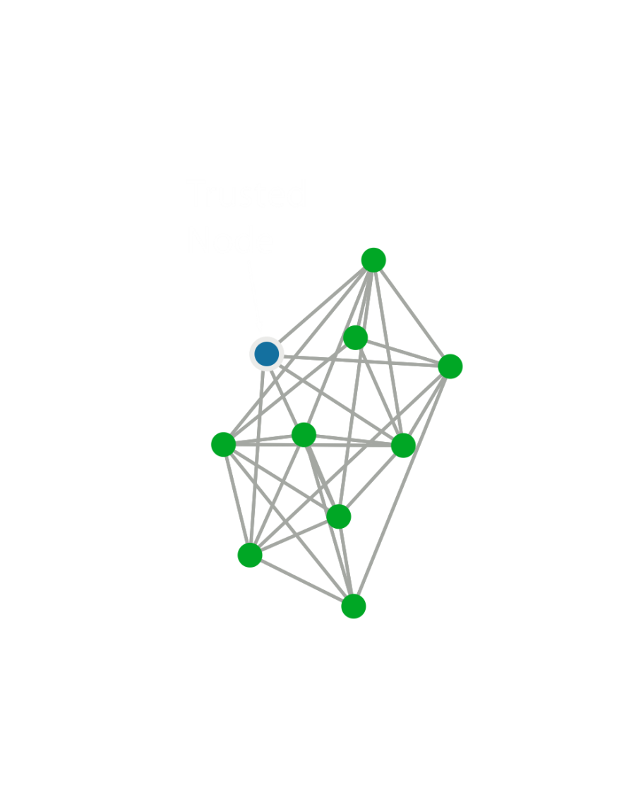
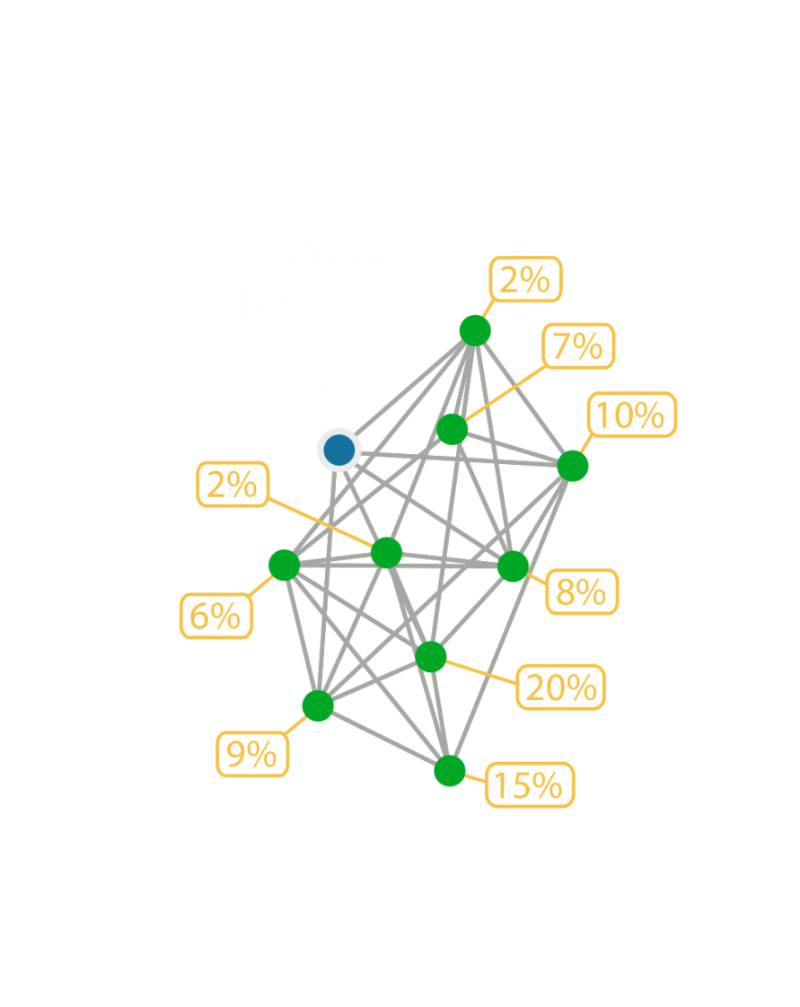

Decompose the current work
Take in a social network and trusted node
  Declare Sybils from perspective of trusted node
Internally, schemes assign probability to nodes
  Likelihood of being a Sybil
Leverage this to compare schemes?
  View schemes as inducing ranking on nodes
  Easier to compare rankings than full schemes

Slide 10
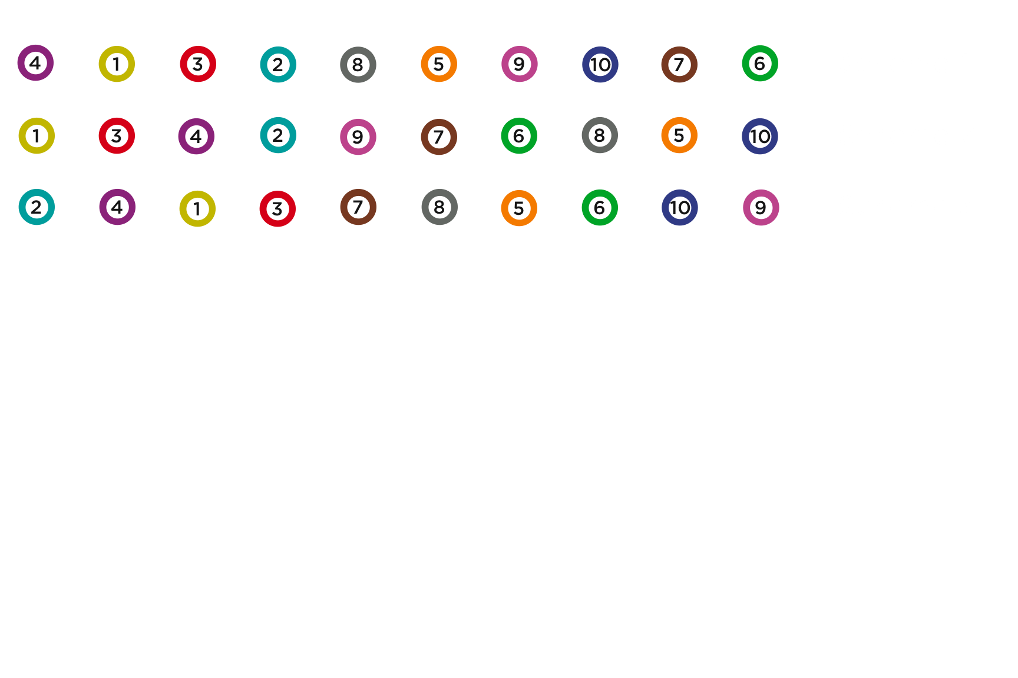
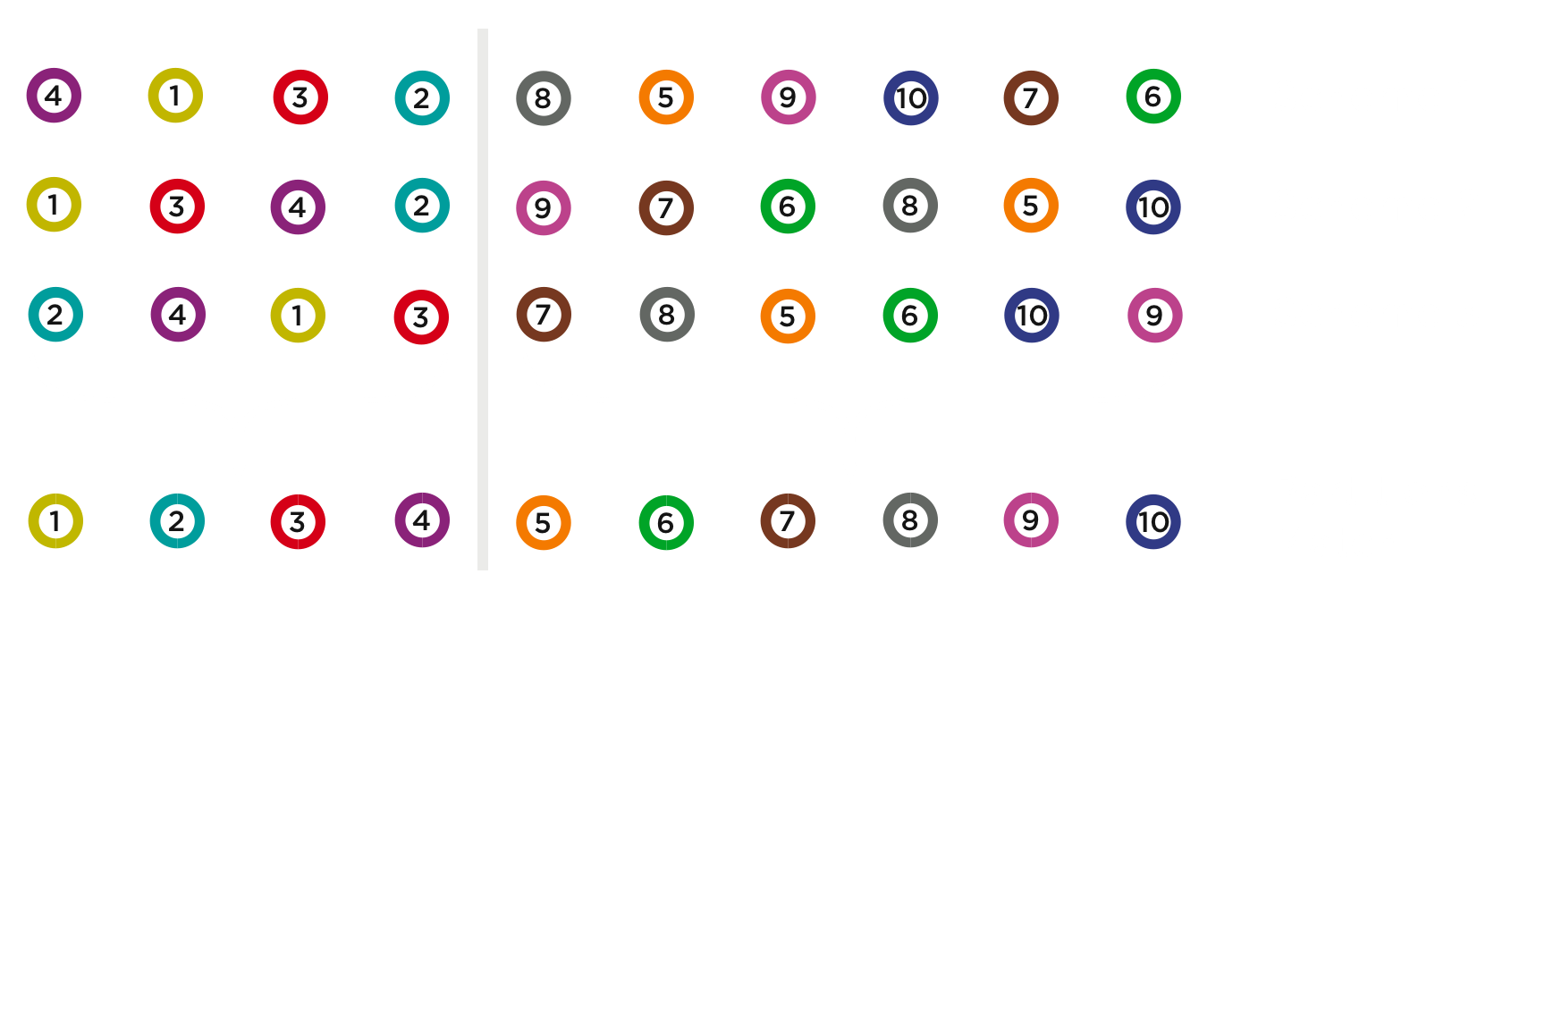
How do the rankings compare?
Cut-off
All schemes observed to have distinct cut-off point
  What happens in this cut-off point?

Slide 11
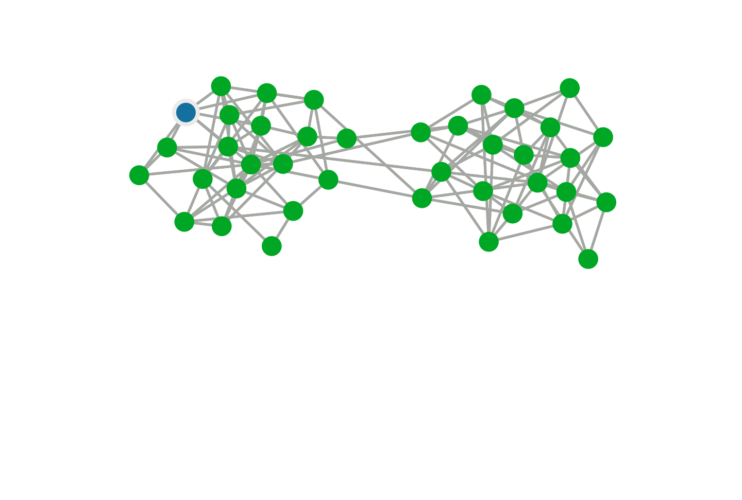
Where do the rankings match?
The cut-off point at the boundary of the local community
  Around the trusted node
Community well-defined in paper
  Roughly, set of nodes more tightly knit than surrounding graph

Slide 12
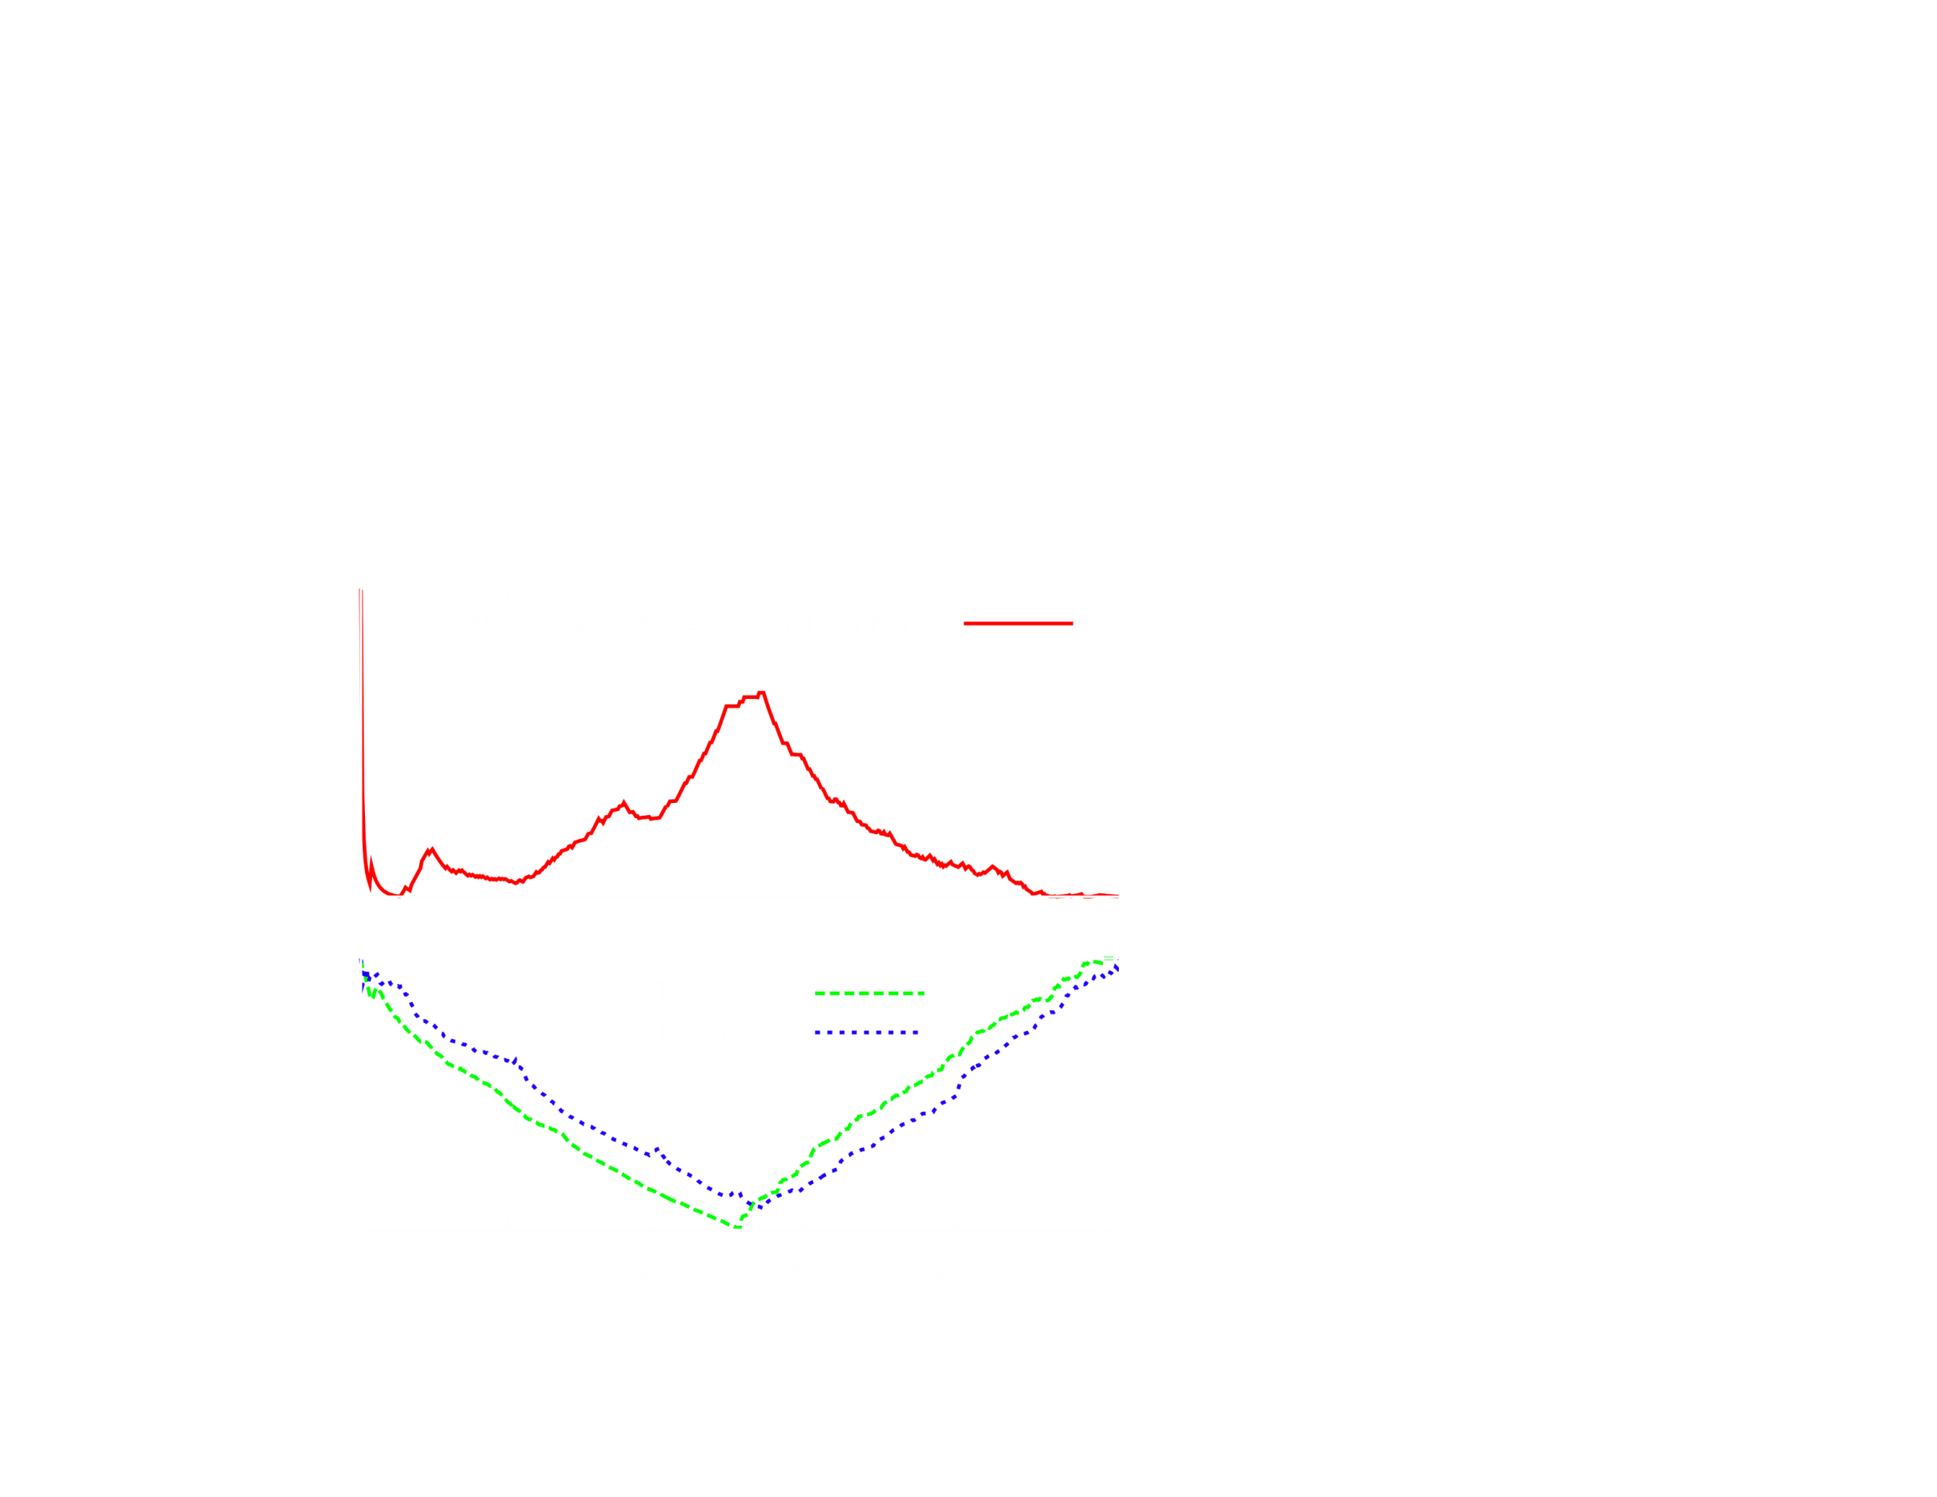
Investigating the cut-off point
Partition
similarity
(higher is better)
Community
Strength
(lower is better)
Cut-off
Peak in similarly corresponds to boundary of local community
Details, more results in paper

Slide 13
Common insight across schemes
All schemes are effectively detecting communities
  Nodes in the local community are ranked higher
  Ranking within and outside community in no particular order

Slide 14
Implications

Slide 15
Leveraging community detection
Community detection is a well-studied topic
  Wealth of algorithms available
Can leverage existing work on community detection
  To design new approaches to detect Sybils
Also, better understand the limitations

Slide 16
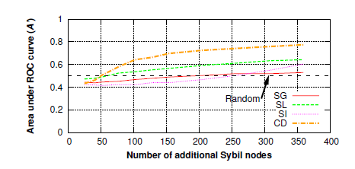
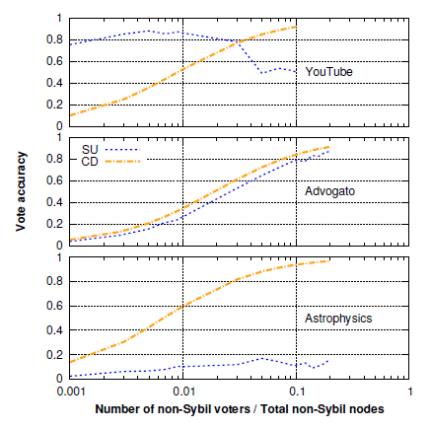
Results
Accuracy comparison in Facebook network
Accuracy comparison in three other network

Slide 17
What are the limitations?
Recall, schemes effectively finding local communities
Suggests dependence on graph structural properties
  Size, location, characteristics of local community
Explore two implications:
IMPLICATION 1 Are certain network structures more vulnerable?
IMPLICATION 2 What happens if the attacker knows this?
  Are more intelligent attacks possible?

Slide 18
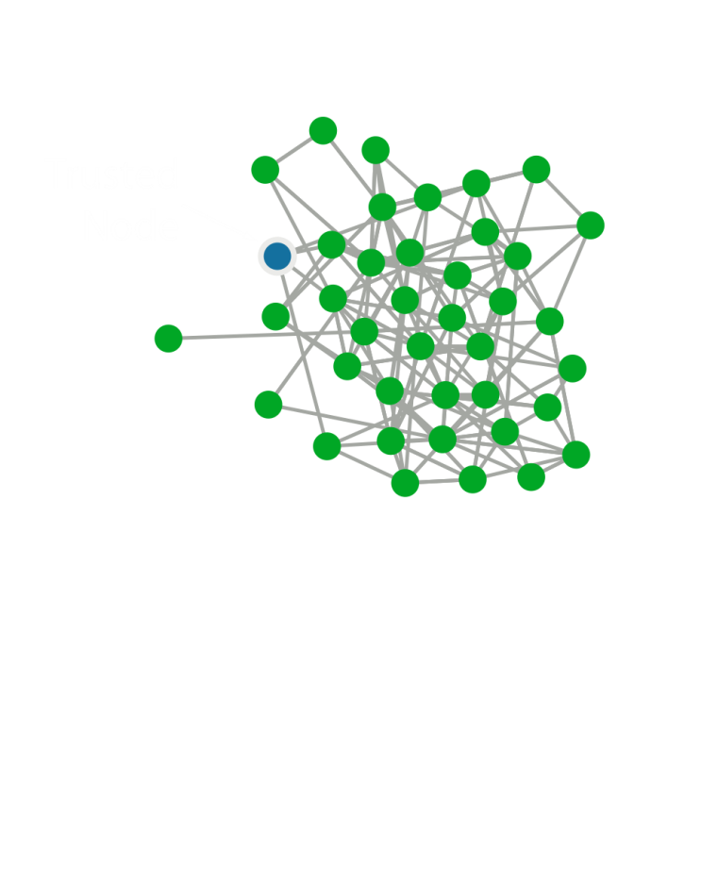
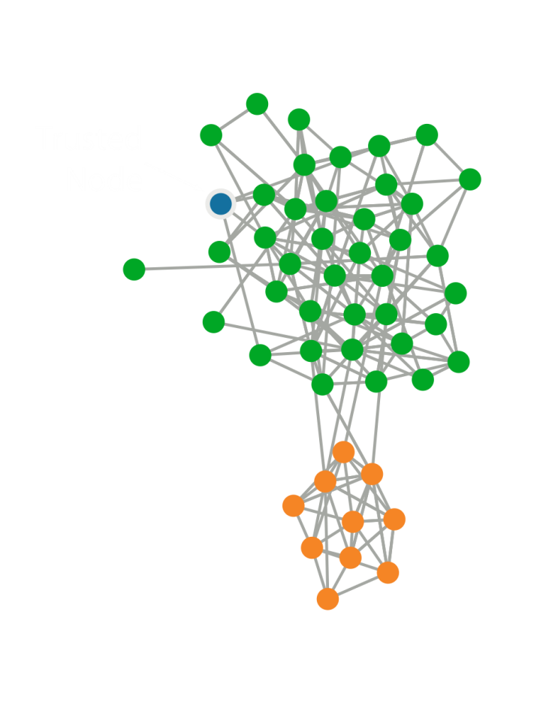
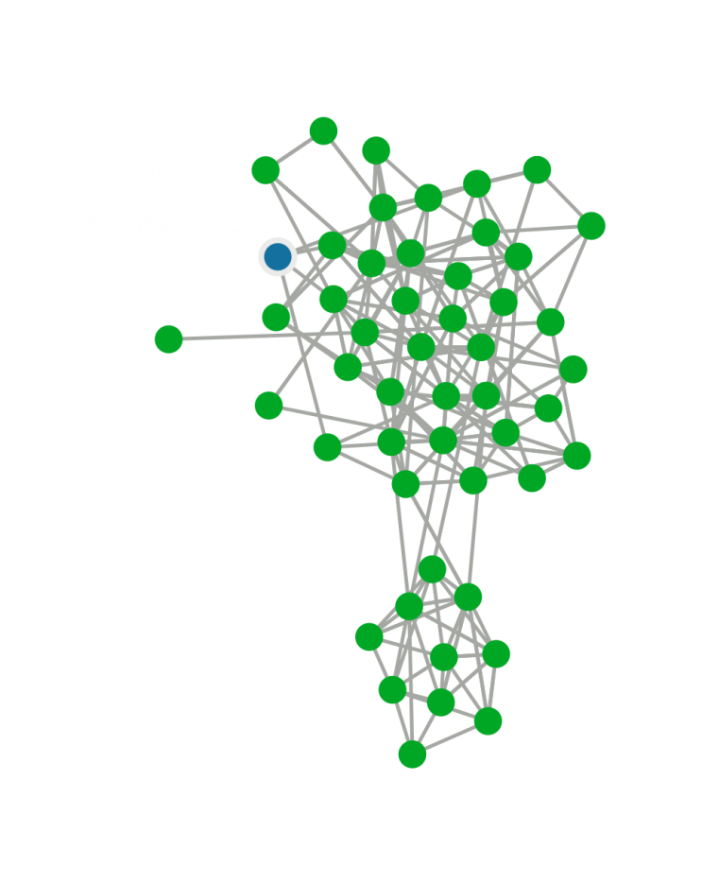
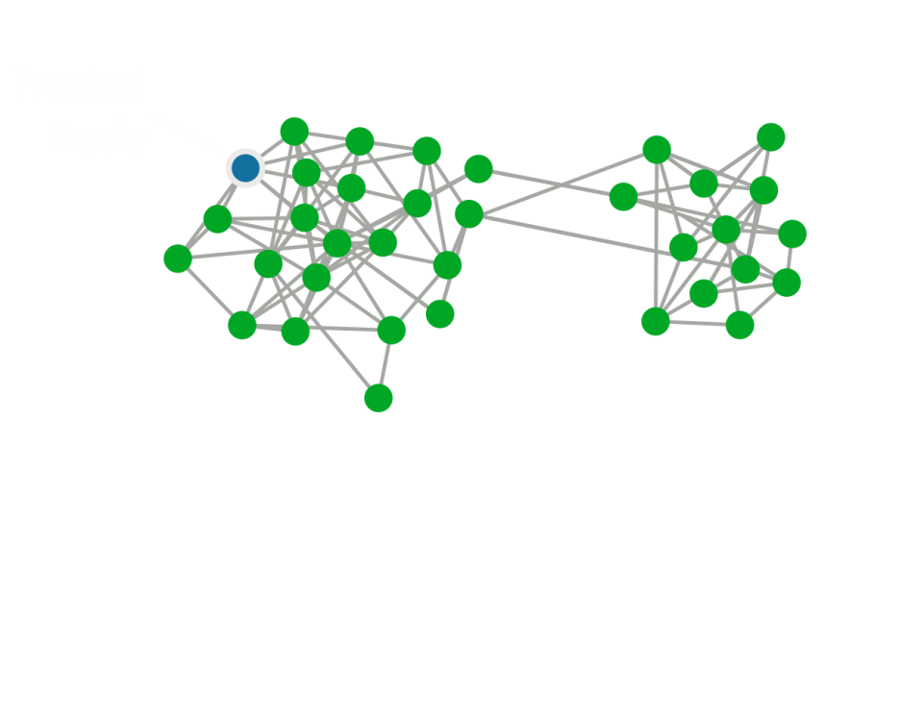
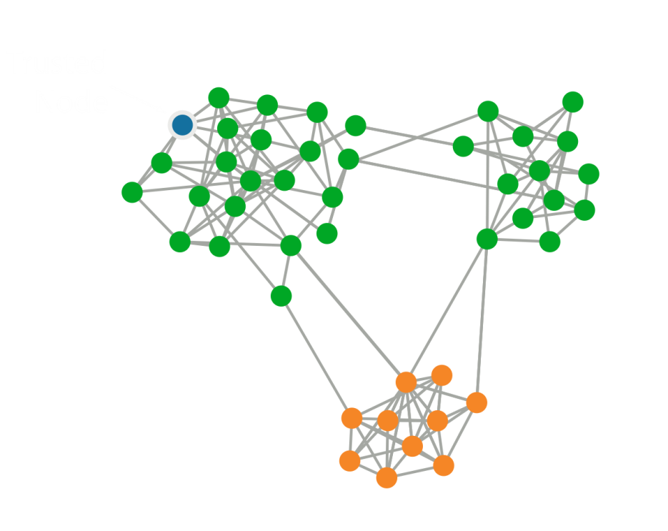
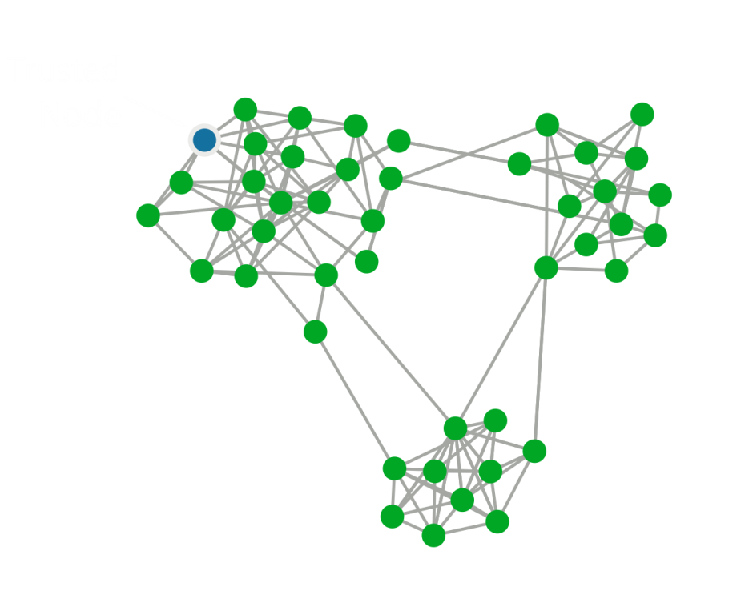
Certain network structures vulnerable?
Increasing community structure of honest region
  Hypothesis: Community structure makes identifying Sybils harder

Slide 19
Testing community structure hypothesis
Selected eight real-world networks
  Online social networks: Facebook (2)
  Collaboration networks: Advogato, Wikipedia, co-authorship
  Communication networks: Email
Simulated attack by consistently adding Sybils
  Similar strength attacker, despite different network sizes
  5% attack links, 25% Sybil nodes
Measure accuracy using ranking
  Accuracy: Probability Sybils ranked lower than non-Sybils
  Fair comparison across schemes, networks

Slide 20
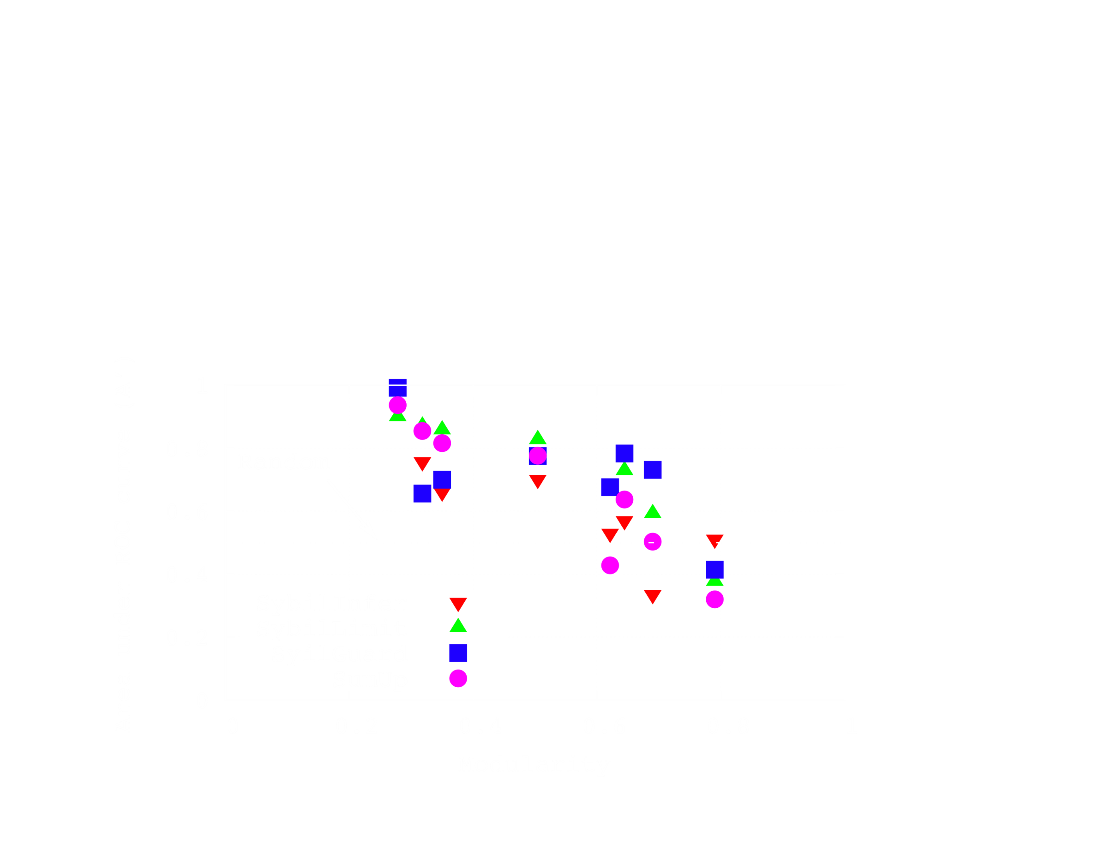
Impact of community structure?
Accuracy
(higher is better)
Amount of community structure (modularity)
(higher is more community structure)
  More community structure makes Sybils indistinguishable

Slide 21
Can attacker exploit this dependence?
Attacker’s goal is to be higher up in the rankings
Increases likelihood of being “accepted”
Existing Sybil schemes tested with “random” attackers
  Links placed to random non-Sybils
What happens if attacker given slightly more power?

Slide 22
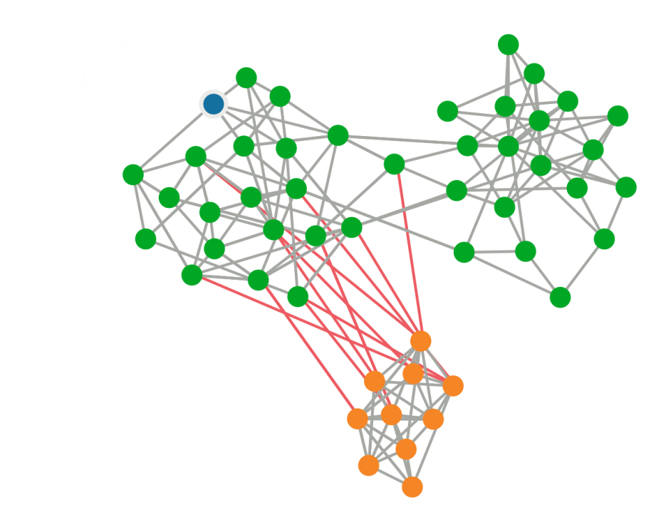
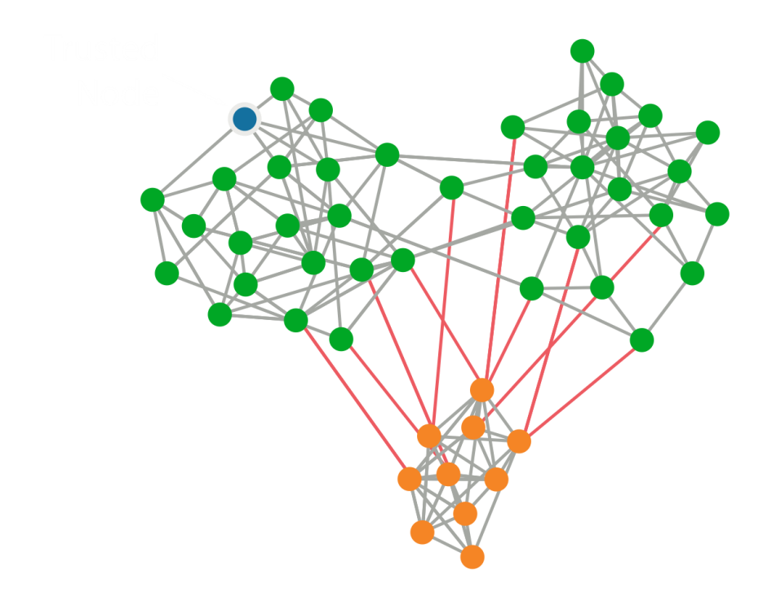
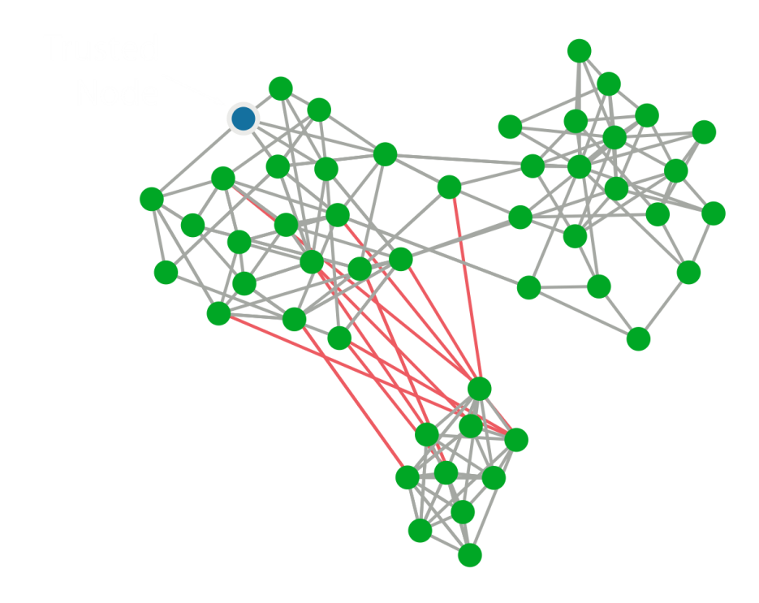
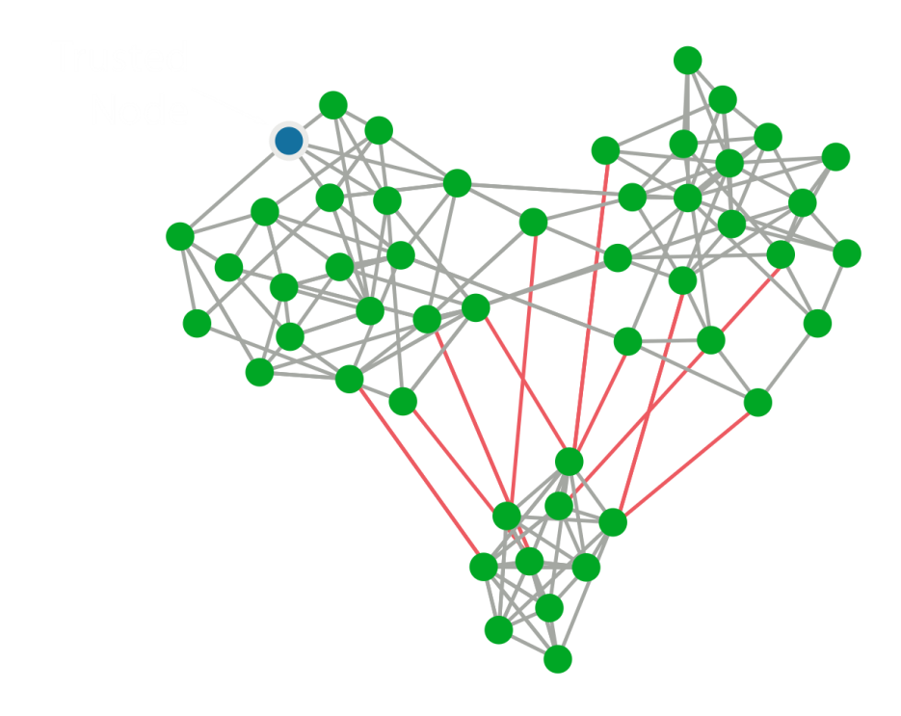
Changing attacker strength
Links placed closer to trusted node
Hypothesis: Closer links makes Sybils harder to detect

Slide 23
Testing strong attacker hypothesis
Simulated attack by consistently adding Sybils
Same strength as before
Allow attacker more flexibility in link placement
  Place links randomly among top N nodes; vary N
  Lower N represents more control
Present results on the Facebook network
Tested other networks as well
What happens as Sybils given more control?

Slide 24
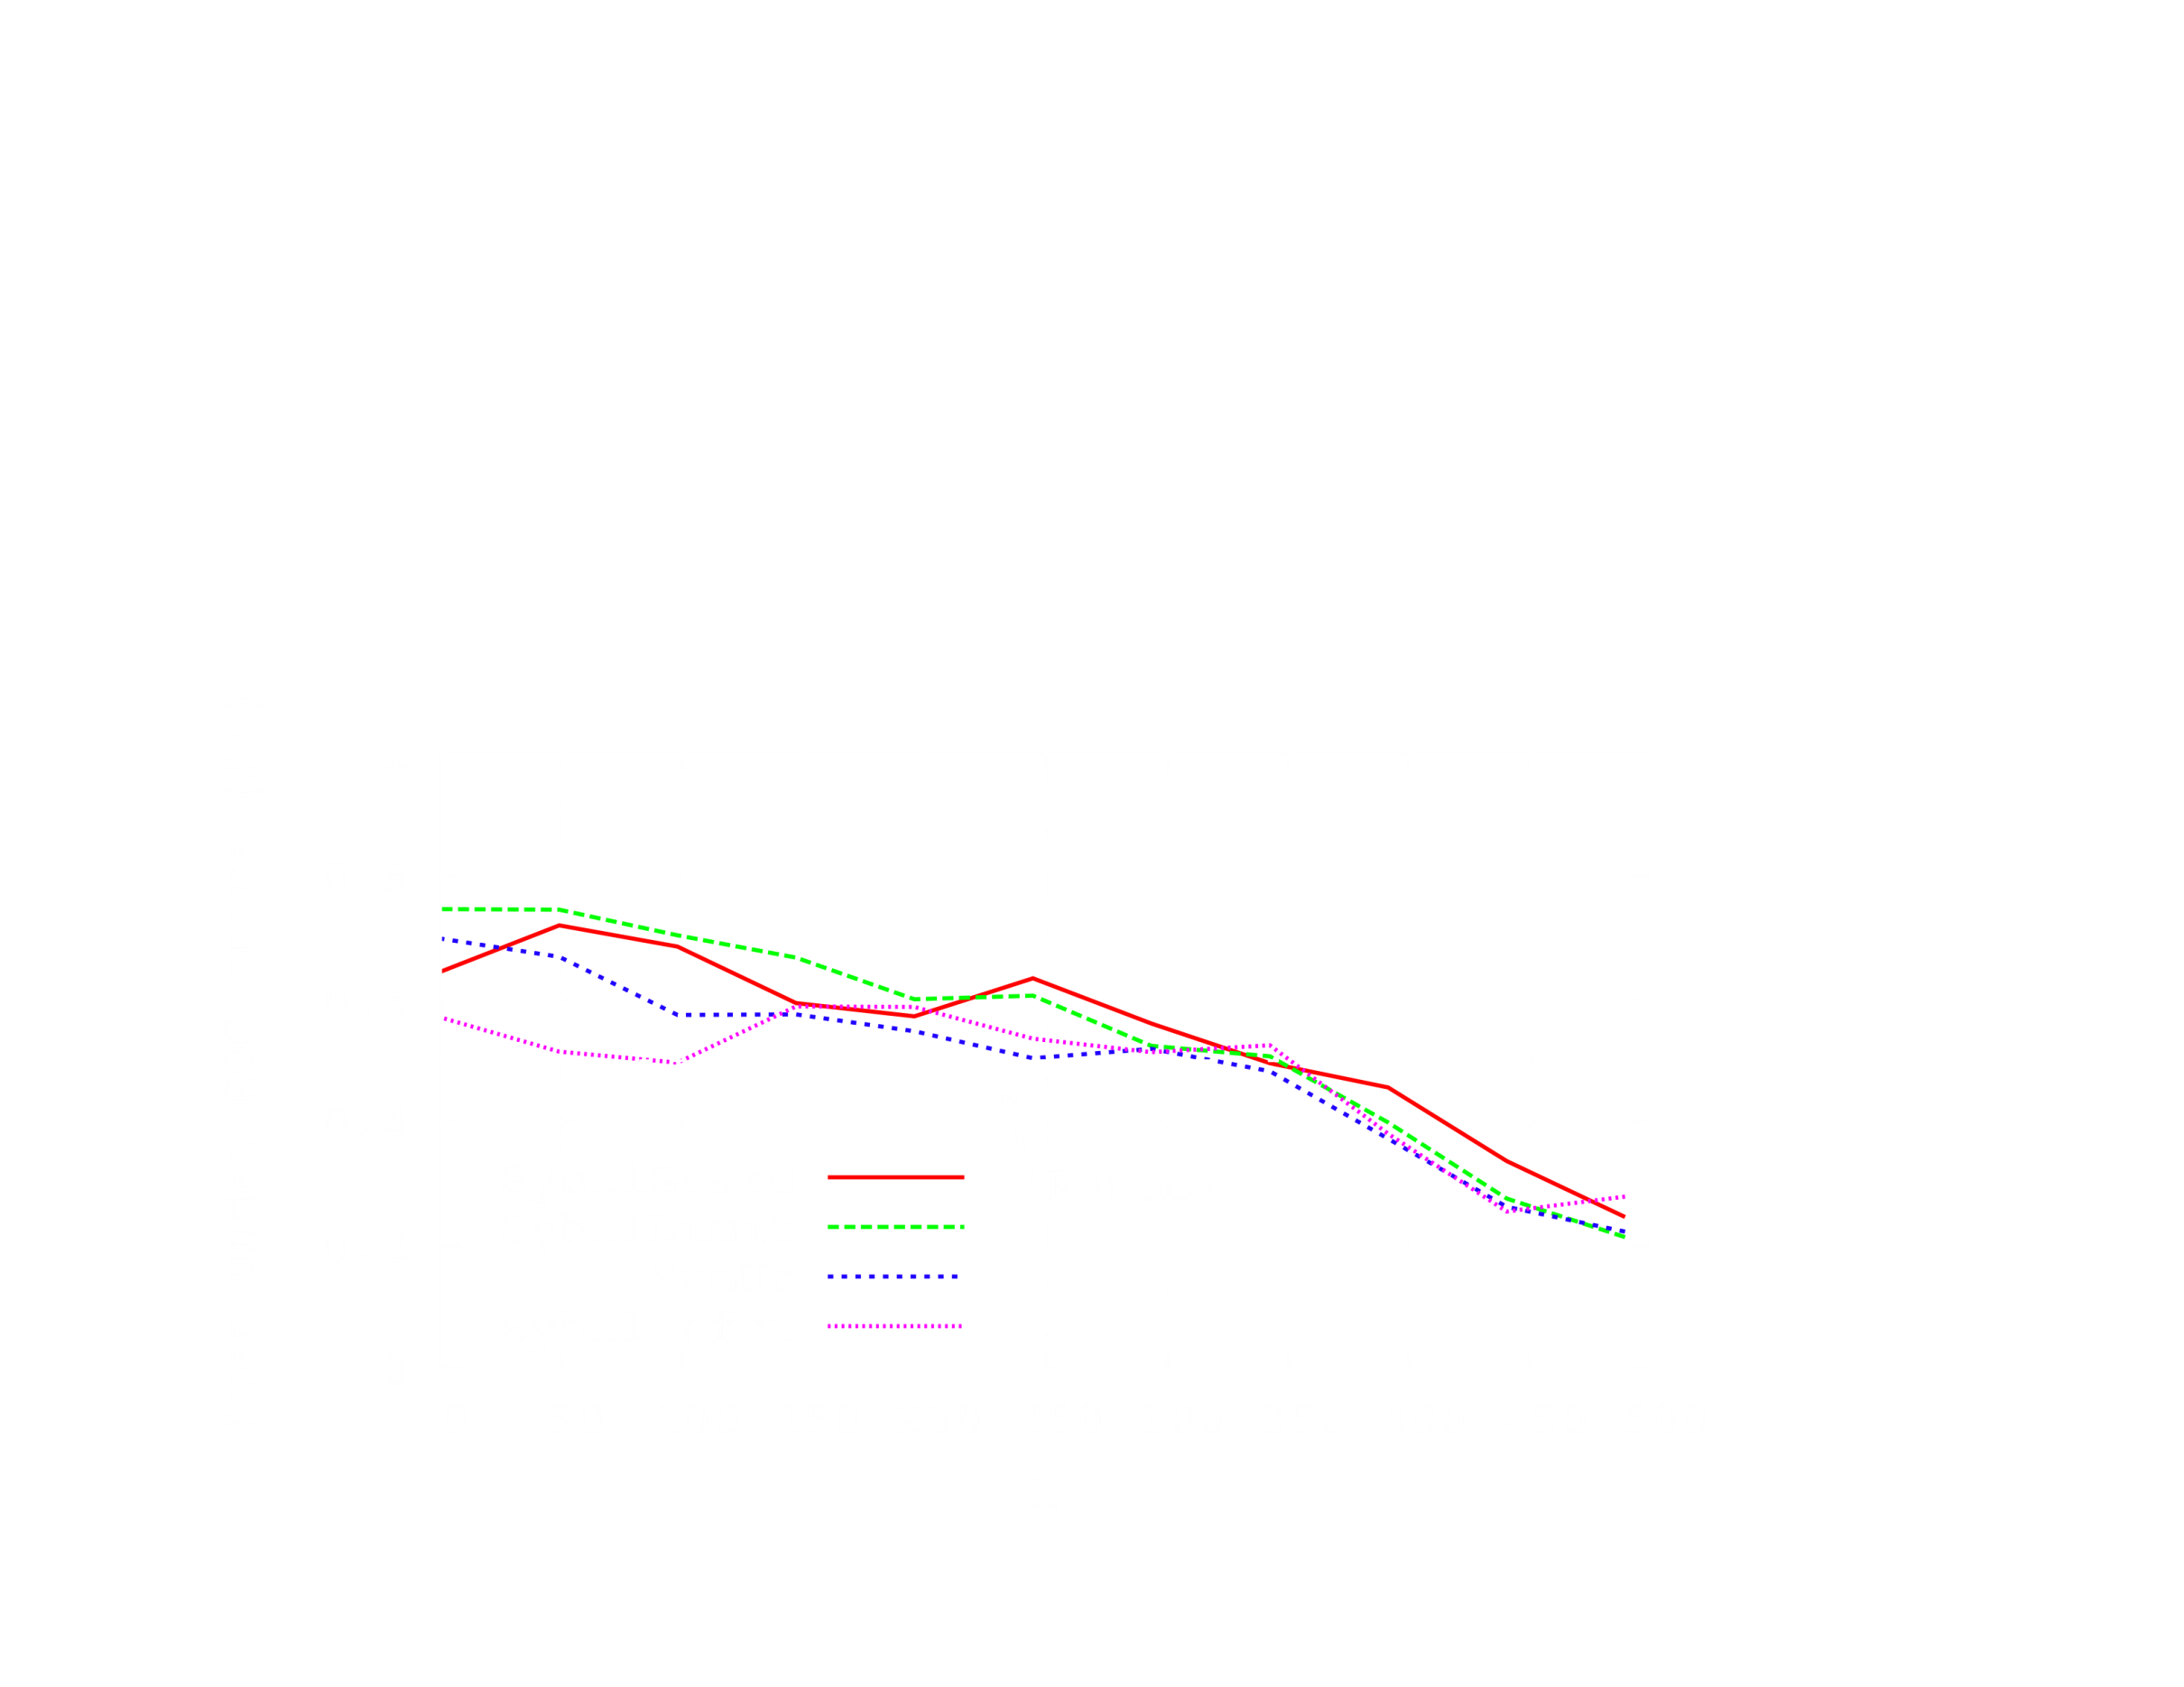
Impact of targeted links?
Attack becomes much more effective
  Sybils ranked higher than non-Sybils (accuracy << 0.5)
Accuracy
(higher is better)
Control over link placement
(higher is more control over placement)

Slide 25
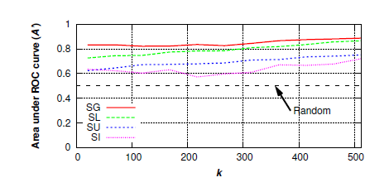
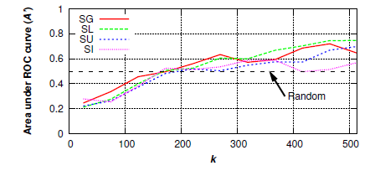
More Results
Accuracy in synthetic network
Accuracy in Facebook graduate student network
Falls no better than random

Slide 26
Summary
Many social network-based Sybil defense schemes proposed
  All use very different mechanisms
  Hard to understand relationship, fundamental insight
Are they doing the same thing?
Developed methodology to compare schemes
  Found they are all detecting local communities
Significant implications of this finding
  Can leverage community detection for Sybil defense
  Certain networks more difficult to defend
  Attacker can exploit this to spend effort more wisely

Slide 27
Moving forward
Is social network-based Sybil defense always practical?
  Certain real networks have significant communities
  Could be still useful for white-listing small number of nodes
Is more information beyond graph structure helpful?
  More information about Sybil/non-Sybil nodes is useful
  Other information from higher layers eg. interaction

Slide 28
Contribution
Compare different Sybil attack schemes
Find common property “Local Community”
  Broaden this research directions by introducing “Community detection”
Spot the weakness: structure does matter

Slide 29
Weakness of This Paper
Only spot the weakness:
  Did not propose any concrete solution to solve it.
Rethink about the current solutions.
  Since graph-based ranking not enough, is there any other solutions?
Only detecting Sybil is enough?
  Defend the sybil seems to be more intriguing.

Slide 30
Improvement
Sybil tolerance?
  Prevent sybils from gaining extra privilege
More information than just a trusted node and graph-based solutions
  Such as judging the activities among the users

Slide 31
Questions?
Thank You!

