Slide 1
Taintdroid:
An Information-flow Tracking System For Realtime Privacy
Monitoring On Smartphones
Authors:
William Enck The Pennsylvania State University
Peter Gilbert Duke University Byung-Gon Chun Intel Labs
Landon P. Cox Duke University Jaeyeon Jung Intel Labs
Patrick McDaniel The Pennsylvania State University
Anmol N. Sheth Intel Labs
Present By
Christopher Hodges

Slide 2
Acknowledgement
http://en.wikipedia.org/wiki/Java_Native_Interface
http://developer.android.com/sdk/ndk/overview.html

Slide 3
Introduction
Smartphones constantly download millions of applications.
How can we trust these Apps?
Solution:
  Taintdroid
    Labels (taint) and tracks data real time.
    Identifies
      App responsible for access and transmission.
      Destination of data.
Notes:
So… what is taintdroid. I’m going to give someone a chance to earn some easy participation points. How many people in here own a smartphone, more particularly and Android. You sir, I’m betting that it’s a safe be to assume that you download apps on you smartphone. “Yes”
When you download an app how do you know that it’s no abusing it’s privileges. For example if you download a weather tracking app, and ask you for permission to access your location information, how do you know that its not sending out gps coordinates to an advertiser or some terrorist organization. We have no insight to what these application are doing with our data, and thus its difficult to detect a misbehaving application. The Solution…
Taintdroid Labels and tracks the data real time, and also Identifies the apps responsible for transmission and where the data is being sent. For example if my weather application is sending my GPS location to Joe’s rib shack on wheels, taintdroid will allow me to see this. Thus identifying the misbehaving application.

Slide 4
Performance
Google Nexus one version 2.1
  Relative small performance overhead.
  14% overhead on CPU-bound Bend Mark.

Slide 5
Presentation Outline
Android Background Information.
High Level Overview of Taintdroid.
Taintdroid Design.
Results from an Android Application Study.
Notes:
The format of this presentation concludes: Read the slides.

Slide 6
Android Background Information
Linux Based.
Open Source.
Mobile Phone Platform.
Functionality Implemented Applications.
App run on top of middleware.
Middleware written in Java and C/C++.

Slide 7
Android Background Information
Applications written in Java.
  Java Native Interface (JNI)
  Compiled into Dalvik Executable(DEX) byte-code format.
  Executes within Dalvik VM interpreter instance.
    Register-based as opposed to stack-based.
    Runs isolated on the platform.
      Has unique UNIX user identities.
  Communicate via binder IPC mechanism.

Slide 8
High Level Overview of Taintdroid
Takes advantage of well defined interfaces to place labels.
  Ex: All Information from GPS hardware is location sensitive data.
Four Levels of taint tracking for common smart phone architecture.
  Message Level Tracking.
  Variable Level Tracking.
  Method Level Tracking.
  File Level Tracking.

Slide 9
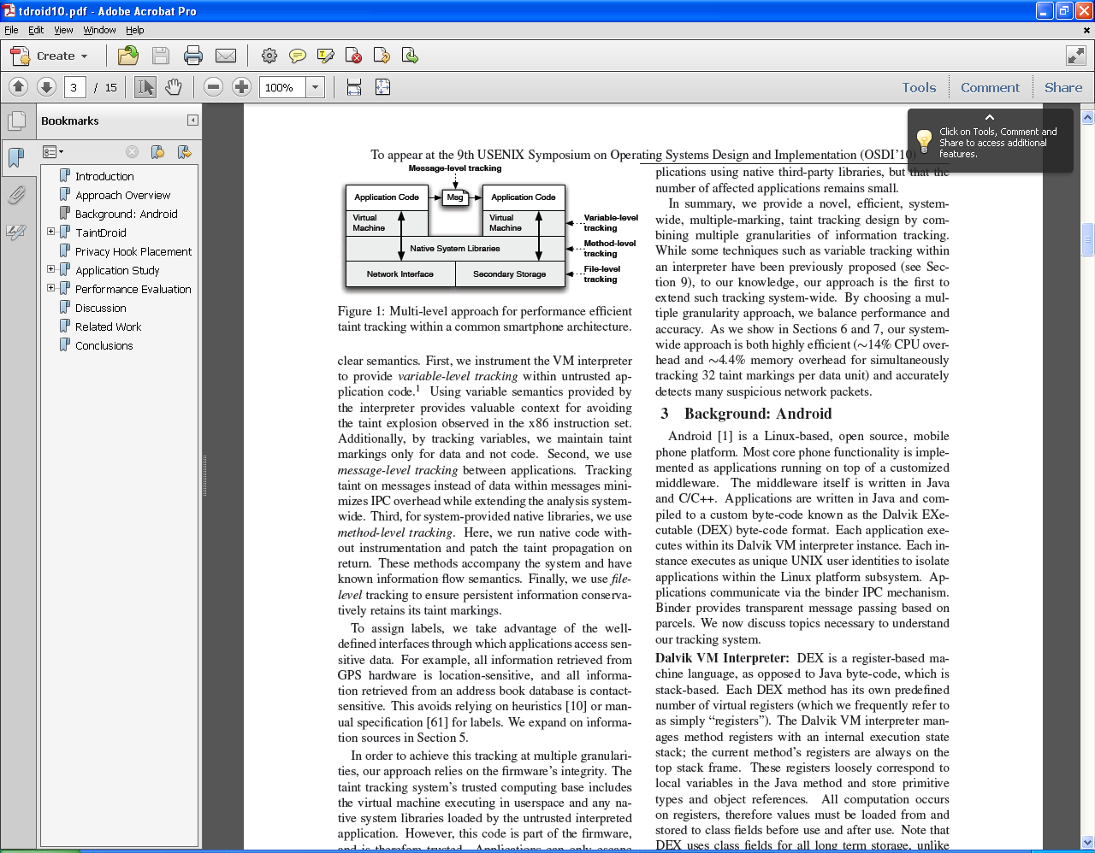
High Level Overview of Taintdroid
Firmware is trusted.
Library loader modified to prevent third party Library usage.

Slide 10
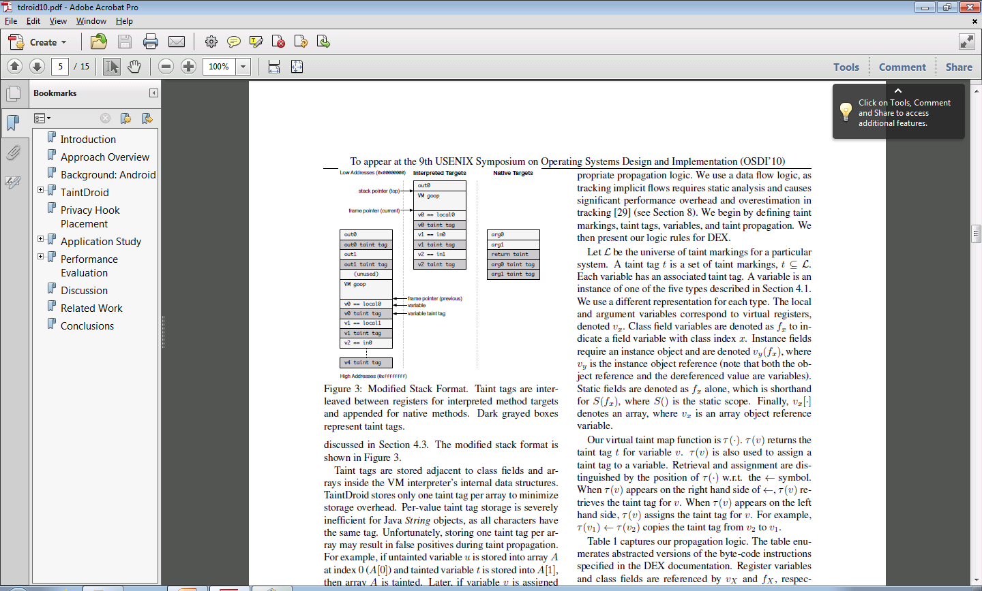
Taintdroid Design
When App is invoked a new stack frame is allocated.
Registers (variables) are placed on the stack.
Stack frame are twice as big for taint tags.

Slide 11
Taintdroid Design
Message Level Tracking
  Binder IPC mechanism (Centralized location).
  Entire message is labeled instead of variables.
    Trade off between performance and accuracy.
Variable Level Tracking
  Registered VM makes this possible.
  Primary Tracking Method
    Propagation Rules are key.
Method Level Tracking
  Labels are made here.
File Level Tracking.
  Taint label stored in the extended file attribute.
  Entire file is labeled.
    Trade off between Performance and accuracy.
  Taint label propagated to variables on access.

Slide 12
Taintdroid Design
Identifying Privacy Data.
Each source must be studied carefully.
  False Positives if wrong source is tainted.
  False Negative if a source is missed.
Low-bandwidth Sensors
  Variety of privacy data obtain from these sensors.
    Ex: Location, and Accelerometer.
  Changes frequently, and used by many applications.
  Most smartphone OS have some type of manager to multiplex this information.
  Android privacy hook (labels) in LocationManager and SensorManager Applications.

Slide 13
Taintdroid Design
High-bandwidth Sensors
  Include privacy information such Microphones and Cameras.
  Returns a large amount of data and is only used by one application at time.
    Sensor information is propagated through large data buffers and/or files.
    Hooks placed in these data buffers and files.

Slide 14
Taintdroid Design
Information Databases
  Contact and SMS (Text) Messages are often stored in file based databases.
  Taint Tags place on these files.
Device Identifiers
  Information that Identifies the phone or user.
    Ex SIM card identifiers.
  Some are access through well defined APIs.
  APIs are hooked.

Slide 15
Taintdroid Design
Network Taint Sink
  When data is transmitted out of the network interface.
  Taint is place in VM Interpreter.
  Label read when the socket library is invoked.
Summary
  Privacy data is labeled (tainted).
  Propagates up and down the architecture.
  These labels are read and thus…

Slide 16

Taintdroid Design
    Apps are caught Red handed!

Slide 17
Application Study
Experimental Setup
  2010 Survey of 1100 of most popular Apps.
    Revealed 1/3 (358) require permissions to access the internet and sensitive data.
  30 applications where studied with taint droid from this set.
    Installed and noted any user consents.

Slide 18
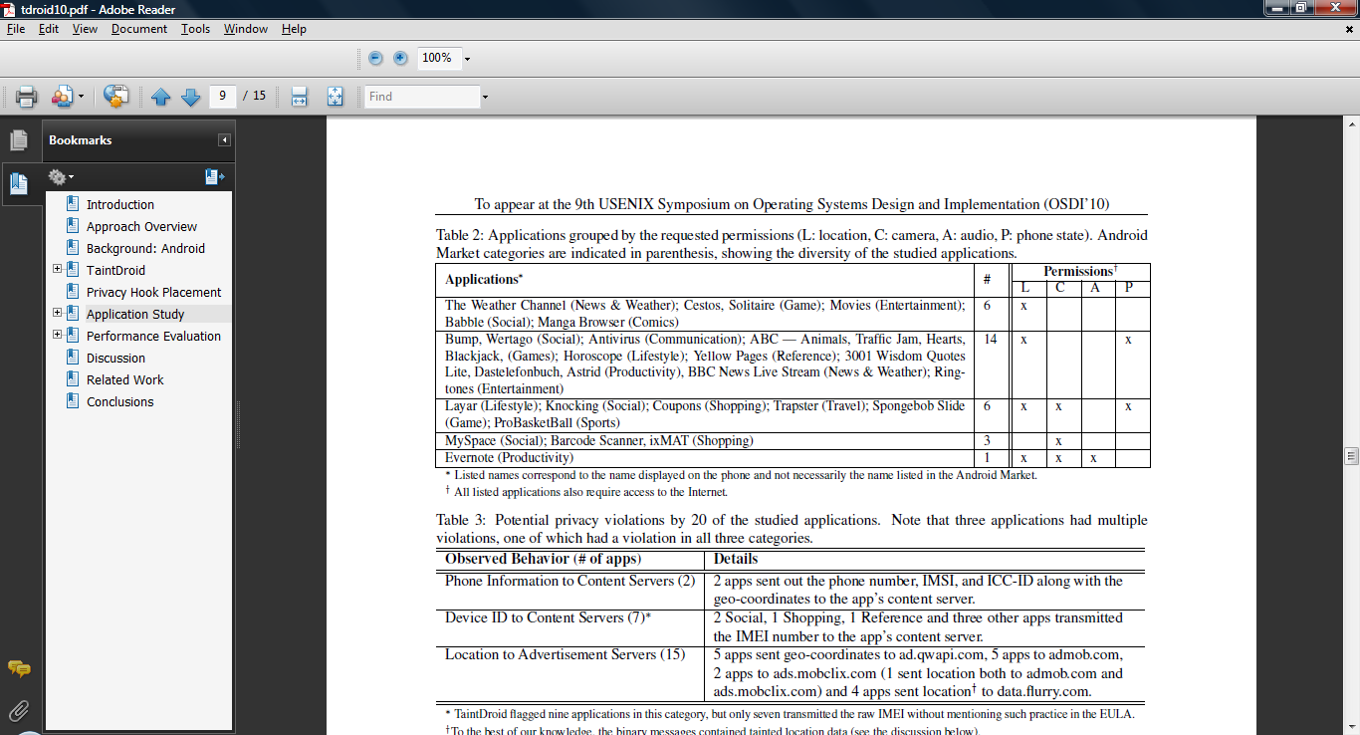
Application Study
20 out of 30 of the applications suggest privilege abuse.
Many with multiple violations.

Slide 19
Application Study
Half of the studied applications share location information with advertisers.
One third expose device ID.
  Sometimes with phone and SIM card serial numbers.
Scary!!!

Slide 20
Contribution
We have control over applications accessing our data, but no insight.
Taintdroid
  Tool that allows us to monitor our data real time on mobile devices with low overhead.
Also found that 2/3rds of the 30 randomly selected applications abuse their permissions.

Slide 21
Weakness
Needs a bigger sample size for statistics.
Taint tags are added manually.
Taint tags memory location is predictable.

Slide 22
Improvement
Use the tool to test a larger sample size.
Develop component to automate the tagging process.
Randomized the taint tag memory location, or prevent it from being modified.

