Slide 1
Protecting Browsers from Extension Vulnerabilities
Adam Barth
Adrienne Porter Felt
Prateek Saxena
University of California, Berkeley
Aaron Boodman
Google, Inc.
Presented by
Charles Tymms

Slide 2
Abstract
One in three Firefox users run extensions
Security not focus on extension development
Buggy code can be exploited
Most extensions studied need less than full privileges and use unnecessarily powerful API
New system proposed using least privilege, separation, and isolation

Slide 3
Introduction
Extensions modify core browser experience
  Skype browser
Little attention paid to extension architecture
Firefox extensions run with full privileges
  Malware example: Liverani & Freeman
  Image → control user mouse & keyboard

Slide 4
Privilege Gap
22 of 25 extensions studied don’t require full system access
  Many extensions to store settings have full read/write access
Firefox platform does not provide fine-grained privileges

Slide 5
Proposal
New system to protect from benign-but-buggy extensions
Extensions limited to privileges chosen at installation
Unable to increase privileges if compromised
Unable to execute arbitrary code

Slide 6
Proposed Extension Components
Content Script
  Direct access to Document Object Model (DOM) of single web page
  No privileges other than contact with Core
Extension Core
  Bulk of extension privileges
  Only interacts with content via content scripts
  No direct access to host machine
Native Binary (optional)
  Host access with full privileges
  Contact with core via NPAPI interface

Slide 7
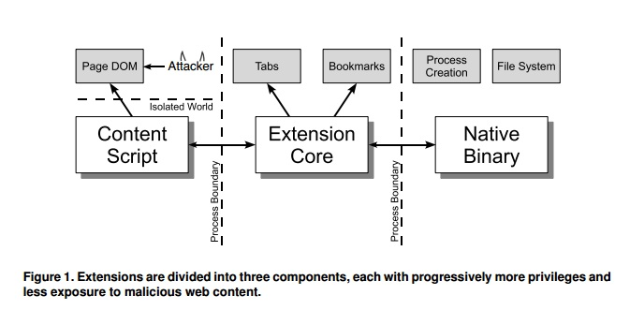
Extension Design

Slide 8
Protection
Attacker would require malicious input forwarded twice to Native Binary
Strong protection boundaries
  Each component run in separate OS process
  Script & core run in sandboxed processes, little access to OS services
Script isolated from web page
  Separate JavaScript heap
  Script & web page never exchange Java pointers

Slide 9
Threat Model
Focus on benign-but-buggy extensions
Assume browser itself is vulnerability-free
Focus on extensions rather than plug-ins
  Plug-ins render specific media
  Requested explicitly by websites

Slide 10
Firefox Extensions
Run with full browser privileges
Full access to browser internals & OS
  Modify website behavior
  Run arbitrary code
  Access file system
Combines high privilege with interaction with untrusted content

Slide 11
Four Attack Classes
Cross-Site Scripting
  Potential injection of script into extension
  Ex: eval, document.write
Replacing Native API
  Attacker replaces DOM API methods
  Buggy XPCNativeWrapper protection
JavaScript Capability Leak
  Leaked Java objects allows greater access to powerful API
  Ex: Greasemonkey exposed XMLHttpRequest
Mixed Content
  Replace HTTP script to hijack extension privileges
Notes:
RSS extension evaluated from <description> element

Slide 12
Case Study
25 extensions reviewed manually
Two extensions chosen from each of 13 categories in “recommended” section of Firefox
  Also highly ranked in “popular” directory
Compare extension privilege requirements with actual extension privileges
Notes:
One excluded as distributed only binary

Slide 13
Extension Ratings
Critical
  Arbitrary file access (can run arbitrary code)
High
  Access to site-specific information (cookies/password) or all DOMs
Medium
  Access to private user data (history) or specific DOMs
Low
  Minor annoyances
None

Slide 14
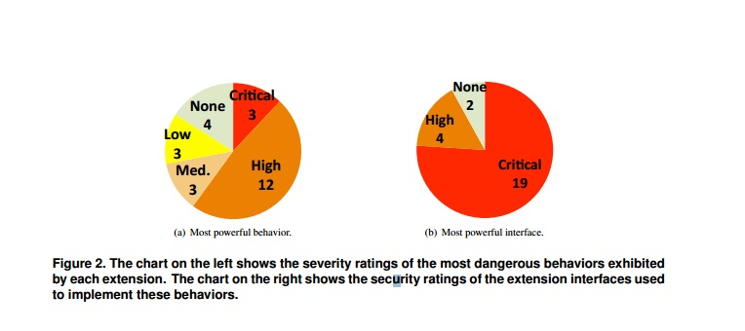
Results

Slide 15
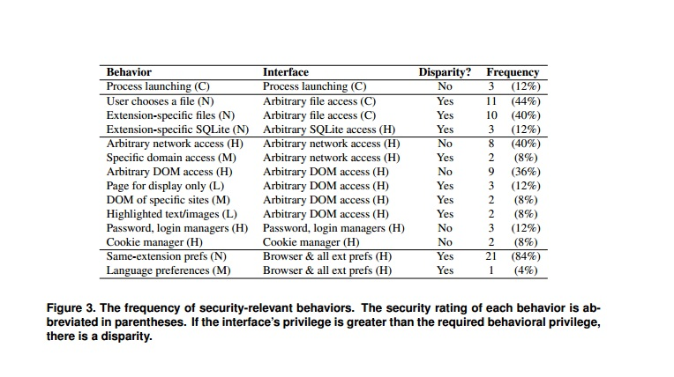
Results

Slide 16
Summary of Results
Only 3 extensions require critical privileges
  All download managers requiring process creation
19 use critical interface
No extensions required arbitrary file access
Total of 19 extensions have broader privileges than required

Slide 17
Firefox Issues
All extensions run with full privileges
Firefox extension API bundles most privileges into single interface
  Extension-local preferences saved via service that can change browser-wide and other extensions’ preferences
File system interface could be (but is not) limited
  Via file open dialog
  Extension-specific directory

Slide 18
Firefox Security Lattice
Extensions and browser components use the same XPCOM interfaces, usually implemented by browser
Extensions replace these implementations
  SafeCache replaces HTTP cache
613 interfaces labeled to compute when a reference to one interface may lead to a reference to another interface via deductive inference

Slide 19
Deductive System
Computes which interfaces an extension can obtain from one interface
Conservative estimate
  Does not consider actual interface implementation
  Based on input parameters
  Example: type foo’s method accepts type bar as parameter, while bar has method that returns a file type

Slide 20
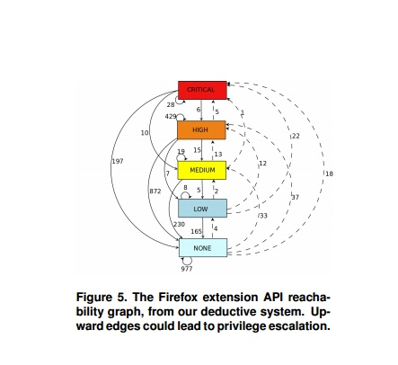

Slide 21
Google Chrome Extensions
Extension privileges requested through a manifest
Example: Gmail Checker extension
  Requires access to google.com subdomains and tab API
  Website access limited to designated websites
  API access limited to groups described in manifest

Slide 22
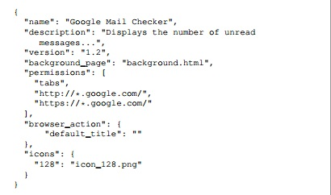

Slide 23
Incentives
Developers likely to request maximum privileges
Extensions able to execute arbitrary code not permitted unless dev signs contract with Google
Prioritized reviews of extensions with lower privileges
No protection for users who are tricked into installing malicious extensions

Slide 24
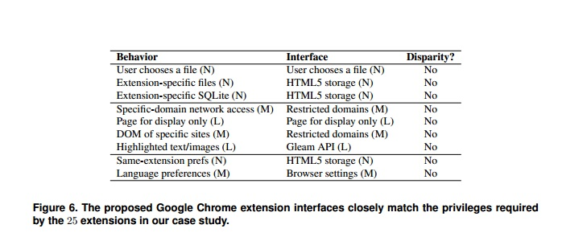

Slide 25
Privilege Separation
Separated into content script, extension core, and native binary
Content scripts interact with untrusted content
  Only has access to a single DOM API & messaging to core
Core, written in HTML & JavaScript, controls user interface
  Contains majority of privileges, but can only interact with web content through content script or XMLHttpRequest; both require explicit action
Binary can run code or access files
  Can only interact with core (not content script)
  Limited to interfaces defined when compiled

Slide 26
Isolation Mechanisms
Three mechanisms used to isolate extension components
Core run in unique origin designated by public key
Core and binaries run in separate processes
Content scripts run in separate JavaScript heap from untrusted content

Slide 27
Origin
Script authority derived from origin
  Scheme, host, URL
Extensions are loaded from user’s file system
  Origin assigned by public key in extension’s URL
Browser verifies extension is “self-signed” by the public key
Makes updating easy provided privileges remain the same

Slide 28
Process Isolation
Each component run in different process
  Core & binaries receive dedicated processes
Defends against low-level exploits
Protects extension core from browser implementation errors
  JavaScript leaks cannot leak from one process to another

Slide 29
Isolated Worlds
Additional protection by running content scripts in an isolated world
Each content script accesses the DOM through its own JavaScript objects rather than those used by web page
Scripts and pages never exchange pointers
  More difficult for malicious page to confuse content script
Implemented using series of hash tables

Slide 30
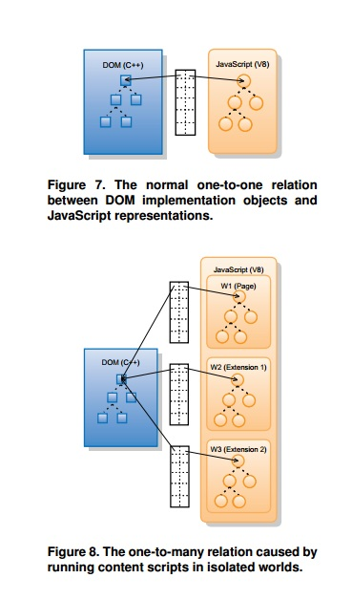

Slide 31
Performance
Separating extension components creates overhead
Run-time overhead evaluated on Google Chrome 4.0.249.22 run on Mac OS X
Content script to extension core adds average round-trip latency of .8ms
  Only incurred if extension requires communication between components
Isolated worlds overhead adds 33.3% to DOM access time
  No change to layout or render time

Slide 32
Additional Work
Firefox Jetpack
  Similar to proposed system’s interfaces, however provides full privileges and extension API
Internet Explorer Browser Helper Object (BHO)
  BHO modules have direct access to win32 API, and have full access to web pages and file system read access

Slide 33
Weaknesses/Improvements
Increase number of extensions studied
Study extensions on Internet Explorer and Safari
Examine browser-based protection for malicious extensions

Slide 34
Conclusion
Browser extensions are not designed with security in mind
Firefox extensions run with full privileges
25 “recommended” extensions studied
  Most do not require full privileges
Reducing privileges is difficult due to Firefox API
Proposed extension platform separating extension into three components
  Content script, extension core, native binary
  Interact via specific interfaces

Slide 35
Paper Acknowledgments
Nick Baum, Erik Kay, Collin Jackson, Matt Perry, Dawn Song, David Wagner, Google Chrome Team
Work partially supported by the Air Force Office of Scientific Research under MURI Grant No. 22178970-4170

Slide 36
Extensions Surveyed
Adblock Plus 1.0.2, Answers 2.2.48, Autopager 0.5.0.1, Auto Shutdown (InBasic 2.1.1B, Babel Fish 1.84, Cool-Previews 2.7.4, Delicious Bookmarks 4.3, docked JS-Console 0.1.1, DownloadHelper 4.3, Download Statusbar 2.1.018, File and Folder Shortcuts 1.3, Firefox Showcase 0.3.2009040901, Fission 1.3, Glue 4.2.18, GoogleEnhancer 1.70, Image Tweak 0.18.1, Lazarus: Form Recovery 1.0.5, Mouseless Browsing 0.5.2.1, Multiple Tab Handler 0.9.5, Quick Locale Switcher 1.6.9, Shareaholic 1.7, Status-bar Scientific Calculator 4.5, TwitterFox 1.7.7.1, Weatherbug 2.0.0.4, and Zemanta 0.5.4

Slide 37
Questions?

