Slide 1
TaintScope: A Checksum-Aware Directed Fuzzing Tool for Automatic Software Vulnerability Detection Tielei Wang^{1,2}, Tao Wei^{1,2}, Guofei Gu³, Wei Zou^{1,2} ¹Key Laboratory of Network and Software Security Assurance (Peking University), Ministry of Education, Beijing 100871, China ²Institute of Computer Science and Technology, Peking University ³Department of Computer Science & Engineering, Texas A&M University Presented by Ricky Landry University of Central Florida April 11, 2012

Slide 2
What is fuzz testing?
Testing executable code (typically an application) for programming errors that cause crashes, corruption, or increased consumption of resources (CPU or memory)
Crashes can cause data loss and expose potential vulnerabilities that can allow for a process to be hijacked

Slide 3
What is fuzz testing?
Common Fuzzer Topology
Malformed
Input
Code under test
Observe behavior
Report samples that cause erroneous behavior
Fuzzer

Slide 4
What is fuzz testing?
Two main approaches to fuzz testing
Mutation-based
Easy to implement, as a well-formed sample can be used as the mutation base
Typically inefficient, but easy to generate sample
Generation-based
Difficult to implement, as sample formats or source code must be known for proper sample generation
Efficient, but costly to generate sample

Slide 5
Mutation-based fuzzing
The preferred method of fuzzing
Well-formed samples are typically easy to acquire
The simplest design only requires random mutation of data bytes within a well-formed sample
The problem
Mutation-based approaches are inefficient, as a majority of input samples are discarded prior to reaching vulnerable code
This problem exacerbated if data integrity checks are present (i.e. checksums)

Slide 6
Current Solutions
Whitebox Fuzzing Systems
Symbolic execution, which tracks values as symbolic values during execution
Constraint solvers, which determine path constraints for code coverage and generate inputs that drive program executions along desired paths
Protocol Reverse-engineering can extract input format specs and translate to fuzzing specifications
However, current solutions are ineffective at generating and solving the constraints or reverse-engineering the complete process of complex checksum algorithms!

Slide 7
Checksum Integrity Checks
Checksums are used to verify data integrity
Checksum values are a function of data bytes
Changes to data bytes require recalculation of checksum
Fuzzing requires mutation of data bytes, and re-computation of a checksum is non-trivial
When a process utilizes checksum, it is likely that data integrity will be verified early on. Mutation will be detected and discarded before reaching vulnerabilities

Slide 8
Enter TaintScope
A fully-automated, checksum-aware, directed fuzzing system based on dynamic taint analysis and symbolic execution
Three main contributions:
Identifies checksum fields in inputs and checksum-based integrity checks in target code
Directed fuzzing at the X86 binary level (Linux and Windows) using taint-based code tracing
Repairs malformed inputs discovered during directed fuzzing to allow for proper crash generation on original executable

Slide 9
TaintScope High-Level Design
Four stages of execution:
Dynamic taint tracing
Determine hot bytes
Flag potential integrity checkpoints
Detecting checksum
Directed fuzzing
Use hot bytes info to fuzz (mutate) intelligently
Bypass integrity checkpoints to allow mutations to propagate
Repairing samples (Compute checksums for crashed samples)

Slide 10
Dynamic Taint Tracing
Unlike traditional taint analysis (which uses 0/1 labels), TaintScope marks each input byte with a unique label (i.e. the byte’s position in an input sample)
Execution monitor observes and reports:
Input bytes which are arguments to specified API functions (i.e. malloc(), strcpy() )
Input bytes which are dependencies of conditional jump instructions
Input bytes to API functions are considered “hot bytes”
Input bytes to conditional jump instructions are used for checksum integrity checkpoint detection

Slide 11
Dynamic Taint Tracing
Execution monitor report example
Assume size of an input file is 1024 bytes
Analysts are interested in the size argument of a call to malloc()
Hot bytes report will contain an entry: 0x8048db5: invoking malloc: [0x8, 0xf]
Interpretation: Instruction at 0x8048db5 calls malloc() with an argument the depends on input bytes 0x8 – 0xf
Analysts are interested in the input byte dependencies of a JZ conditional jump instruction
Checksum information report will contain an entry: 0x8048d4f: JZ: 1024: [0x0, 0x3ff]
Interpretation: Conditional jump instruction JZ at 0x8048d4f depends on 1024 input bytes in the range of 0x0 – 0x3ff

Slide 12
Detecting Checksum
Checksum-based integrity checks behave like a classifier
All well-formed inputs will pass the integrity checks
Most malformed inputs will fail the integrity checks because the checksum does not match the data payload
Assume that special branch predicates exist in the program that correspond to these integrity checks
When well-formed inputs are used, these predicates always evaluate to True/False
When malformed inputs are used, these predicates always False/True

Slide 13
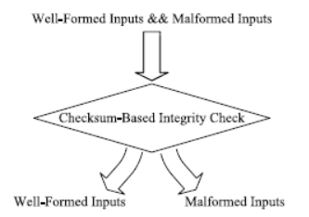
Detecting Checksum
TaintScope builds four predicate sets:
P₁ – Always true with well-formed inputs
P₀ – Always false with well-formed input
P’₁ – Always true with malformed inputs
P’₀ – Always false with malformed inputs

Slide 14
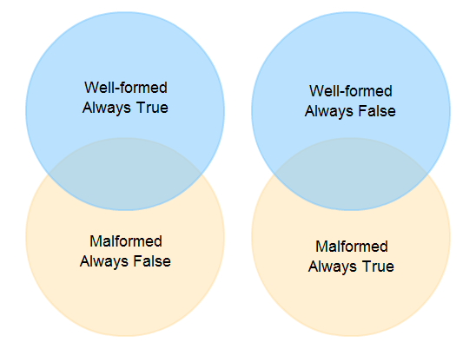
Detecting Checksum
Predicates in the following set usually correspond to checksum checks:

Slide 15
Detecting Checksum
Checksum detector will generate bypass rules to satisfy the “checksum-aware” logic of the directed fuzzing
As an example, a bypass rule may be reported as follows:
0x8048d5b: JZ: always-taken
Interpretation: The branch instruction JZ at 0x8048d5b needs to always be taken
Checksum detector can also identify checksum fields in an input sample by combining the following information:
Branch predicates determined as checksum integrity checkpoints
Hot bytes determined as branch dependencies for these checksum integrity checkpoints

Slide 16
Directed Fuzzing
Fuzzer is responsible for generating malformed test samples and passing them to the target program
If the checksum detector does not generate bypass rules (no checksum integrity checkpoints detected), the test samples are fed directly to the original program
If bypass rules exist, the test samples are fed to an instrumented instance of the original program
Fuzzing is “directed” because the fuzzer alters the execution traces at detected checksum integrity checkpoints based on the bypass rules (i.e. modification of the eflags register prior to branch execution to produce desired behavior)

Slide 17
Directed Fuzzing
Mutations to well-formed samples are based on the hot bytes information acquired during the dynamic taint tracing stage
Increased mutation efficiency; only bytes that are likely to expose vulnerabilities are mutated
Mutations target specified API calls that are security critical by supplying arguments that may cause errors (i.e. integer overflow, heap overflow, etc.)

Slide 18
Repairing Crashed Samples
Mutated test samples from the directed fuzzing stage are highly unlikely to cause an un-instrumented instance of the target program to crash
Test samples must be “repaired”, meaning the checksum field of the test sample needs to be recalculated
Checksums are not generated prior to directed fuzzing, as it is time/compute expensive
Only a small number of test samples will cause a crash, so checksum repairs are performed only when this occurs
This is accomplished through symbolic execution and constraint solving

Slide 19
Repairing Crashed Samples
TaintScope can utilize the checksum field detection to treat only the checksum field as the symbolic value
This contrasts with current symbolic execution methods which would require ALL of the bytes involved in the checksum computation to be handled symbolically
Data bytes that are dependencies to the checksum become concrete values, simplifying the constraint solving for the checksum field
This allows for many current constraint solvers to be adequate to solve this simple checksum constraint

Slide 20
Taint Tracing Evaluation
Well-formed image files were sent to three popular applications to evaluate the efficiency of the execution monitor in determining the “hot bytes”
Image file formats:
PNG
JPEG
TIFF
BMP
GIF
Applications:
ImageMagick
Google Picasa
Adobe Acrobat
Focus placed on malloc(), realloc()

Slide 21
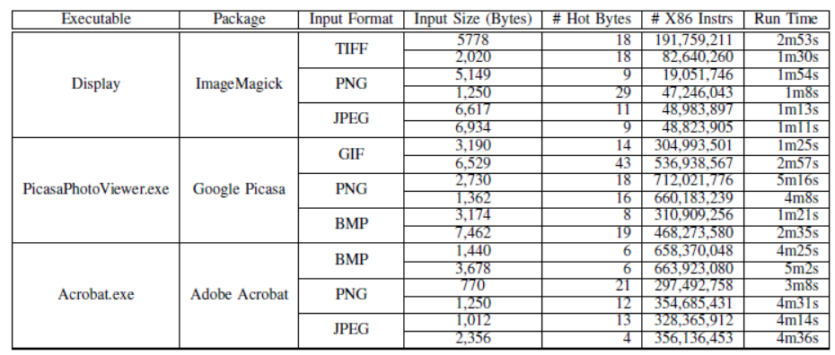
Taint Tracing Evaluation

Slide 22
Taint Tracing Evaluation
While input files are large, only a small number of bytes were determined to be “hot” for these image files and applications
Memory allocation for images typically only relies on a few fields in the format
Width
Height
Color Depth
Performance overhead was deemed acceptable

Slide 23
Checksum Checkpoint Identification
Six known file formats were chosen that are known to employ checksum algorithms
PNG
Divided into chunks that contain CRC checksums for each chunk
Stored in zlib format, which uses an Adler-32 checksum
PCAP – Contains IP and TCP/UDP packet headers that have checksum fields
CVD – ClamAV Virus Database, which uses MD5
VCDIFF – Generic Differencing and Compression Data Format; uses Adler-32 checksum
Tar – archive format that contains a checksum of its 512 byte header
Intel HEX – text format where each line contains a checksum of its data values

Slide 24
Checksum Checkpoint Identification
Eight applications were tested
Google Picasa (PNG)
Adobe Acrobat (PNG)
Tcpdump (PCAP)
Snort (PCAP)
ClamAV (CVD)
Open-vcfdiff (VCDIFF)
Tar (Tar)
objcopy (Intel HEX)
Checksum detector monitored these applications as they opened the files of their respective formats

Slide 25
Checksum Checkpoint Identification
The minimum dependent bytes threshold of the for a potential checkpoint to be flagged was set to 16 bytes, which was empirically chosen by the experimenters
The checksum detector successfully detected the checksum integrity checkpoints
This phase can be completed typically in tens of minutes

Slide 26
Checksum Repair Evaluation
Checksum field identification was evaluated for the following file formats:
PNG
PCAP
Tar archive
Intel HEX
To evaluate that the checksum repair was performing correctly, the detection and repair was performed on well-formed inputs for which the expected checksum was known

Slide 27
Checksum Repair Evaluation
The checksum detector correctly identified all of the checksum fields present, as well as their sizes (in bytes)
The checksum fields were successfully repaired for each of the cases
Detection and repair took approximately 5 – 10 minutes

Slide 28
Fuzzing Evaluation
TaintScope detected 27 severe vulnerabilities in widely-used applications such as:
Microsoft Paint
Adobe Acrobat
Google Picasa
ImageMagick
Libtiff
and others…
Vulnerabilities were classified into five groups
Buffer overflow
Integer overflow
Double free
Null pointer dereference
Infinite loop

Slide 29
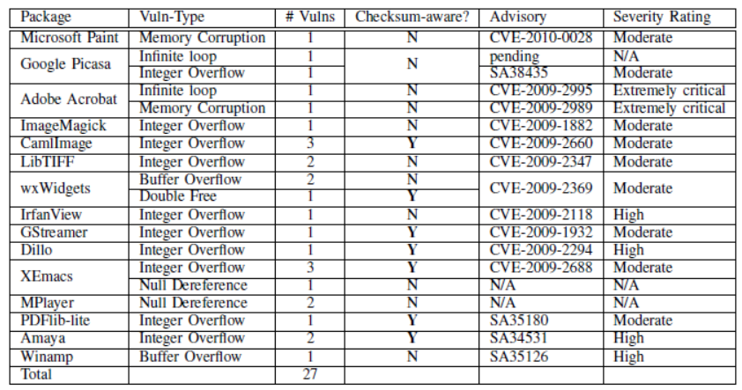
Fuzzing Evaluation

Slide 30
Fuzzing Evaluation
7 of these applications had vulnerabilities that were exposed because of the checksum-aware behavior of the fuzzer
Some of the vulnerabilities found have been classified as “High” or “Extremely Critical” by Secunia
These vulnerabilities have been reported to the respective software vendors, and many have been patched

Slide 31
Contribution
Development of a method of “checksum-aware” fuzzing
Utilizing taint-based tracing to dramatically reduce the size of the mutation space
Utilizing symbolic execution and constraint solving in conjunction with directed fuzzing to increase the fuzzer’s performance
Discovery of real-world vulnerabilities

Slide 32
Weaknesses
The TaintScope design, although pioneering, is limited when checksums are cryptographic, as opposed to data integrity-based
TaintScope design is built upon currently-existing research technologies, and this paper does not go into great depth as to how these technologies are utilized
The value of checksum-aware fuzzing is understood, but more emphasis on a current lack of focus in this are may have “sold” their approach more strongly

Slide 33
Improvement
A more detailed explanation of the roles that the various technologies play in the design would allow for better reproducibility of their design paradigm
A more detailed explanation of how reliable the checksum repairing is expected to be on mutated samples
For example, what if a case exists that the length of a file is mutated to be larger than the file’s contents, and the checksum dependent data bytes extend to the arbitrary contents of memory?

Slide 34
Questions
?

