Slide 1
  Authors:
  Yinqian Zhang
  University of North Carolina
  Chapel Hill, NC, USA
  Ari Juels
  RSA Laboratories
  Cambridge, MA, USA
  Alina Oprea
  RSA Laboratories
  Cambridge, MA, USA
  Michael K. Reiter
  University of North Carolina
  Chapel Hill, NC, USA
Home Alone: Co-Residency Detection in the Cloud via Side-Channel Analysis
2011 IEEE Symposium on Security and Privacy
Presented by:
Melvin Rodriguez
CAP6135 Malware and Software Vulnerability Analysis
Spring 2012

Slide 2
HomeAlone - Project
Abstract
  Security barrier to Cloud computing
  Physical co-residency with other tenants presents risks
  Research indicates extraction of data via side comm channels is possible
  Tool HomeAlone uses side comm channels as a defense by monitoring L2 cache usage to detect malicious activity
Introduction
  Cloud offers vendors lower costs
  Customer relinquish control of resources into shared environment
  Vendor configuration can lead to security weaknesses
    Potential unauthorized extraction of sensitive data
    Strong isolation can prevent issues however, validation is not available
  New tool allows tenants / auditors verify VM isolation
  No changes to the hypervisor
  No vendor interaction
  Silence customer VMs for a determined time period
  Measure cache usage to detect activity

Slide 3
HomeAlone – Technical Challenges
Needed a way to:
  Detect cache based side channels
      Identify friendly vs foe cache activity
      Distinguish normal vs abnormal activity
    Classifier to distinguish VM activity
  Not introduce performance degradation
    Selectively silencing VMs
  Avoid selective areas of cache
    Remap physical memory pages
    Reserved pool of available memory pages

Slide 4
HomeAlone – Background
Although some information is provided, authors assume that reader has an understanding of: cache memory, virtualization, cloud computing
L2 Cache Memory
  Most PCs are offered with a Level 2 cache to bridge the processor/memory performance gap
  The aim of the Level 2 cache is to supply stored information to the processor without any delay (wait-state)
  Level 2 cache typically comes in two sizes, 256KB or 512KB, etc
L2 cache may be placed:
  On the processor core - integrated or on-die cache.
  In the same package/cartridge as the processor, but separate from the processor core - backside cache.
  Separate from the core and processor package. In this case L2 cache memory is usually located on the motherboard.
Dependent on processor architecture and its use

Slide 5
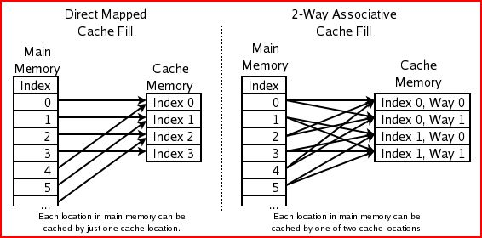
HomeAlone - Background
Memory is split into "locations," which correspond to cache "lines”
Cache is organized in data blocks (cache lines) / contains the actual data fetched from the main memory
Main memory can be placed / map into cache set
The index describes which cache row (which cache line) that the data has been put in
- The replacement policy decides where in the cache a copy of a particular entry of main memory will go. If the replacement policy is free to choose any entry in the cache to hold the copy, the cache is called fully associative. At the other extreme, if each entry in main memory can go in just one place in the cache, the cache is direct mapped. Cache
http://en.wikipedia.org/wiki/File:Cache,associative-fill-both.png / http://en.wikipedia.org/wiki/CPU_cache

Slide 6
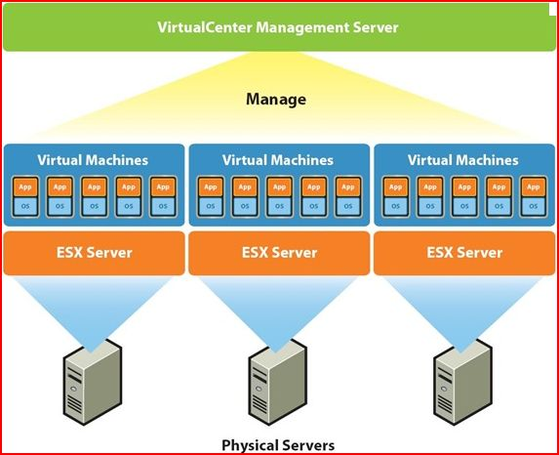
HomeAlone –Virtualization Sample
Is the creation of a virtual (rather than actual) version of something, such as a hardware platform, operating system, a storage device or network resources
Software executed on these virtual machines is separated from the underlying hardware resources
Different types of hardware virtualization include:
Full virtualization: Almost complete simulation of the actual hardware to allow software, which typically consists of a guest operating system, to run unmodified
Partial virtualization: Some but not all of the target environment is simulated. Some guest programs, therefore, may need modifications to run in this virtual environment.
Paravirtualization: A hardware environment is not simulated; however, the guest programs are executed in their own isolated domains, as if they are running on a separate system. Guest programs need to be specifically modified to run in this environment. Ref: http://en.wikipedia.org/wiki/Virtualization
Ref: http://www.google.com/search?q=vmware+diagram&hl=en&prmd=imvnsfd&tbm=isch&tbo=u&source=univ&sa=X&ei=avBvT_HeCoa6twfT0aWNBg&sqi=2&ved=0CE0QsAQ&biw=1440&bih=766

Slide 7
HomeAlone – Background
Cloud computing is the delivery of computing as a service rather than a product, whereby shared resources, software, and information are provided to computers and other devices as a utility (like the electricity grid) over a network (typically the Internet)
Cloud computing entrusts, typically centralized, services with your data, software, and computation on a published application programming interface (API) over a network
Ref: http://en.wikipedia.org/wiki/Cloud_computing

Slide 8
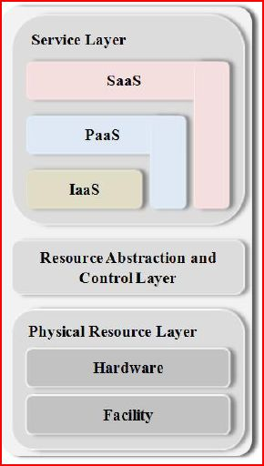
HomeAlone - Background
NIST Definition of Cloud:
Cloud computing is a model for enabling ubiquitous, convenient, on-demand network access to a shared pool of configurable computing resources (e.g., networks, servers, storage, applications, and services) that can be rapidly provisioned and released with minimal management effort or service provider interaction. This cloud model is composed of five essential characteristics, three service models, and four deployment models..
    Characteristics (5)
      On-demand self-service - Broad network access
      Resource pooling ( Location independence)
      Rapid elasticity - Measured service
    Service Models (3)
      Software as a Service (SaaS)
      Platform as a Service (PaaS)
      Infrastructure as a Service (IaaS)
    Deployment Models (4)
      Private cloud -enterprise owned or leased
      Community cloud - shared infrastructure for specific community
      Public cloud - Sold to the public, mega-scale infrastructure
      Hybrid cloud - composition of two or more clouds [2]
[1]
[1] http://www.nist.gov/customcf/get_pdf.cfm?pub_id=909505
[2] http://csrc.nist.gov/publications/nistpubs/800-145/SP800-145.pdf

Slide 9
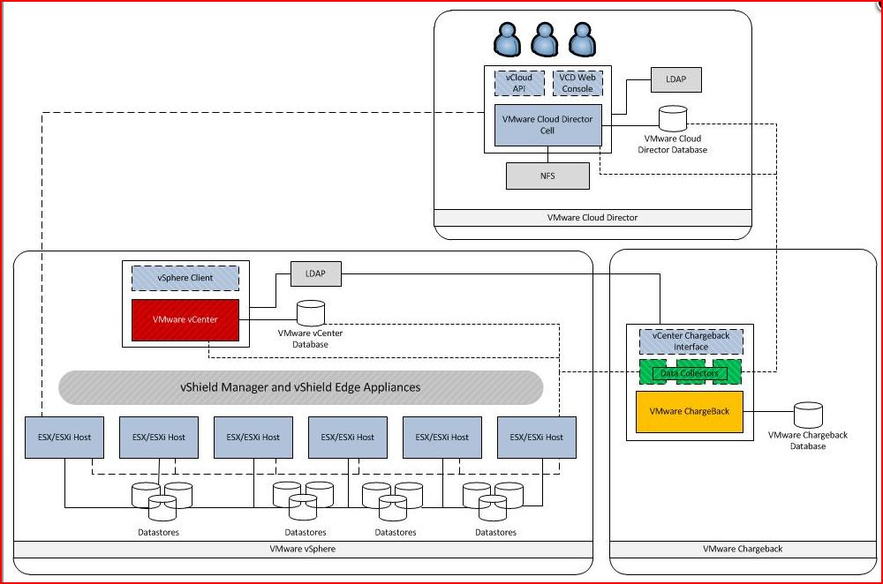
Cloud Arch – Sample Implementation
http://www.virtual-blog.com/2010/09/vmware-vcloud-director-building-block-resource-group-design/

Slide 10
HomeAlone – Cloud Threats
Several VM reside in the same host (Co-residency)
  Your own and from other customers (good vs bad tenants)
Customer has no control / visibility over the hypervisor
Customer assumes vendor is following service agreements
Customer still required to meet regulatory compliance
Among others:
  PCI (Payment Card Industry)
  DSS (Data Security Standard)
  PII (Personal Identifiable Information)
  HIPAA (Health Insurance Portability and Accountability Act)
A way to detect VMs in the environment is needed – (HomeAlone)

Slide 11
HomeAlone – Cache Approach
Cache-based Timing Channel Approach
  Prime-Probe Protocol
  Monitor cache load sharing common cache
    Reads memory region
    Waits for interval to expire while being monitored
    Validates if previous memory has been used

Slide 12
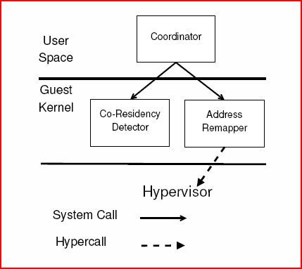
HomeAlone – Tool Components
Implements custom tools in each VM
  User level
    Coordinator (detection tasks )
      Establishes detection period
      Communicates with Address Remapper to clear cache
      Creates a token (monitoring)
      Tells Co-Residency Detector to perform prove
      Forward token and prove information to next VM

Slide 13
HomeAlone – Tool Components (cont)
  OS Kernel (Extensions)
    Address Remapper (memory mapping tasks)
      Establish pool memory pages (not to be used)
      Enumerates pseudo-physical memory pages
      Copies / moves to memory pages to respective area (color coded)
      Updates Kernel page table
    Co-residency detector (monitors memory activity)
      Maps memory to cache
      Assigns a color to cache
      Monitors cache activity by set interval (30 ms)

Slide 14
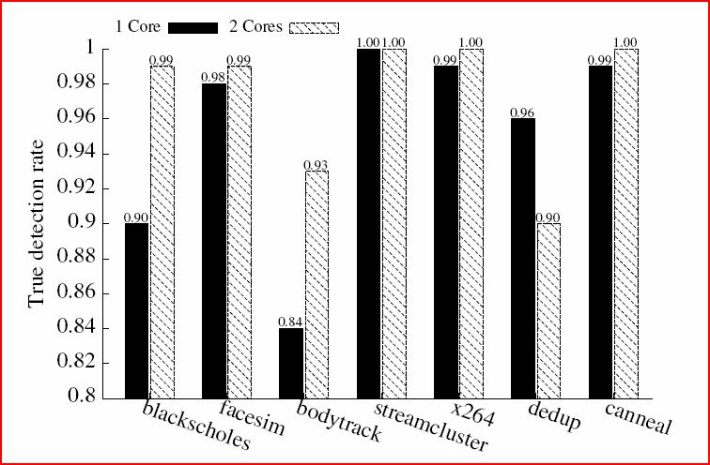
HomeAlone – Detection
Detection of VM with different OS is possible
  Linux 15% / Windows 70%
Increase detection rate when VM used multiple cores (2)
Up to 85% successful detection rate
Detection accuracy depends on:
  How often VM executes calls
  Number and location of caches sets being monitored

Slide 15
    HomeAlone – Contributions
  How can these tenants verify that their computing resources (and VMs, in particular) are actually physically isolated?
Provides cloud customers a method to validate computing resources are actually physically isolated from other tenants
  Allows cloud customers detect other VM in their environment
  Provides a way to detect policy violations and/or mis-configurations
  Serve as an early warning of possible isolation breach or compromise

Slide 16
    HomeAlone – Weaknesses
Tool detection can be avoided
  Limit footprint cache utilization
  Avoid use of cache
Developed and tested using Xen – PVM (Paravirtualization) technology only
VM are paused during remapping
Assumes the number of VMs is constant during detection
  Need to account for VM migrations
Only works if CPU supports Simultaneous Multithreading (SMT)
Deploying tool my break vendor agreements

Slide 17
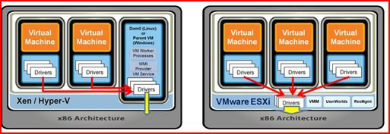
HomeAlone – Xen Virtual Arch
Not all virtualizations are created equal
Xen architecture can introduce additional activity and influence results
Ref: http://blogs.vmware.com/virtualreality/WindowsLiveWriter/Indirect_arch.png

Slide 18
    HomeAlone – Improvements
Create a friendly VM Registrar with unique number / flag
Make tool compatible with other VM technologies
Concurrent discovery while VM run
Introduce improvements on identifying and isolating write protected memory pages
Resolve limitation on the number of memory tagging colors by adding an external mapping module (passing mapping / cross-reference externally)
Additional research needed to address tools inherent limitations
  Guess access to physical memory access (hardware)
  Statistical dependency between runs
  Balance / tradeoff between execution time and sensitivity for probability (threshold of expected values)
Research could be most applicable to all virtualization technologies instead of Cloud focus

Slide 19
Backup Slides

Slide 20
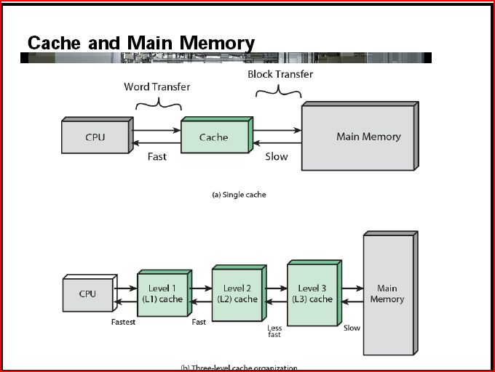
HomeAlone - Background
Ref: http://umcs.maine.edu/~cmeadow/courses/cos335/COA04.pdf

Slide 21
HomeAlone – Background
What is L2 Cache Memory
  Most PCs are offered with a Level 2 cache to bridge the processor/memory performance gap. Level 2 cache – also referred to as secondary cache) uses the same control logic as Level 1 cache and is also implemented in SRAM.
  Level 2 cache typically comes in two sizes, 256KB or 512KB, and can be found, or soldered onto the motherboard, in a Card Edge Low Profile (CELP) socket or, more recently, on a COAST (“cache on a stick”) module. The latter resembles a SIMM but is a little shorter and plugs into a COAST socket, which is normally located close to the processor and resembles a PCI expansion slot. The Pentium Pro deviated from this arrangement, sitting the Level 2 cache on the processor chip itself.
  The aim of the Level 2 cache is to supply stored information to the processor without any delay (wait-state). For this purpose, the bus interface of the processor has a special transfer protocol called burst mode. A burst cycle consists of four data transfers where only the address of the first 64 are output on the address bus. The most common Level 2 cache is synchronous pipeline burst.
  Ref: http://www.pctechguide.com/computer-memory/what-is-l2-level-2-cache-memory

Slide 22
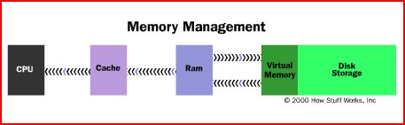
HomeAlone - Background
The area of the hard disk that stores the RAM image is called a page file. It holds pages of RAM on the hard disk, and the operating system moves data back and forth between the page file and RAM. On a Windows machine, page files have a .SWP extension.
  Ref: http://computer.howstuffworks.com/virtual-memory.htm
Level 2 cache is often abbreviated as "L2 cache". L2 cache may be placed:
  On the processor core - integrated or on-die cache.
  In the same package/cartridge as the processor, but separate from the processor core - backside cache. This type of L2 cache was used in Pentium Pro, Pentium II, early Pentium III and slot A Athlon processors.
  Separate from the core and processor package. In this case L2 cache memory is usually located on the motherboard.
  Ref: http://www.cpu-world.com/Glossary/L/Level_2_cache.html

Slide 23
HomeAlone – Background
L2 Cache Memory
  Most PCs are offered with a Level 2 cache to bridge the processor/memory performance gap
  The aim of the Level 2 cache is to supply stored information to the processor without any delay (wait-state)
  Level 2 cache typically comes in two sizes, 256KB or 512KB, etc
L2 cache may be placed:
  On the processor core - integrated or on-die cache.
  In the same package/cartridge as the processor, but separate from the processor core - backside cache.
  Separate from the core and processor package. In this case L2 cache memory is usually located on the motherboard.

