Slide 1
Detecting Spammers on Social Networks
Gianluca Stringhini, Christopher Kruegel, Giovanni Vigna (University of California)
Annual Computer Security Applications Conference
2010
Best student paper award
Presented by:
Yazan Jadaa

Slide 2
Outline
Abstract
Introduction
Background
Data collection
Analysis of collected data
Spam profile detection
Conclusion
Contribution
Weakness
Improvement
Questions

Slide 3
Abstract
In this paper, They analyze to which extent spam has entered social networks. More precisely, They analyze how spammers who target social networking sites operate. To collect the data about spamming activity, They created a large and diverse set of “honey-profiles” on three large social networking sites, and logged the kind of contacts and messages that they received. Then they analyzed the collected data and identified anomalous behavior of users who contacted their profiles. Based on the analysis of this behavior, they developed techniques to detect spammers in social networks, and they aggregated their messages in large spam campaigns. Their results show that it is possible to automatically identify the accounts used by spammers, and their analysis was used for take-down efforts in a real-world social network.

Slide 4
Introduction
Over the last few years, social networking sites have become one of the main ways for users to keep track and communicate with their friends online.
Sites such as Facebook, MySpace, and Twitter are consistently among the top 20 most-viewed web sites of the Internet.
Statistics show that, on average, users spend more time on popular social networking sites than on any other site.
The tremendous increase in popularity of social networking sites allows them to collect a huge amount of personal information about the users, their friends, and their habits.
Unfortunately, this wealth of information, as well as the ease with which one can reach many users, also attracted the interest of spammers.

Slide 5
Introduction
From a security point of view, social networks have unique characteristics.
  First, information access and interaction is based on trust.
  Second, different levels of user awareness with respect to threats.
Unfortunately, social networking sites do not provide strong authentication mechanisms, and it is easy to impersonate a user and sneak into a person’s network of trust.
Even though social networks have raised the attention of researchers, the problem of spam is still not well understood.

Slide 6
Introduction
Mobile Interface.
  To attract more users and to make their platform more accessible from any kind of device, major social networks launched mobile versions of their sites.
  To improve usability, no JavaScript is present on these pages.
  This has made social networks more accessible from everywhere. However, the mobile environment provides spammers with an easy way to interact with these sites and carry out their tasks.

Slide 7
Background
The Facebook Social Network
  Facebook is currently the largest social network on the Internet. On their website, the Facebook administrators claim to have more than 400 million active users all over the world, with over 2 billion media items (videos and pictures) shared every week
  Usually, user profiles are not public, and the right to view a user’s page is granted only after having established a relationship of trust (Friends)
  Most of the time, Facebook users accept friendship requests from persons they barely know, while in real life, the person asking to be friend would undergo more scrutiny.

Slide 8
Background
The MySpace Social Network
  MySpace was the first social network to gain significant popularity among Internet users. The basic idea of this network is to provide each user with a web page, which the user can then personalize with information about herself/himself and her/his interests.
  Even though MySpace has also the concept of “friendship,” like Facebook, MySpace pages are public by default. Therefore, it is easier for a malicious user to obtain sensitive information about a user on MySpace than on Facebook.

Slide 9
Background
The Twitter Social Network
  Twitter is a much simpler social network than Facebook and MySpace. It is designed as a microblogging platform, where users send short text messages (i.e., tweets) that appear on their friends’ pages.
  Unlike Facebook and MySpace, no personal information is shown on Twitter pages by default. Users are identified only by a username.
  A Twitter user can start “following” another user. As a consequence, user receives the user’s tweets on her/his own page. By default, profiles on Twitter are public, but a user can decide to protect her/his profile. By doing that, anyone wanting to follow the user needs her/his permission.

Slide 10
Data collection
The first goal of their paper was to understand the extent to which spam is a problem on social networks, as well as the characterization of spam activity.
Honey-Profiles
  They created 900 profiles on Facebook, MySpace, and Twitter, 300 on each platform. The purpose of these accounts was to log the traffic (e.g., friend requests, messages, invitations) they receive from other users of the network. They call these accounts honey-profiles.

Slide 11
Data collection
Collection of Data
  After having created their honey-profiles, they ran scripts that periodically connected to those accounts and checked for activity. They decided that their accounts should act in a passive way. Therefore, they did not send any friend requests, but accepted all those that were received.
  In a social network, the first action a malicious user would likely execute to get in touch with his victims is to send them a friend request. After having acknowledged a request (i.e., accepted the friendship on Facebook and MySpace or started following the user on Twitter), they logged all the information needed to detect malicious activity.
  Their scripts ran continuously for 12 months for Facebook and for 11 months for MySpace and Twitter periodically visiting each account. The visits had to be performed slowly (approximately one account visited every 2 minutes) to avoid being detected as a bot by the social networking site and, therefore, having the accounts deleted.

Slide 12
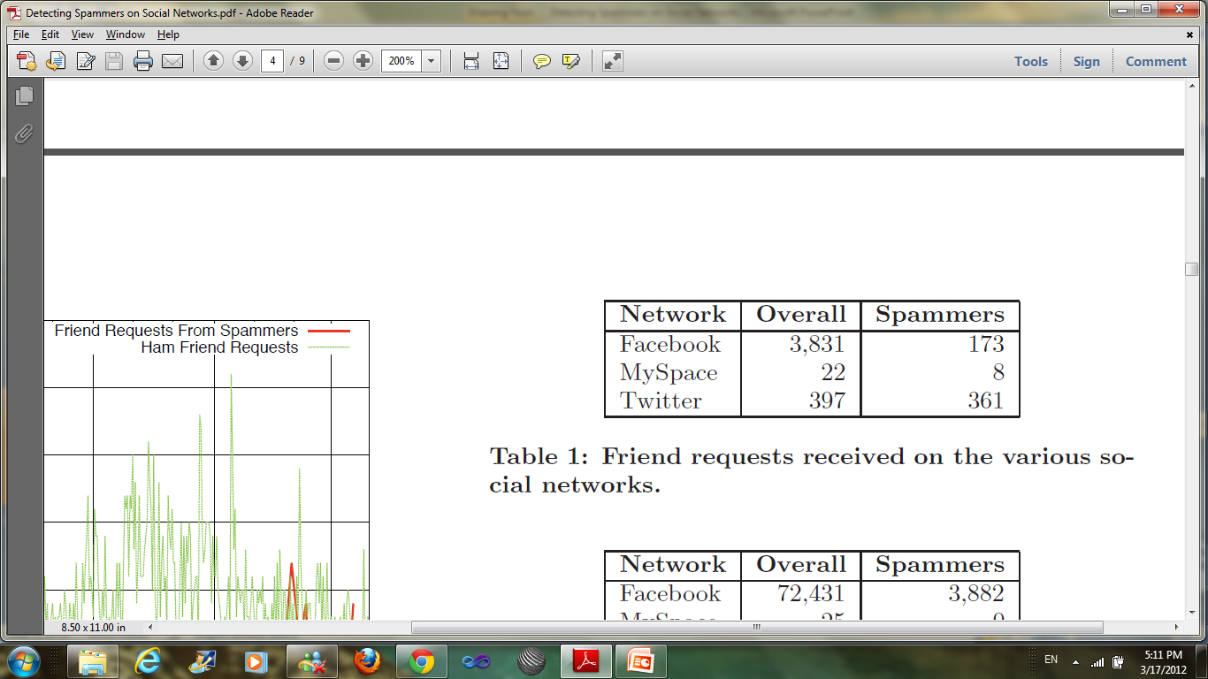
Analysis of collected data
During their study, they received a total of 4,250 friend requests

Slide 13
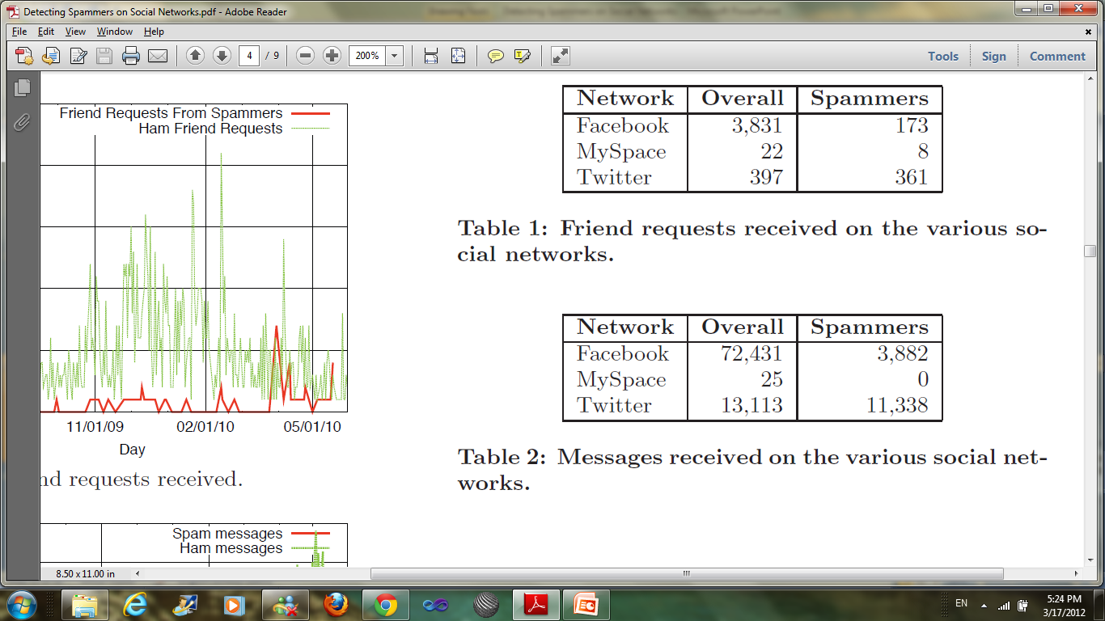
Analysis of collected data
Overall, they observed 85,569 messages

Slide 14
Analysis of collected data
Identification of Spam Accounts
  Friend requests are not always the result of spammers who reach out. In particular, many social network users aim to increase their popularity by adding as friends people they do not know.
  Since not all friend requests and messages are malicious, they had to distinguish between spammers and benign users.
  They started to manually check all the profiles that contacted them. During this process, they noticed that spam bots share some common traits, and formalized them in features that they then used for automated spam detection.

Slide 15
Analysis of collected data
Spam Bot Analysis
  Four categories of bots
    Displayer: Bots that do not post spam messages, but only display some spam content on their own profile pages All the detected MySpace bots belonged to this category, as well as two Facebook bots.
    Bragger: Bots that post messages to their own feed. 163 bots on Facebook belonged to this category, as well as 341 botson Twitter.
    Poster: Bots that send a direct message to each victim. Eight bots from this category have been detected, all of them on the Facebook network.
    Whisperer: Bots that send private messages to their victims. 20 bots of this kind on Twitter.

Slide 16
Analysis of collected data
  They identified two kinds of bot behavior: stealthy and greedy bots. Greedy ones include a spam content in every message they send. They are easier to detect, and might lead users to flag bots as spammers or to revoke their friendship status. Stealthy bots, on the other hand, send messages that look legitimate, and only once in a while inject a malicious message. Since they look like legitimate profiles, they might convince more people to accept and maintain friendships. Of the 534 spam bots detected, 416 were greedy and 98 were stealthy.
  While observing Facebook spammers, they also noticed that many of them did not seem to pick victims randomly, but, instead, they seemed to follow certain criteria. In particular, most of their victims happened to be male. Since Facebook does not provide an easy way to search for people based on gender, the only way spammers can identify their victims is by looking for male first names.

Slide 17
Spam profile detection
They decided to focus on detecting “bragger” and “poster” spammers, since spammers do not require real profiles for detection, but are just detectable by looking at their feeds. They used machine learning techniques to classify spammers and users.
To detect whether a given profile belongs to a spammer or not, they developed six features, which are:
  FF ratio (R)
  URL ratio (U)
  Message Similarity (S)
  Friend Choice (F)
  Messages Sent (M)
  Friend Number (FN)

Slide 18
Spam profile detection
FF ratio (R):The first feature compares the number of friend requests that a user sent to the number of friends a he/she has. Unfortunately, the number of friend requests sent is not public on Facebook and onMySpace. On Twitter, on the other hand, the number of users a profile started to follow is public. Therefore, They can compute the ratio R = following / followers (where following,is the number of friend requests sent, and followers is the number of users who accepted the request).
URL ratio (U): The presence of URLs in the logged messages. To attract users to spam web pages, bots are likely to send URLs in their messages. Therefore, they introduce the ratio U as: U = messages containing urls / total messages, they only count URLs pointing to a third party site when computing this feature.

Slide 19
Spam profile detection
Message Similarity (S): The third feature consists in leveraging the similarity among the messages sent by a user. Most bots we observed sent very similar messages, considering both message size and content, as well as the advertised sites.
Friend Choice (F): The fourth feature attempts to detect whether a profile likely used a list of names to pick its friends or not.
Messages Sent (M): They use the number of messages sent by a profile as a feature. This is based on the observation that profiles that send out hundreds of messages are less likely to be spammers, given that, in their initial analysis, most spam bots sent less that 20 messages.
Friend Number (FN): Finally they look at the number of friends a profile has. The idea is that profiles with thousands of friends are less likely to be spammers that the ones with a few.

Slide 20
Spam profile detection
Identification of Spam Campaigns
  After having identified single spammers, they analyzed the data to identify larger-scale spam campaigns.
  They consider two bots posting messages with URLs pointing to the same site as being part of the same campaign.
  Then, they clustered all the profiles that advertised the same page. They list the top eight campaigns, based on the number of observed messages.
  They then tried to understand how bots choose their victims. The behavior seems not to be uniform for the various campaigns.

Slide 21
Conclusion
In this paper, They showed that spam on social networks is a problem. For their study, they created a population of 900 honey-profiles on three major social networks and observed the traffic they received. They then developed techniques to identify single spam bots, as well as large-scale campaigns.
They also showed how their techniques help to detect spam profiles even when they do not contact a honey-profile. They believe that these techniques can help social networks to improve their security and detect malicious users. In fact, they develop a tool to detect spammers on Twitter. Providing Twitter the results of their analysis thousands of spamming accounts were shut down.

Slide 22
Contributions
They created a set of honeynet accounts (honey-profiles) on three major social networks, and we logged all the activity (malicious or not) these accounts were able to observe over a one-year period for Facebook and an eleven-month period for Twitter and MySpace.
They investigate how spammers are using social networks, and we examine the effectiveness of the countermeasures that are taken by the major social network portals to prevent spamming on their platforms.
They identify characteristics that allow us to detect spammers in a social network.
They built a tool to detect spammers, and used it ona Twitter and Facebook dataset. We obtained some promising results. In particular, we correctly detected 15,857 on Twitter, and after our submission to the Twitter spam team, these accounts were suspended.

Slide 23
Weakness
Redundancy.
No Future Work.
Using “she/her” when refers to a user. (Not Technical)
What about linkedin? Because user here can be spammed much easier.

Slide 24
Improvement
Doing a reverse study
  Becoming spammers and check how users will respond and how easy to get their attention and information, and come up with percentages and numbers.
Doing the same study again to confirm if they will get the same results.
Including other networks, like LinkedIn.

Slide 25
Questions
?
?
?
?
?
?
?
?
?
?
?

