Slide 1
TaintDroid:
Presented at OSDI 2010
Presented By:
Steven Zittrower
Authors:
William Enck (Penn St)
(Duke) Peter Gilbert
Byung-Gon Chun (Intel)
(Duke) Landon P. Cox
Jaeyeon Jung (Intel)
(Penn St) Pat McDaniel
Anmol Sheth (Intel)
An Information-Flow Tracking System for Realtime Privacy Monitoring on Smartphones
Notes:
Paper published at the 9th USENIX Symposium on Operating System Design and Implementation (OSDI ‘10)

Slide 2
Overview
What is TaintDroid
Why it’s Important
Implementation
Costs and Tradeoffs
Results
?

Slide 3
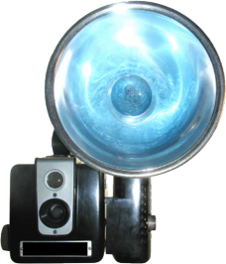
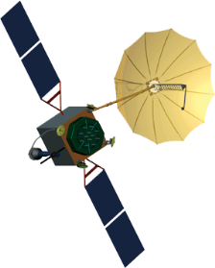
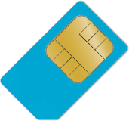
Modern Smartphones
GPS/Location Data
Camera/Photos/Microphone
Contacts
SMS Messages
SIM Identifiers (IMSI, ICC-ID, IMEI)

Slide 4
TaintDroid
Identifies Sensitive Data
Taints and Tracks Data Flow via
Variables, Messages, Methods, and Files
Monitors Behavior of Running Applications in Realtime
Identifies Misuse of Private Data
Notes:
2. Uses virtualized execution environment inherit in Android’s operating system

Slide 5
Android: The OS
Built on the Linux kernel
Applications run on top of middleware
Written in JAVA
Stack-based
Executed in the Dalvik VM Interpreter
Register-based
Allows access to certain native libraries

Slide 6
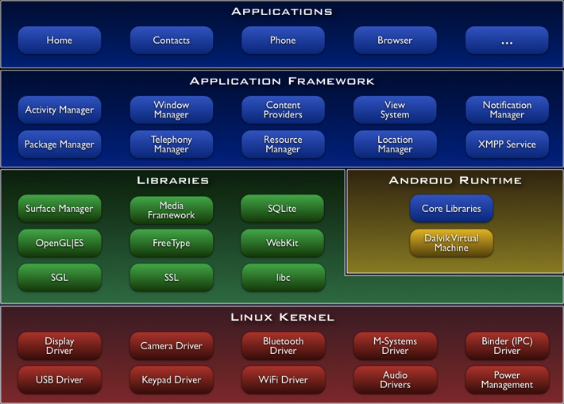
Android architecture graphic courtesy of Google
Notes:
Binder (IPC) Driver – Controls all interprocess communication.
Designed for BeOS, extended by Palm, customized for Android by Google
Parcels serialize active and standard data objects (active objects core to managing shared data objects between processes)

Slide 7
TaintDroid Architecture
TaintDroid Architecture map courtesy of TaintDroid: An Information-Flow…
Interpreted Code
Trusted Applications
Untrusted Applications
8
Taint Source
1
Trusted Library
Taint Sink
2
3
6
7
9
Userspace
Taint Map
Taint Map
Dalvik VM
Interpreter
Dalvik VM Interpreter
4
Binder IPC Library
Binder IPC Library
Binder Hook
Binder Hook
5
Kernel
Binder Kernel Module
Notes:
Taint Map actually is a 32bit vector (shown as 16 for clarity in the image).
Process Flow
Information is tainted in a trusted application (i.e. location provider)
Taint interface invokes a native method that interfaces with the Dalvik VM interpreter, storing markings on the taint map
Dalvik VM propagates taint tags according to data flow rules (see future slide)
When application uses tainted data in IPC transaction the custom modified binder library ensures the parcel has a taint tag reflecting the combined taint markings of all contained data
Parcel passed through the kernel to be received by untrusted application
Modified binder library retrieves taint tag from parcel and assigns it to all values read from it
Dalvik VM propagates taint tags (same as 3)
When untrusted application invokes a library specified as a taint soure (i.e. network send)…
Library retrieves the taint tag for the data and reports the event

Slide 8
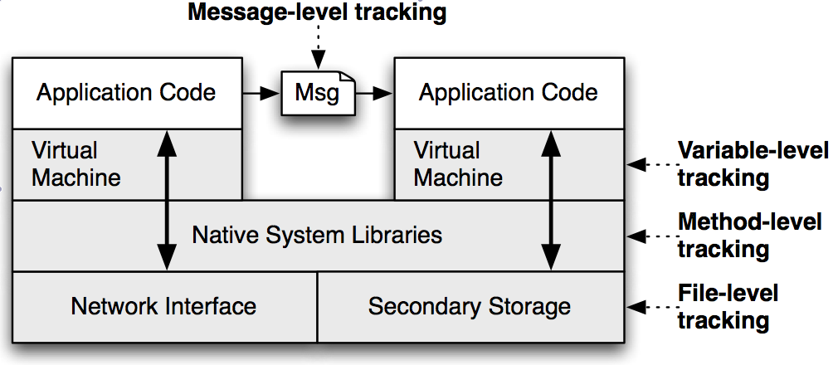
Types of Tainted Data
Variables
Locals, arguments, statics, classes, and arrays
Messages
Taint tag is upper bound of tainted variables in message
Methods
Tracks and propagates system provided native libraries
Files
One tag per-file, same logic as messages
Notes:
Variables
Stored on internal stack adjacent to variables in memory (spatial locality)
Double the size of the stack frame allocation
For classes and arrays, one taint tag per entire structure (saves overhead and more efficient)
This does allow for false positives though
Messages
Keeps track of taints from IPC exchange of data
Methods
Initially taints data from native system libraries
Where taints come from
Files
Tracks and stores persistent tainted data

Slide 9
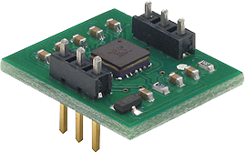
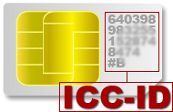
How Things Get Tainted
Sources
Sinks
Low-bandwidth Sensors
High-bandwidth Sensors
Information Databases
Devices Identifiers
Network Calls
File-system Writes
Notes:
Low-bandwidth sensors
GPS
Accelerometers
Typically changes rapidly and simultaneously used by multiple applications
Android OS multiplexes access to improve speed
TaintDroid taints LocationManager and SensorManager applications
High-bandwidth sensors
Microphones
Cameras
Exchange large amounts of data, only used by one application at a time
Transferred via buffers or files
Information Databases
Address books
SMS messages
Notes
Taint added to database files that store data
Device Identifiers
SIM card identifiers
IMSI, ICC-ID
Device identifier
IMEI
API’s are overwritten to taint returns
Problems with tainting IMSI as it is used in conjunction with non-private data often (too many false positives)

Slide 10
Taint Propagation
Rules for passing taint markers
α←C : τ_{α}←0
β←α:τ_{β} ←τ_{α}
α←α⊗β:τ_{α}←τ_{α}∪τ_{β}
…
Govern steps 3, 7 of TaintDroid Architecture

Slide 11
Experiments
30 random popular applications
100 minutes, 22,594 packets, 1,130 TCP connections
Logged all TaintDroid messages
Verified by logging network traffic

Slide 12
Performance Overhead

Slide 13
Throughput Overhead

Slide 14
Performance Takeaways
14% performance overhead
Most operations less than 20ms slower
IPC 27% slower than normal Android OS
Due to continual copying of tags as values placed in buffers
3.5% more memory is used

Slide 15
Results

Slide 16
Contributions
Detects leakage of private after entering applications
Previous work deals with securing data from non-trusted applications
Works even if data is encrypted
Identifies insecure, malicious, and unethical mobile applications
Modest performance overheads

Slide 17
Weaknesses
Requires custom OS modification
No checks on native libraries
No power overhead data
Network traffic only sink tested
Malicious attackers can bypass TaintDroid

Slide 18
Improvements
Real-time tracking and filtering
Eliminate or reduce false-positives through better management of variable-level tags
Detection of bypass attempts

Slide 19
References and Contributions
TaintDroid: An Information-Flow Tracking System for Realtime Privacy Monitoring on Smart Phones
Google (http://code.google.com/android/)
Clip-art courtesy of
Norebbo.com
NASA.com
Linuxchixla.org

