Slide 1
Spamming Botnets: Signatures and Characteristics
Introduction of AutoRE Framework

Slide 2
Introduction
Paper: Spamming Botnets: Signatures and Characteristics
Authors: Yinglian Xie, Fang Yu, Kannan Achan, Rina Pangigraphy, Geoff Hulten*, Ivan Osipkov*
Microsoft Research, Silicon Valley
Microsoft Corporation*
Presented at: SIGCOMM ‘08, August 17-22 2008, Seattle, Washington, USA
Special Interest Group on Data Communication (SIGCOMM), a group of the Association for Computing Machinery (ACM).

Slide 3
Introduction
Figures in presentation credited to original paper
Presentation by Jon Rhoades – Digital Forensics Program – UCF
Questions during presentation are welcome
Speaking without understanding is just a waste of everyone's time

Slide 4
Overview
Developed AutoRE
  What it is.
    Spam signature generation framework
    Targets botnet-based spam by using URLs in the SPAM
    Determines botnet members
    Output is regular expression signatures to detect botnet spam
  What it is not.
    A traditional reactive method such as RBL, Spamhaus, etc.
    A system requiring pre-classifying of IPs or message content
    A framework that has a need for whitelists

Slide 5
AutoRE Details
Input - volume of unfiltered and unclassified Email messages
Output
  set of SPAM URL signatures
  botnet host IP addresses
Comprised of 3 modules
  URL Pre-Processing
  Group selector
  RegEx generator
Fundamental observation is botnet spam contains URLs (74%). The goal is to get the recipient to go to the main URL of the message.

Slide 6
URL Pre-Processing
Extracts data and groups according to web domain
Extracted Data
  URL string
  Source server IP
  Email sending time
Drops forwarded emails (17% of sample)
Dropped email with no URL
Partitioning observation
  Identify SPAM campaigns
  Advertise same product or service from same domain
  $$ They are not spamming you just to spam you $$

Slide 7
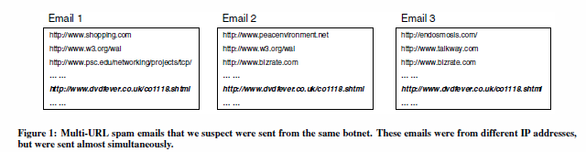
URL Pre-Processing Challenges
Multiple URLs in messages
  Common sites randomly added for confusion. (www.w3.org, etc.)
  Email in the same campaign will still have a common URL

Slide 8
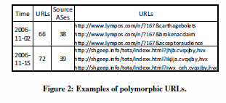
URL Pre-Processing
Polymorphic URLs
  Random strings
  User based information
  How to deal with them
An email message could be in multiple URL groups

Slide 9
Group Selector
Find the URL group that best identifies SPAM campaign
Spam campaigns are “bursty”
Use factors to create a score of URL groups
  Total number of IP addresses that sent at least one URL in a group in a finite time period.
URL groups with sharp spikes are ranked higher

Slide 10
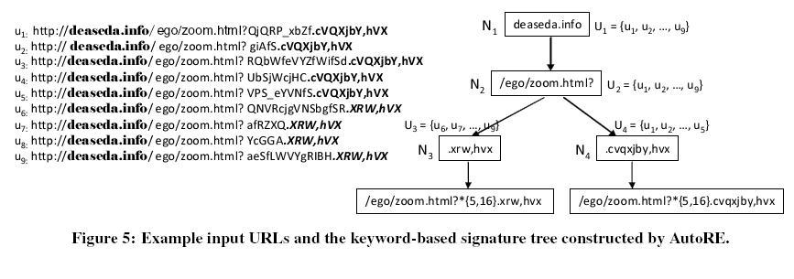
Regular Expression Generation
Detailing
Generate regular expression rules to match URLs included in selected URL group

Slide 11
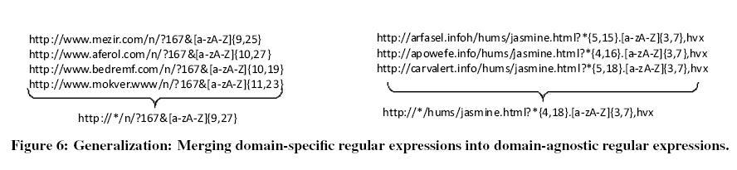
Regular Expression Generation
Generalization
Merge domain-specific expressions into domain-agnostic expressions

Slide 12
Expression Signature Findings
Complete URL expressions (CU)
  Example
  www.spamerrRus.ru/freebluepills.html?steal_credit_card
  Accounted for 70-80% of spammer campaigns
Regular Expression (RE)
  Example
  http://*/n/?167&[a-zA-Z]{9,27}
  Accounted for 20-30% of spammer campaigns

Slide 13
AutoRE Performance
3 Month Sample of Email from Hotmail
  5.38M messages in sample
  7,721 botnet based spam campaigns
  340,050 unique botnet host IP addresses
  580,466 spam messages
Regular Expression
  10 times better then complete URL (fixed string)
  10-30 times better than token matching in regards to false positives

Slide 14
AutoRE Performance
Low false positive rates
  .2% (SPAM) .5% (Botnet Host)
Detected SPAM that passed through other solutions
  Detected 16-18% of SPAM that passed well know solutions (Spamhaus)
Adapt to domain modifications tracking SPAM URLs.
Being domain agnostic and adapting to new domains AutoRE was able to capture 15 times more SPAM.

Slide 15
Contributions
Provided a framework (AutoRE) to consider for battling botnet spam
Traditional method is not fast enough to catch spam campaigns that might come and go within a day or two
In-depth analysis of spamming botnet characteristics
  Spam campaigns doubled in 8 months
  Botnet hosts increased 10%
  Email content varies greatly URLs have patterns
  Different campaigns have similar email patterns showing they are probably using same tools

Slide 16
Weakness
Not actionable for IT security groups
Not clear on how well it works real-time to stop bursty spam campaigns, left for future work
If AutoRE became popular spammers could engineer to make it less effective
  Simple new top-level domains a.com, b.com hard to pick up patterns
  Add more legit domains to SPAM
  Use URL redirection techniques
  Establish a forwarding process for SPAM
Google search of AutoRE Spam did not pick up much

Slide 17
Improvement
Run it in production
  Start with a company
  Move on to a University
  Try a large provider like hotmail.com
Provide a whitelist capability

