Slide 1
HyperSafe: A Lightweight Approach to Provide Lifetime Hypervisor Control-Flow
Integrity
Self Protection for the Hypervisor

Slide 2
Introduction
Paper: HyperSafe: A Lightweight Approach to Provide Lifetime Hypervisor Control-Flow Integrity
Authors: Zhi Wang and Xuxian Jiang
Department of Computer Science, North Carolina State University
Presented at: 31st IEEE Symposium on Security & Privacy, Oakland, CA USA, May 2010

Slide 3
Introduction
Figures in presentation credited to original paper and presentation
Presentation by Jon Rhoades – Digital Forensics Program – UCF
Questions during presentation are welcome

Slide 4
For Context What is it?
Present HyperSafe
A framework capability to protect Virtualization Hypervisors from security threats
Primary Two Techniques
  Non-bypassable memory lockdown
  Restricted pointer indexing
The framework has been used for a prototype system for BitVisor and Xen

Slide 5
Hypervisor
Virtual Machine Manager
Controls when and how the Virtual Machines start and stop
Access to VM settings
Allocates and manages resources for the Virtual Machines
  Established
  Running
Examples of Hypervisors
  Xen, VMware ESX

Slide 6
What are the Threats
VMs vulnerable if Hypervisor is hacked
Xen 2007-9 26 security vulnerabilities identified*
VMware ESX 2007-9 18 security vulnerabilities identified*
Code base for Hypervisors growing
  Xen 230K lines of code
Hypervisor runs at lowest level of software stack
* Source: National Vulnerability Database

Slide 7
Why Protect The Hypervisor
Rapid growth in adoption of Virtual Machines
  16% of server workload in 2010
  50% by 2012 (estimated)
VM escape attacks
  Break out of a VM and access HyperVisor
Hypervisor based rootkits
If you get control of Hypervisor you have control of the VMs
  Console access
  Physical access

Slide 8
Types of Hypervisors
Type
  I –No underlying OS ( VMware ESXi, Citirix XexServer)
  II – Hypervisor loaded onto an OS ( Microsoft Virtual PC, VMware Server)
Type I is also referred to as bare metal or native hypervisor

Slide 9
Goals of HyperSafe
Enable self protection of commodity type-I (bare-metal) hypervisors
Not require significant changes to the existing hypervisor design and function
Efficiently implemented on commodity hardware
Assumptions
  Trustworthy hardware
  Software bugs in hypervisor

Slide 10
How does HyperSafe Work?
Protects the memory space the hypervisor runs in
Provides structure for calls and returns
Two main Techniques
Non-bypassable memory lockdown
  Current hypervisors all page tables are writable
Restricted pointer indexing
  Control what functions can be called and acceptable return addresses

Slide 11
Non-bypassable Memory Lockdown
Most significant technique
Divides memory (physical and virtual) into page tables
Each table has a number of page table entries. (512 in x86_64)
Each entry has certain bits to specify protection attributes (writable(r/w), executable, or specify user or supervisor(u/s))
A page can either be executable OR writable
Hypervisor code is write protected
Sometime it needs to be updated (benign update)

Slide 12
Benign Update
Sometimes executable memory needs to be updated / written to
Supervisor only not User
Technique uses the W P bit (Write Protect) in hardware
On initial load set page tables read only and W P bit on
On benign update clear W P bit, make the change, then set the W P bit on
HyperSafe can ensure the action matches a security policy
During process disable interrupts then re-enable

Slide 13
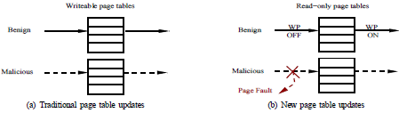
Updates
Effectively locks down access to hypervisor code to ensure integrity

Slide 14
Restricted Pointer Indexing
Restrict control of functions and return addresses from the user space
Establishes tables maintained in protected memory for approved function and ret calls
The table contains the pointers to the approved functions and returns

Slide 15
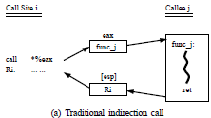
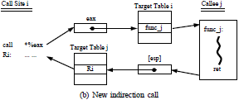
Restricted Point Indexing

Slide 16
Production Use
Prototype developed for BitVisor and Xen
HyperSafe protection
  Used attacks mimicking those in the National Vulnerability Database
  Performed as designed
  Writing to protected page tables generated error codes
  Attempts to change control flow were silently defeated

Slide 17
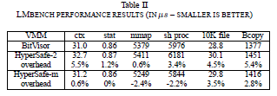
Performance Overhead
Performance hit of about 5% (3% for –m)
HyperSafe-m is HyperSafe with some optimization

Slide 18
Contributions
A framework with two techniques to protect hypervisors
  Protect the memory space
  Protect control flow
Actually did it vs. just talk about what is possible

Slide 19
Weakness
Not actionable for IT security groups
  I can’t get it and use it
  No commercial or open source plans
Not clear to me on how you deploy HyperSafe
  Assumption is modify the source code of hypervisor software and kernel and recompile it

Slide 20
Improvement
Get it in the field
  Partner with hypervisor vendors
  VMware would be a big one

