Slide 1
Hey, You, Get Off of My Cloud: Exploring Information Leakage in Third-Party Compute Clouds
For the ACM Conference on Computer and Communications Security - CCS 2009
Thomas Ristenpart*, Eran Tromer , Hovav Shacham*, Stefan Savage*
Dept. of Computer Science and Engineering
University of California, San Diego, USA
* Computer Science and Artificial Intelligence Laboratory
Massachusetts Institute of Technology, Cambridge, USA
Presented by Bo Sun

Slide 2
Acknowledgement
Paraphrasing of titular authors and using their figures
Quotes from Amazon and Microsoft webpages
  http://aws.amazon.com/ec2/
  http://microsoft.com/Cloud/WindowsAzure
Clip art from Microsoft Office
  http://office.microsoft.com/en-us/images

Slide 3
Outline
Compute Cloud Services
Motivation & Goal
Procedure
  Amazon EC2 vulnerability
Contribution
Weakness
Improvement

Slide 4
Compute Cloud
Client wishes to rent a remote computer resource
Compute Cloud
  Provider grants a virtualized resource
  Many to one (client : physical resource)
  Clients share the physical resource

Slide 5
Compute Cloud (User’s Perspective)
From Amazon’s EC2 website
  “quickly scale capacity, both up and down”
  “pay only for capacity that you actually use”
  “failure resilient applications”
From MS’s Azure website
  “launch [webapps] in minutes instead of months”
  “unencumbered by redundancy, bandwidth or server constraints”

Slide 6
Compute Cloud (Provider’s Perspective)
Efficient & Cheap
  Maximize usage of physical resources
Provides for Users’ Needs
  Dynamic Provisioning
  Ease of deployment via Virtualization
  Ease of backup
So what is bad about it?
  VMs have their own vulnerabilities!

Slide 7
Multiplexing Tenancy (Co-residence)
Multiple “tenants”, single physical server
  Works well if no user is malicious
John Doe’s Virtual Machine
Bob’s Virtual Machine
Physical Server
Trudy’s Virtual Machine

Slide 8
Problem
Trudy is Bob’s Adversary
  Breaks data isolation between users
  Violates Confidentiality
John Doe’s Virtual Machine
Bob’s Virtual Machine
Physical Server
Trudy’s Virtual Machine

Slide 9

Motivation & Goal
Motivation
  Authors fear the compromise of confidentiality within compute clouds
    Medical records, e-commerce (credit cards), etc.
Goal
  Prove the existence of confidentiality breach within EC2
  Suggest countermeasures

Slide 10
Procedure Overview
Placement
  Placing adversary’s VM on the physical machine which hosts the victim’s VM
    Attacker-Victim VM Co-residence Strategy
  Proving Co-residence
Extraction
  Culling confidential information
    Via “Manipulation of shared physical resource”
    “Information Leakage”
    Side channel Attacks

Slide 11
Amazon EC2 (Elastic Compute Cloud)
Uses XEN Virtual Machine Monitor
Each account can run 20 VM instances
VMs have access to many network probing tools
  WHOIS, hping, nmap, wget
  Arbitrary attack code which attacks other guest OS (VM instances)

Slide 12
Amazon EC2 options
Region
  Europe or US
Zone
  Locales which are power-grid isolated
  3 Zones available
Configuration
  Virtual Machine specs
    RAM, CPU, etc.
    Windows, linux, FreeBSD, etc.

Slide 13
Cloud Mapping
Map EC2
  To find any patterns
Surveying External Addresses (WHOIS)
  Three distinct IPs prefixed with /17, /18, /19
    57344 IPs
Internal Addresses
  DNS lookup within EC2 mapped external/internal IPs
    14054 IPs with open port 80, 443
Notes:
Intermediate step was to locate Ips with port 80 or 443 open

Slide 14
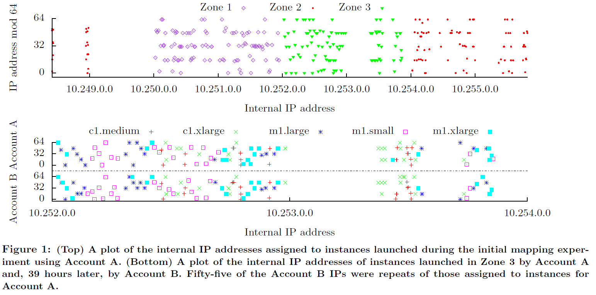
Mapping Continued…
Note coarse clustering

Slide 15
Mapping Significance
Showed that internal IPs were assigned correlates with zone and VM type
Such patterns can be exploited to ensure maximum likelihood of Co-residence
Prevention of mapping
  Remove clustering based on zone & VM type
  Make it harder to map external/internal IPs
    VLANs and bridging

Slide 16
Co-residence Proof
Matching Dom0 IP
  Special-privileged “first guest OS”, which manages routing of traffic to other guest VMs
  Using two traceroute to identify
    First hop = attacker instance’s Dom0 IP
    Last hop = victim instance’s Dom0 IP
      Done on a different physical machine

Slide 17
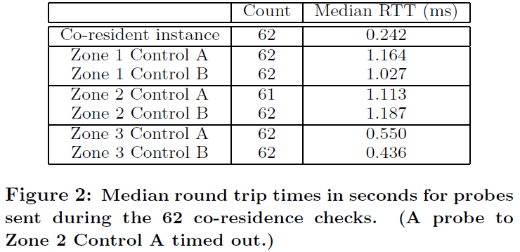
Co-residence Proof
Can also be inferred in other ways
Round trip times
  Lower in
  Co-resident
  instances
Numerically close IPs within 7
  Only 8 VM instances on a physical machine

Slide 18
Co-residency Obfuscation
Dom0 does not respond to traceroute
Do statically assign internal IPs
Non-network based checks still persist
  Co-residence based on observing CPU load
    PRIME+TRIGGER+PROBE
    Estimate based on anticipated cache eviction
  Observation of host CPU load after an attacker triggers heavy load in victim

Slide 19
Co-residency Strategy
Naïve
  Infer likely victim zone & config type from cloud map
  Spawn many instances within a time frame and hope for co-residency
  Of 1686 victims, 141 successful co-residencies using 1785 attacker instances
    8.4% coverage

Slide 20
Co-residency Strategy
Placement Locality Abuse
Instances created with small time-gap exhibit high chance of being on the same physical machine
  Wait for a known victim instance to disappear
  Then wait for it to appear again
    Immediately spam attacker instances

Slide 21
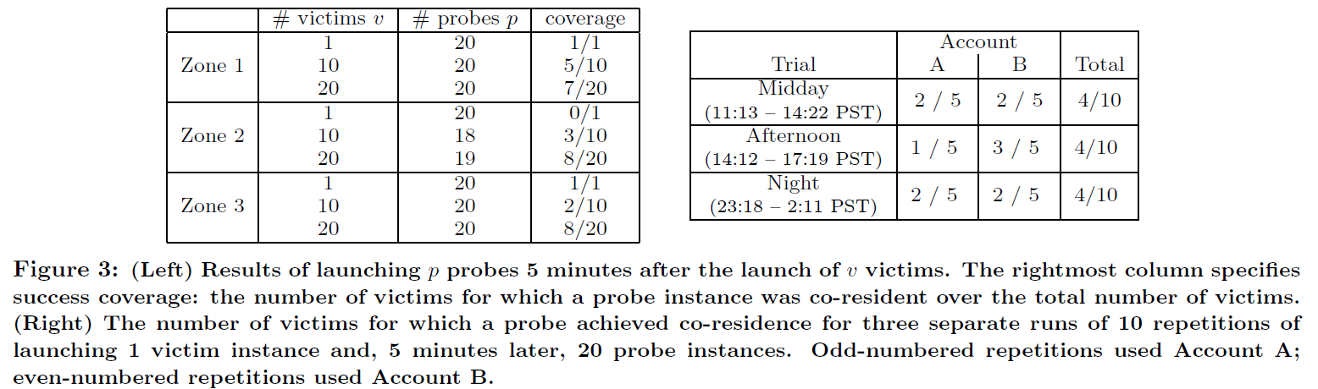
Co-residency Strategy
Much better coverage using time locality
Time of day did not effect coverage

Slide 22
Anti-Placement Strategy
Authors suggest letting users control where their VM instances run
Users decide who to share hardware with
Users pay extra for loss of efficiency

Slide 23
On Leakage of Data
Just from Cache-correlated CPU load
  Covertly monitor web traffic of victim
  Estimate key-stroke timing
    victim inputting SSH password becomes insecure
Other sophisticated attacks exist, but low risk
  Cross-VM cryptographic attacks
  Authors defers to references

Slide 24
Contribution
Identified security risk of EC2
  Amazon will work harder to ensure security
Tied together exploits using
  network base tools
  CPU load estimation
Addressed legal, ethical concerns

Slide 25
Weakness
Authors suggest generalizability of their approach, but procedure is tailored-made for EC2
Cache-based covert communication is a digression
Published information that might be useful for EC2 rivals

Slide 26
Improvement / Extension
Do the same for MS Azure, or other service to ensure the claim that this approach is generalizable
Re-examine “fundamental” risk of resource sharing and come up with more clever solution

Slide 27
Thank you!
Questions?

Slide 28
References
Thomas Ristenpart, Eran Tromer, Hovav Shacham, and Stefan Savage. Hey, You, Get Off of My Cloud: Exploring Information Leakage in Third-Party Compute Clouds. Computer and Communications Security - CCS 2009

