Slide 1
Dude, where’s that IP? Circumventing measurement-based IP geolocation
Presented by: Steven Zittrower

Slide 2
Authors:
Phillipa Gill, Yashar Ganjali, David Lie (University of Toronto) & Bernard Wong (Cornell University)

Slide 3
USENIX Security ‘10 Proceedings of the 19th USENIX Conference on Security

Slide 4
IP Geolocation
Determine location of computer based on its IP
Methods
  Passive methods
  Delay-based techniques
  Topology-aware techniques
Hulu, BBC iPlayer, Pandora, mlb.tv, Google Search Results
Banks, Facebook, Gmail
Internet Gambling

Slide 5
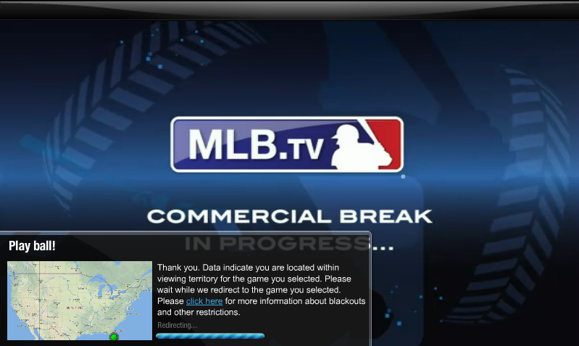
Examples, Access Control

Slide 6
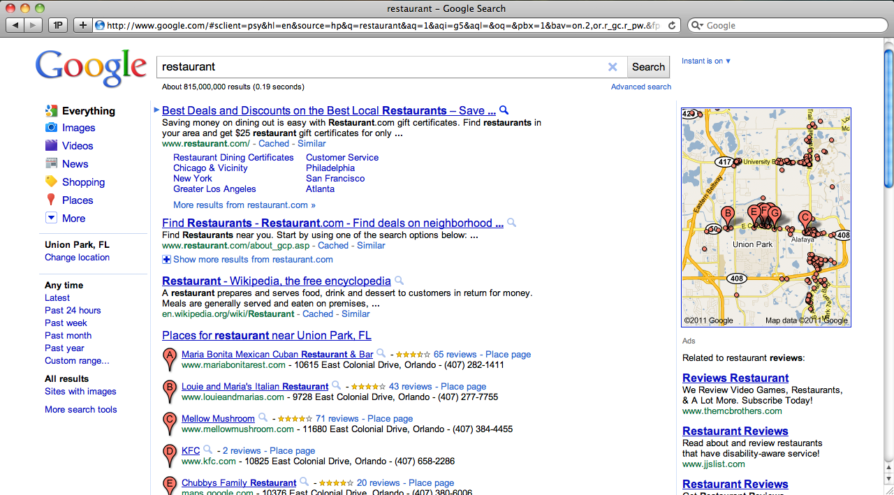
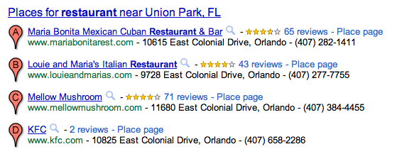
More examples, Custom Content
Geolocation Based Search Results

Slide 7

Examples in Cloud Computing
Regional restrictions of cloud servers
Virtual Machines required by law or SLA to be in certain physical locations
Malicious providers incentivized to circumvent geolocation

Slide 8
Passive Approaches for Location
WHOIS
  Database of server information
Commercial databases
  Quova
  MaxMind
Arbitrarily updated
Proxies can circumvent databases

Slide 9
Active Approaches
Measurement Based
  Use known landmarks
  Calculate time delays and traffic paths
  Algorithms approximate location
Combination of passive and active methods

Slide 10
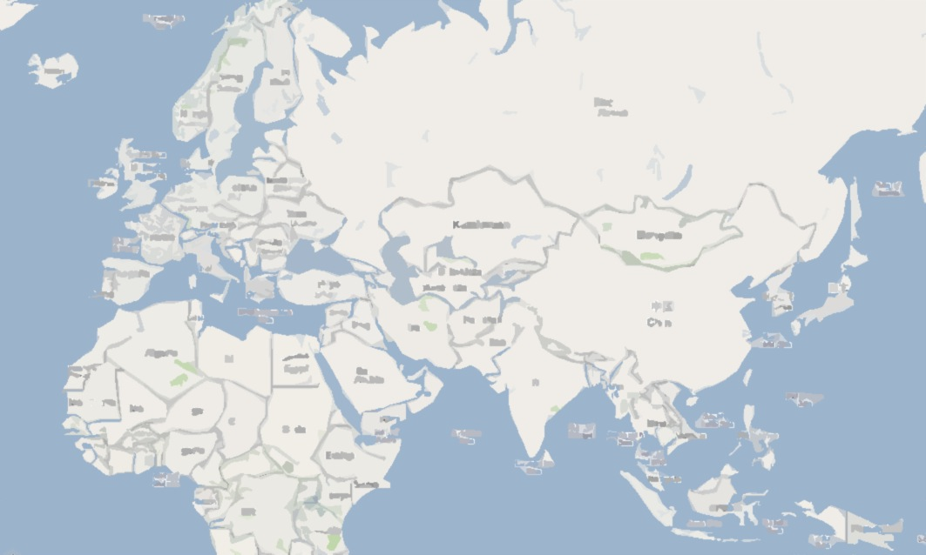
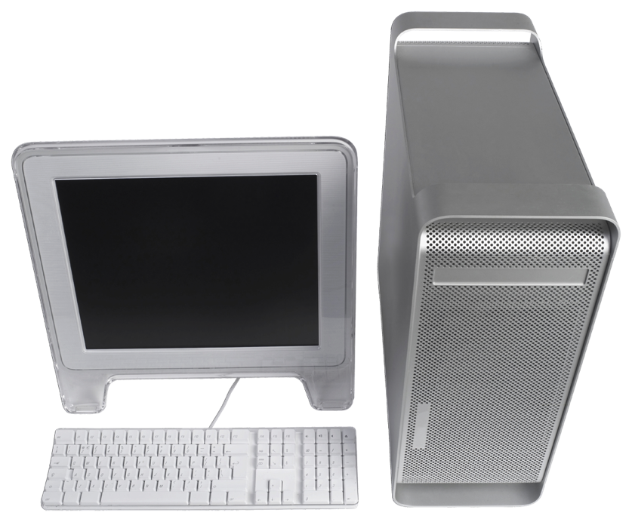

Delay-based Geolocation
ping
ping
ping
ping

Slide 11
Delay-based Geolocation

Slide 12
Topology-aware Geolocation
Knows some routing information (traceroute)
Uses RTT and topology to better determine location
Delay-based geolocation assumes direct routes
ping
ping

Slide 13
Effectiveness of Approaches
Courtesy of Dude, where’s that IP…
Class | Algorithm | Average Accuracy (km)
Delay-Based | GeoPing | 109-150
 | CGB | 78-182
 | Statistical | 92
 | Learning-based | 407-449
Topology-Aware | TBG | 194
 | Octant | 35-40 (median)
Other | GeoTrack | 156 (median)

Slide 14
Attacks and Adversaries
Simple Adversary
Sophisticated Adversary
Tampers with RTT times
Delays packets from certain landmarks
Can only increase RTT
Models a home user
Can fake routes and paths
Owns several IP addresses/gateways
Constructs paths to confuse topology-aware geolocation
Adds delays in-between hops on path
Models a cloud service provider
Notes:
Knows the geolocation algorithm
Assumption: network measurements reach target

Slide 15
Delay Adding Attacks (Simple Attack)

Slide 16
Limits and Downsides
Cannot move a target to a forged location that’s in the same region of the landmarks
  Cannot decrease RRT’s
Detection is evident by large intersection areas
Limited accuracy
Poor against topology-aware geolocation

Slide 17
50 Landmarks Used For Evaluation

Slide 18
Each Landmark Moved To “Forged” Location

Slide 19
Accuracy of Attacks
Courtesy of Dude, where’s that IP…

Slide 20
CDF of Region Sizes
Courtesy of Dude, where’s that IP…

Slide 21
Topology-Aware Geolocation
Determines delay of each intermediate router in path
Estimates location of each stop
Limits impact of circuitous end-to-end paths
Better estimates of target location
Very effective in detecting Simple attacks

Slide 22
Sophisticated Attacks vs. Topology-Aware Geolocation
Adversary has geographically distributed gateway routers in its network
Delay routes along path instead of just the last node
Paper’s Claim: Theoretically with three or more geographically distributed gateway routers an adversary can move a target to an arbitrary location!

Slide 23
Accuracy of Attack
Courtesy of Dude, where’s that IP…

Slide 24
CDF of Region Sizes
Courtesy of Dude, where’s that IP…
Very little increase in intersection sizes

Slide 25
Conclusions
Current Geolocation methods are highly susceptible to attacks
Topology-Aware Method
  Better at locating non-malicious users
  Much worse at detecting malicious attackers
Simple attacks good enough to get within target country
Sophisticated attacks with topology-aware geolocation can relocate to specific states
Need for better location based detection
Better algorithms for detection of malicious users

Slide 26
Contributions
Evaluated current methods of geolocation
Devised two separate attacks for each method (simple & sophisticated)
Suggested methods for detection of attacks

Slide 27
Weaknesses
No data on frequency of attacks (are these attacks common?)
Evaluation nodes all within North America (only one outside of the USA)
Limited explanation on Best-Line vs. Speed of Light attacks

Slide 28
Improvements
Provide suggestions for ways to prevent attacks
Better analysis on which algorithms within each class work the best for detecting malicious users

Slide 29
References
Dude, where’s that IP? Circumventing measurement-based IP geolocation
mlb.tv
Google
Amazon EC2

