Slide 1
“Analysis of Social Network based Sybil Defenses”
Authors:
B. Viswanath, K. Gummadi, A. Post, A. Mislove
Conference:
ACM SIGCOMM 2010
Presented by:
M. Faisal Amjad

Slide 2
Acknowledgements
The tables and graphs have been taken from the paper "An Analysis of Social Network-Based Sybil Defenses", Viswanath et al., SIGCOMM 2010.
Cliparts from MS Office

Slide 3
Outline
Introduction to Sybil attack
Sybil Defense mechanisms
Performance comparison of generated node Ranking
Performance comparison for detection of Sybils
Limitations of Sybil Defense schemes
Contribution, weaknesses & Improvements

Slide 4
Introduction to Sybil Attack
Internet
traffic
Owns
www.

Slide 5
Introduction to Sybil Attack
Reputation System
Internet
Vote
traffic
www.

Slide 6
Introduction to Sybil Attack
Sybils
Reputation System
votes
Internet
traffic
www.

Slide 7
Sybil Defense Mechanisms
Many social networks, p2p networks and reputation systems exist
Attacker can arbitrarily create Sybil identities
Two ways to determine the trust level of a social network entity
  Centralized i.e. through a trusted certification authority
  Defense mechanisms to determine trust level of an entity
Creating connections from all Sybils to many non-Sybils is almost impossible
Results in poor network connectivity in case of Sybils.

Slide 8
Sybil Defense Mechanisms Covered
Sybil-Guard
Sybil-Limit
Sybil-Infer
SumUp

Slide 9
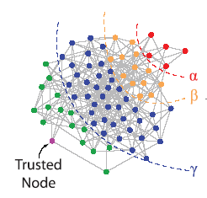
Creation of Network Partitions
One way to evaluate performance of Sybil defense schemes is to treat them as black boxes
Output of these schemes creates partitions in the network graph

Slide 10
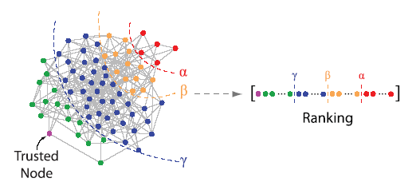
Derivation of node Ranking
Sybils and non-Sybils can be told apart with the help of node ranking which is based upon proximity to trusted node
Sybils cannot have many connections to high ranking nodes

Slide 11
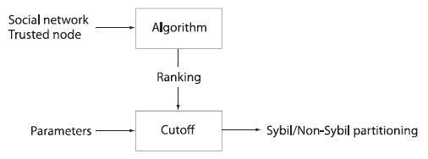
Reduction of Sybil Defense Schemes

Slide 12
Comparison of Generated Rankings

Slide 13
Comparison of Generated Rankings
Two metrics are used to compare rankings generated by the Sybil defense schemes
Mutual Information: measures the similarity of two partitionings of a set. Values Range 0 – 1.
  0 = no correlation
  1 = perfect match
Conductance: measures quality of communities within large networks. Values Range 0 – 1. lower numbers indicate stronger communities.
A synthetic network and real world social networks are used to compare rankings

Slide 14
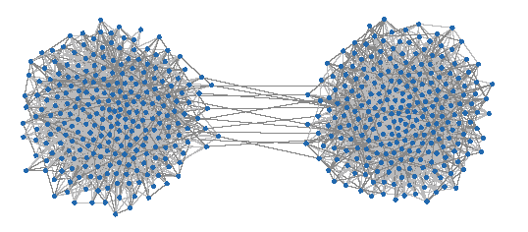
Comparison of Generated Rankings
(Synthetic Network)
Synthetic network generated using Barabasi-Albert Preferential attachment model
The network consists of two densely connected communities of 256 nodes each, connected by a small number of edges

Slide 15
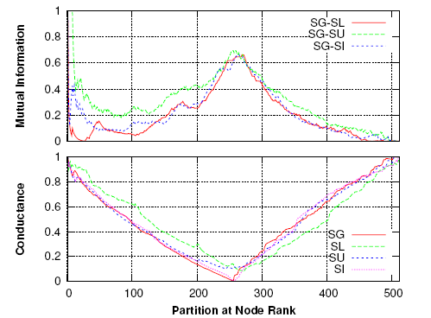
Comparison of Generated Rankings
(Synthetic Network)
The similarity of generated partitions and quality of communities is max at partition size of 256

Slide 16
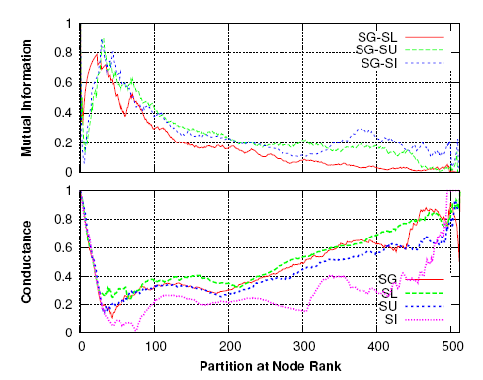
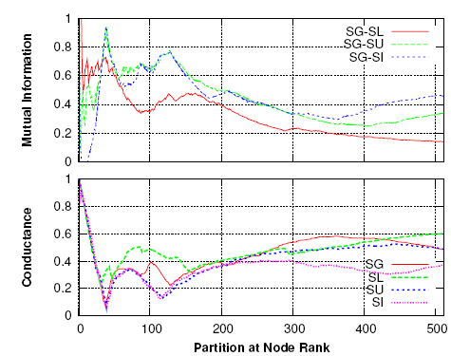
Comparison of Generated Rankings
(Real World Networks)
Facebook Network
Astrophysics Network
Nodes that are tightly connected around a trusted node are more likely to be ranked higher
When there are multiple nodes that are similarly well connected to the trusted node are often ranked differently in different algorithms

Slide 17
Application of Community Detection Algorithms

Slide 18
Applying Community Detection (CD) Algorithms
There are numerous approaches to detect communities and the quality of these communities
The authors use their own community detection algorithm to evaluate its performance in detecting Sybils
Metric used to show Sybil detection capability is called Area Under the Receiver Operating Characteristic (ROC) curve or A’
A’ is the probability that a Sybil defense scheme ranks a randomly selected Sybil node lower than a randomly selected non-Sybil node.

Slide 19
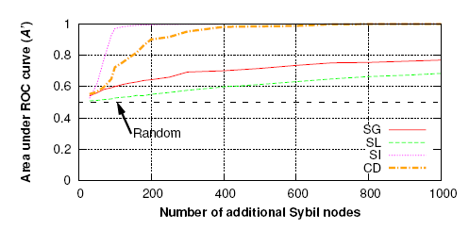
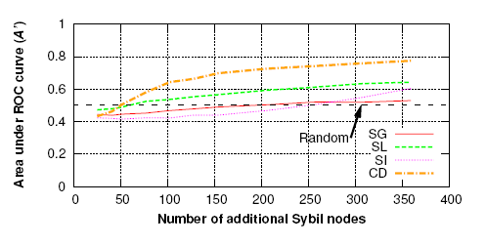
Performance comparison for Sybil Detection
Synthetic Network
Facebook Network

Slide 20
Limitations of Sybil Defense Schemes

Slide 21
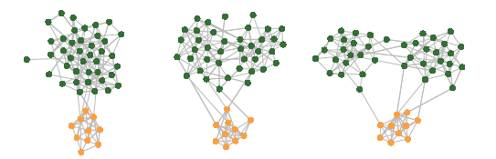
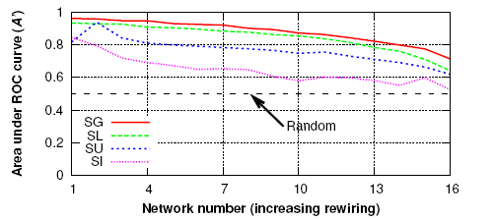
Limitations of Sybil Defense - Impact of Social Network Structure
Synthetic Network

Slide 22
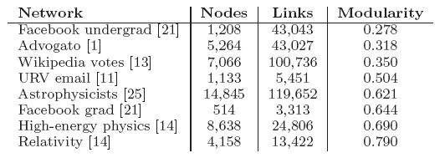
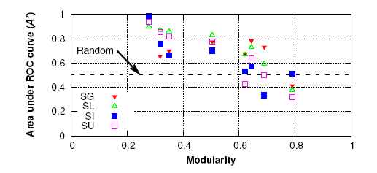
Limitations of Sybil Defense - Impact of Social Network Structure

Slide 23
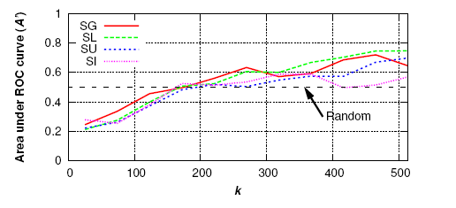
Limitations of Sybil Defense – Targeted Sybil Attacks
Sybil defense schemes assume that attackers (Sybils) establish links to randomly selected nodes in the network
To find out the performance of Sybil defense schemes in targeted attacks, attackers have more control over their link placement to k nodes closest to trusted node.
As Sybil links get closer to trusted node, Sybil nodes are ranked higher than non-Sybil nodes

Slide 24
Contributions
Shown the working of social network-based Sybil defense systems.
Shown that these schemes degrade in networks with strong communities
Shown that these schemes degrade when Sybils can establish targeted links
Argue that existing Community Detection schemes perform better than Sybil defense schemes
Question the basic assumptions of existing Sybil defense schemes and suggested improvements.

Slide 25
Weaknesses
NO description about the experimental setup used in the study
Authors have shown that the Sybil defense schemes are sensitive to level of community structure but did not explain why

Slide 26
Improvements
Sybil detection could leverage information other than mere connections to other nodes.
Patterns such as location, duration, time and nature of activities, even passwords and PIN codes could be incorporated to find Sybil identities

Slide 27
Questions

