Slide 1
All Your iFRAMEs Point to Us
Authors:
Niels Provos Moheeb Abu Rajab
Panayiotis Mavrommatis Fabian Monrose
Google Inc. Johns Hopkins University
Presenter: Justin Rhodes

Slide 2
Presentation
All Your iFRAMEs Point to Us
Presented at: 17th USENIX Security Symposium
San Jose, California
July 28 – August 1, 2008
Presentation by Justin Rhodes
UCF MS Digital Forensics

Slide 3
Overview of paper
Detailed study of drive-by downloads
Finding malicious URLs
Aspects of the drive-by downloads problem
Browsing habits vs. exposure to malware
Techniques used to distribute malware
Use URLs collected over 10 months to see which are malicious

Slide 4
What is a drive-by download?
From Wikipedia:
Downloads which a person authorizes, but doesn’t know the consequences.
Any download that happens without the user knowing.
From the paper:
Caused by URLs that attempt to exploit their visitors and cause malware to be installed and run automatically.

Slide 5
Web-based attacks
Traditional scanning attacks are being replaced
Exploitation on the web
Used to distribute malware
Web-based malware infection follows a pull-based model.

Slide 6
Pull-based infection model
The victim directly causes their own infection.
Visiting the site which causes the attack.
Could happen from a “trusted” site that has been hacked.
Malicious Code
Trusted
Site
User

Slide 7
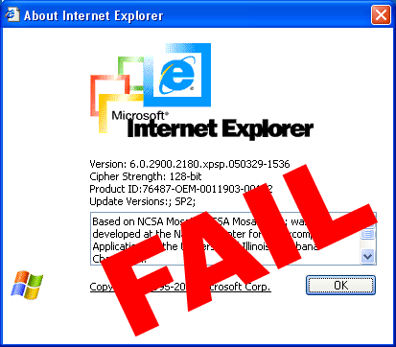
Web-malware
Social engineering techniques to entice visitors to download or run malware.
Targets browser vulnerabilities which will automatically download and run.

Slide 8
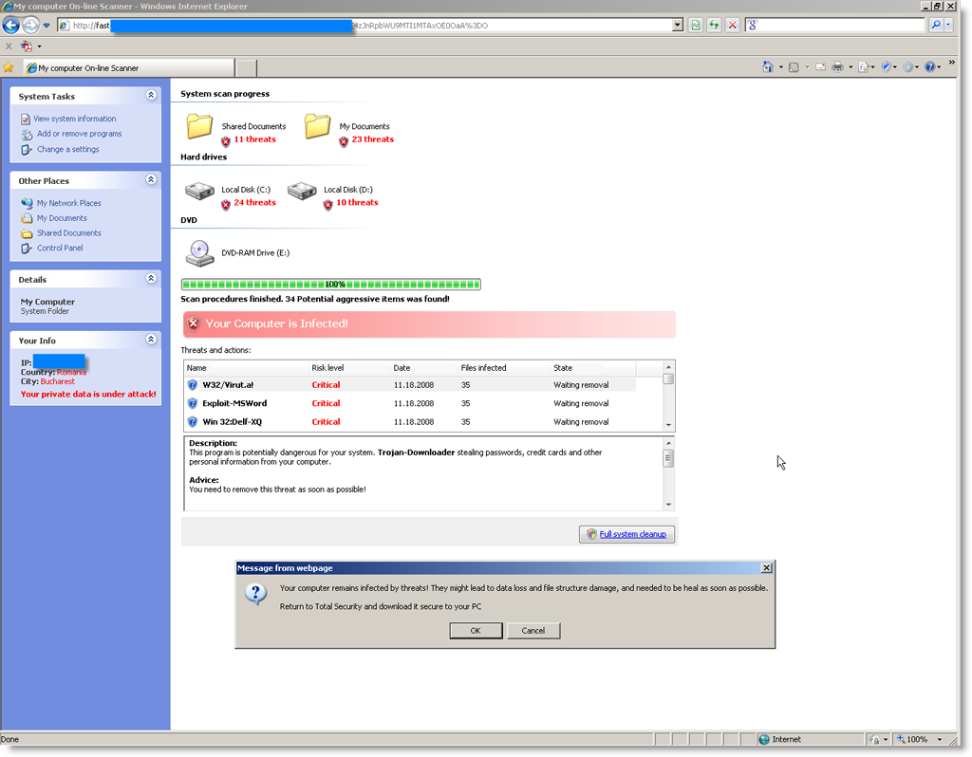
Example of social engineering technique

Slide 9
Common techniques for attackers
Remotely exploiting vulnerable network services
Has become less successful and less profitable
NATs and firewalls
Lure web users to connect to compromised malicious servers.
Deliver exploits targeting the vulnerabilities in web browsers or their plugins.

Slide 10
Common techniques for attackers
Exploit web servers with scripting apps
phpBB2 or InvisionBoard
Use IFRAMEs to hide injected content
Websites that allow user input
Forums or blogs
Can redirect to malicious URL
<IFRAME SRC=“attack.php" WIDTH=0 HEIGHT=0></IFRAME>
MAIN GOAL: Redirect to malicious URL

Slide 11
How typical infection occurs
Malicious script is hidden inside of an IFRAME
Exploit script in most cases is written with javascript which targets browser or plugin.
Attackers can evade detection with obfuscated javascript

Slide 12
Primary Objective
Identify malicious URLs and help improve safety on the internet.
Pre-processing starts with large web repository from Google.
Identify the URLs that trigger drive-by downloads
Too expensive because of billions of URLs
Light-weight techniques extract URLs that are more likely to be malicious

Slide 14
Verification Process
Verify if a chosen URL is malicious
Running Windows images on virtual machines
Using an unpatched version of IE
Starts a browser and visits URL
Run VM for 2 minutes and monitor the system
Create a score for each URL
# of created processes, # of registry changes, and # of file system changes

Slide 15
Verification Process
On average, one million URLs go through the verification process daily.
25,000 of these are flagged as malicious
Next step: Find out where these malicious URLs are coming from.

Slide 16
Malware Distribution Network
Set of malware delivery trees from all the landing sites that lead to a particular malware distribution site.
Inspecting the Referer header from the HTTP requests.

Slide 17
Prevalence of Drive-by Downloads
Data Collection Period | Jan – Oct 2007
Total URLs checked in-depth | 66,534,330
Unique suspicious landing URLs | 3,385,889
Unique malicious landing URLs | 3,417,590
Unique malicious landing sites | 181,699
Unique distribution sites | 9,340

Slide 18
Fraction of incoming search queries to Google that return at least one URL reported as malicious.

Slide 19
Top 5 Hosting Countries
Dist. Site hosting country | % of all dist. Sites | Landing site hosting country | % of all landing sites
China | 67% | China | 64.4%
United States | 15% | United States | 15.6%
Russia | 4% | Russia | 5.6%
Malaysia | 2.2% | Korea | 2%
Korea | 2% | Germany | 2%
Shows poor security practices by web admins.
Also distribution networks are highly localized within
common geographic boundaries.

Slide 20
Impact of browsing habits
Kind of a no-brainer…
Search results for “adult” related queries will result in more malicious URLs as opposed to “home/garden” related queries.

Slide 21
Malicious Software Injection
Web server compromise
Vulnerabilities in old versions of Apache and PHP
3rd party contributed content
Blog posts
Drive-by downloads via Ads

Slide 22
Drive-by Downloads via Ads
Ad syndication
Advertiser sells advertising space to another advertising company and they sell it to another, etc…
The more syndication, the better chances of malicious code.
2% of the landing sites were delivering malware from unsafe Ads

Slide 23
Drive-by Downloads via Ads
Ads appear on thousands of websites simultaneously…get removed quickly

Slide 24
Example
United States
Dutch radio station website
Germany
Ad
Ad
Ad
Netherlands
Malware
Austria
Ad
Netherlands
Redirect
Ad

Slide 25
Malware Distribution Infrastructure
Distribution sites can grow to have over 21,000 landing sites.
Makes them easier to detect, but they also can infect more users faster.
Roughly 45% of their detected malware distribution sites used only a single landing site at a time.
Slip under the radar and avoid detection
Malware is shared between MDS

Slide 26
Post Infection Impact
What are these drive-by downloads doing?
Running Processes
Registry Changes
BHO – Browser helper object with privileges
Preferences – home page, search engine
Security – firewall settings, auto updates
Startup – malware stays after reboot
Category | BHO | Preferences | Security | Startup
URLs % | 6.99% | 23.5% | 36.18% | 51.27%

Slide 27
Conclusion
Concerned for the safety of browsing the web
Attempt to fill the gaps by providing a look from several perspectives
Found several relations between MDS and networks
Syndicated Ads
State-of-the-art Anti-Virus engines lack the ability to protect drive-bys

Slide 28
Contribution
Google.com search queries over a period of time
Over 66 million URLs in 10 months
Data collection infrastructure
Acknowledgments:
Oliver Fisher, Dean McNamee, Mark Palatucci, and Ke Wang
Google’s malware detection infrastructure
Funded by NSF grants
CNS-0627611 & CNS-0430338

Slide 29
Weakness
Some research that was done showed results that should already be known
Search terms which result in more malicious URLs
Give no solution to what can be done

Slide 30
Improvement
What can be done to add security?
Google’s end for supplying “clean” URLs
Fixing advertising on the web
iAds – Apples approach to ads in apps
Google Ads
Limiting the number of redirects

Slide 31
Any Questions?

