Slide 1
Scene Tagging: Image-Based CAPTCHA Using Image Composition and Object Relationships
Peter Matthews, Cliff C. Zou
University of Central Florida
AsiaCCS 2010

Slide 2


CAPTCHA
Challenge-response tests that can be easily solved by a human user, but difficult to solve by automated programs
Play an important role in protecting Internet services from automated abuses
  Mass user account registration
  Automated posting of spam comments to blogs, wikis, forums
  Abuse of online polls / recommendation services

Slide 3
Problems with Text-based CAPTCHA
Vulnerability to attack has been repeatedly demonstrated by computer vision researchers
  Microsoft (2008)
  Yahoo (2004)
  ReCAPTCHA (2009)
Stronger and more elaborate distortions have been utilized
  Result: Higher user error rates and user frustration

Slide 4
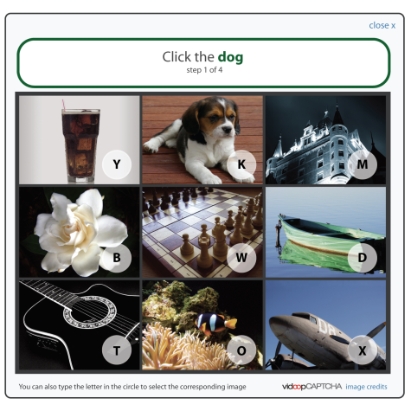
Image-Based CAPTCHA
Identifying the subject of a presented image is (generally) difficult for automated systems
Challenge 1: Construction of a large, correctly-tagged database of images
Challenge 2: Known image database based attack
Notes:
Microsoft Asirra use cat/dog for captcha, but can be defeated by machine learning.

Slide 5
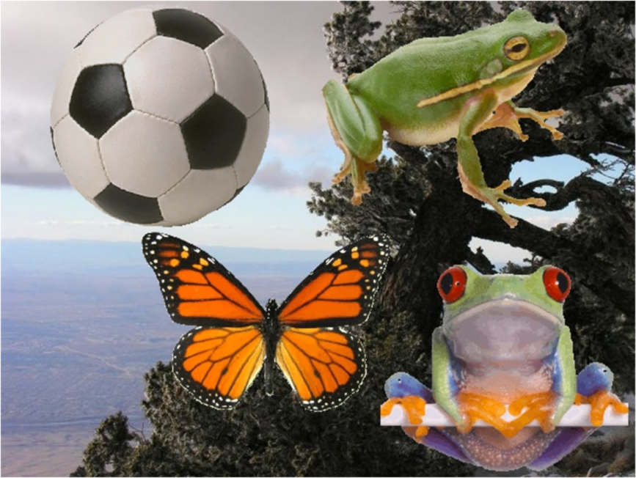
Scene Tagging―A New Form of Image-based CAPTCHA
Scene image via composition of a background image and multiple object images
  Results in a very large space of possible composite images without requiring a large image database
Ask user to answer relationship between several objects in the image
  Requires successful recognition of most of the object images present in order to answer correctly
  Require to understand the relationship based questions

Slide 6
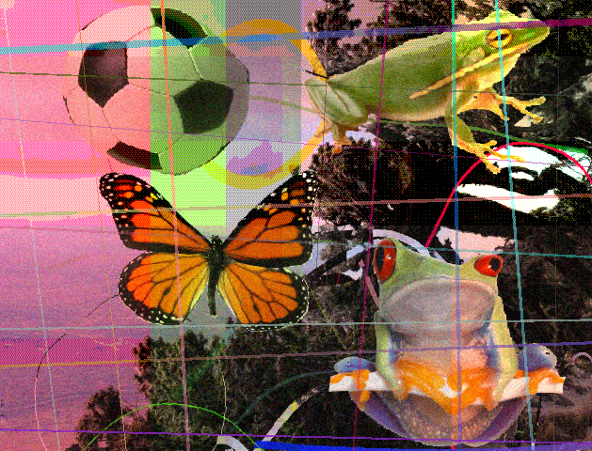
Scene Tagging―A New Form of Image-based CAPTCHA
A carefully designed sequence of systematic image distortions is used to make it difficult for automated attacks to determine the quantity, identity, and location of the objects present

Slide 7
Question Types
1. Relative Spatial
Location Questions
E.g. “Please click the center of the object to the upper-left of the butterfly.”

Slide 8
Question Types
2. Object Quantity
Questions
E.g. “Please select the name of the object that is shown twice on the image.”

Slide 9
Question Types
3. Object Association
Questions
E.g. “Please select the name of the image object that is least like the others present.”

Slide 10


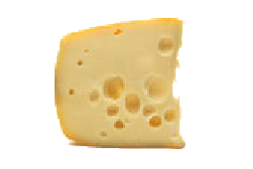
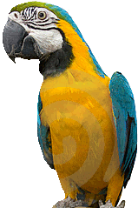
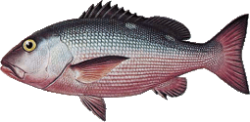
Scene Image Creation / Distortion Sequence
Initial background, object images

Slide 11

Background Clutter, Global Color Shift
Adds regions of interest to flat background area, makes it more difficult to perform object isolation

Slide 12
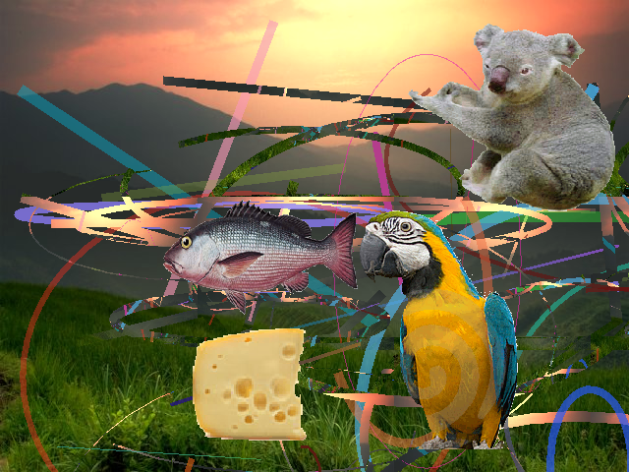
Objects Scaled, Overlaid
Independent dimensional scaling distorts relationships between object features

Slide 13
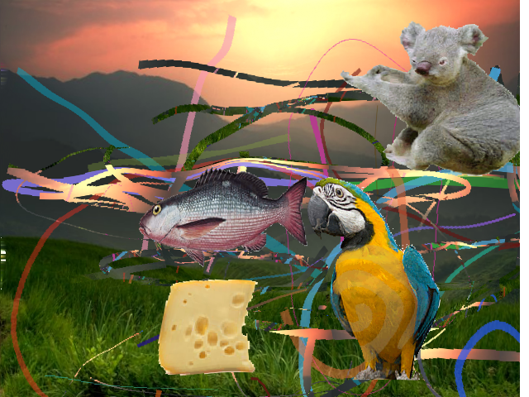
Mesh Warping
Warping image in a non-linear fashion further distorts relationships between image features

Slide 14
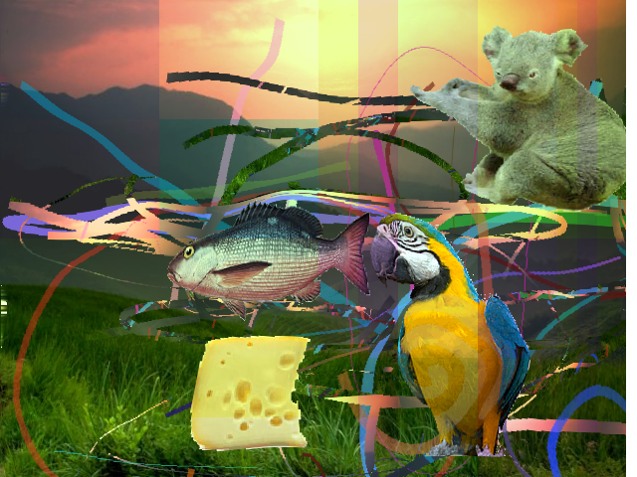
Localized Color Shifting
Impacts local color distribution, breaks up object color segments, introduces image discontinuities

Slide 15
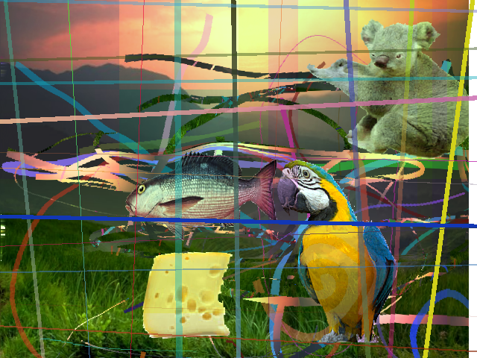
Semi-Regular Clutter
Works to obscure object shape, edges, segments

Slide 16
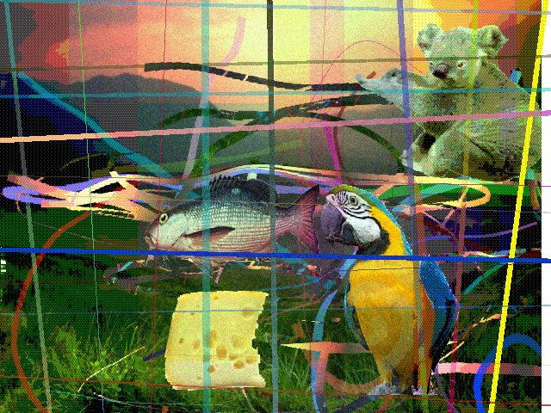
Localized Texture Effects
Dithering, quantization, noise obscures object textural information

Slide 17
Automated Attack Testing
Three likely object recognition techniques tested
One based on matching of pixel color values
  Object template matching via measuring the normalized pixel-wise difference (PWD)
Two advanced methods that look for correlation between object images and the scene image with regards to various types of distinctive image locations
  Scale Invariant Feature Transform (SIFT)
  Speeded Up Robust Features (SURF)

Slide 18
Automated Attack Testing Results
Set | Distortion Set Applied
A | No distortions, objects are placed on flat background
B | Object Scaling, mesh warping
C | Global color shifting, randomized clutter, localized color shifting, semi-regular object clutter
D | Combination of the distortions of set B and C
E | Combination of the distortions of set E and localized texture effects

Slide 19
User Study
20 participants recruited on UCF campus
Each participant answered an average of 65 scene tagging questions
Results were par with reported text CAPTCHA user success rates
Response Format | Multiple Choice | Image Point Selection | Overall
User Success Rate | 0.979 | 0.966 | 0.975

Slide 20
User Response Time

Slide 21
Future Work
Continue preliminary work using scene tagging concepts with the automatic generation of scene images using 3-D models and environments
  Automated 3-D object recognition very difficult due to variations in pose, lighting, etc.
  Allows us to use less intrusive image distortions and produce more attractive images
  Allows us to utilize innovative question types and response formats

