Slide 1
Non-Control Data Attacks Are Realistic Threats
14th Conference of USENIX Security Symposium, 2005
Shuo Chen, Jun Xu, Emre C. Sezer, Prachi Gauriar, and Ravishankar K. Iyer
Brett Hodges
April 8, 2010

Slide 2
Introduction
Emphasis
Control Data vs. Non-Control Data
Security critical non-control data types
Real world application tests
Defense for such attacks
Conclusion

Slide 3
Emphasis of paper
To show that non-control-data attacks are realistic
To show “The viability of non-control-data attacks against real-world applications”
Applicability of Claim:
  “Many real-world software applications are susceptible to non-control-data attacks, and the severity of the resulting security compromises is equivalent to that of control-data attacks.”

Slide 4
Control Data Attack
What is a control data attack?
  Corrupt function pointers, jump targets and return addresses to run malicious code
Common Design for attack
  Hijack the target program
  Inject own code or out-of-context library
  Make a system call to spawn root shell
Most dominate

Slide 5
Non-Control Data Attack
Attacks not corrupting any control data
Corrupt a variety of application data that is critical to program security
  User Identity Data
  Configuration Data
  User Input Data
  Decision-making Data
More rare

Slide 6
User Identity Data
Server applications require remote user authentication
  Applications cache user ID, group ID, and access rights
Overwrite cached information
  First stored in memory -> time used for access control
    Attacker can change identity and perform unauthorized operations
Notes:
-During the user authentication process, the privileged applications cache user-identity information such as user ID, group ID, and access rights in MEMORY WHILE EXECUTING THE AUTHENTICATION PROTOCOL.
**IF the cached information can be overwritten in the window between the time the information is first stored in memory and the time it is used for access control, the attacker can potentially change the identity and perform otherwise unauthorized operations within the target system.**

Slide 7
Configuration Data
Site specific configuration files
  i.e., Apache web server
    “httpd.conf” file
CGI-BIN path directory
  Preselected lists of “trusted” programs
Overwritten through memory corruption vulnerability
  Attacker can bypass the ACL defined
Notes:
-The administrator can specify locations of data and executable files, ACL policies for files and directories, and other security related parameters.
-The server application processes the config files to initialize internal data structures at the beginning of execution.
-At runtime, these data structures are used to control the behaviors of the application and rarely change once the server enters
the service loop.
-So, CORRUPTING the configuration data structures allows the attacker to change and even control the behaviors of the target application.
***
-In this study they focus on the FILE PATH CONFIGURATION INFORMATION
-The FILE PATH DIRECTIVES define where certain data is to be located so the server can find them at runtime.
-In the case of a web server, the CGI-BIN path directive is not only used to located the CGI programs, but it also has a pre-selected list of “trusted” programs in the specific directory that can be ran. So, if it is not on the list, the web server will refuse to run it.
**If the configuration data can be overwritten through memory corruption vulnerabilities, an attacker can bypass the access control policy defined by the system administrator.**
TERMS:
-ACL: Access Control List -> A list of permissions attached to the object
-CGI: Common Gateway Interface -> is a standard for running executables on the server for data processing.

Slide 8
User Input Data
Input validation
After validation altering steps:
  1.Use a legit input to pass the validation checking
  2. Alter the buffered input data to become malicious
  3. Force the application to use the altered Data
Time Of Check to Time Of Use attack
Notes:
-Changing the user input is another way to launch a successful NCD attack
-Input validation is a critical step in many applications to guarantee intended security policies.
**IF user can be altered after the validation step, an attacker would be able to break into the system. They used the follow steps:
1.use a legit input to pass the input validation checking
2.alter the buffered input data to become malicious
3. force the application to use the altered data
This attack is also called a TOCTTOU (Time Of Check to Time of Use).
->Using legit data to pass security checkpoint
->then force the application to use corrupted data that it thinks is legit

Slide 9
Decision-Making Data
Network server applications use multiple steps for user authentication
  Rely on several Boolean values
Corrupt the value of the final decision-making data
  Will influence the eventual critical decision
Notes:
-Decision-making routines rely on several Boolean values to reach a final verdict.
-No matter how many steps are involved to authenticate you eventually will have to get to a conditional branch instruction saying yes or no.
***An attacker can corrupt the value of these final decision-making data to influence the eventual critical decision

Slide 10
How does it work?
Manual source code analysis needed
Attackers use known exploits to overwrite the Non-Control Data
  Format string vulnerabilities
  Heap overflow
  Stack buffer overflow
  Integer overflow

Slide 11
Format String Attack against User Identity Data
Goal: To construct an attack against user identity data that can lead to root privilege compromise without injecting external code.
WU-FTPD FTP server
The Site Exec Command Format String Vulnerability
Notes:
Goal: To construct an attack against user identity data that can lead to root privilege compromise without injecting external code.
-The WU-FTPD FTP server is very widely used.
-The SITE EXEC COMMAND FORMAT STRING VULNERABILITY is one that can result in malicious code execution with root privilege.

Slide 12
Attempt #1: Failed
Find data items that if corrupted could allow the attacker to log in to the system
  Login as root without providing correct password
Why?
  The SITE EXEC format string
    Could not change data due to FTPD authentication steps
Notes:
-The first attempt failed because the SITE EXEC format string occurs in a procedure that can only be invoked after a successful user login.
-That means an attacker could not change data that would directly compromise the existing authentication steps in FTPD.

Slide 13
Attempt #2: Success
Overwrite the information source used for authentication
UNIX system user names and IDs stored in /etc/passwd
  Overwrite passwd to give user root
Exploit getdatasock() on specific FTP server
  Escalate seteuid(0)
    Root access
Notes:
In a unix based system:
-user names, user IDs are saved in a file calld /etc/passwd, which is only writable to a root user.
Steps:
1.After a successful login, the effective UID (EUID) of the FTPD process has properly dropped to the user’s UID, so the process runs as an “unpriveleged user”
2.Therefore, the /etc/passwd can be overwritten ONLY if we escalate the privilege of the server process to ROOT PRIVILEGE.
3. Still possible because the real UID of the process is still 0 (Root UID) even after its EUID is set to be the user UID.
4. We want to corrupt a certain data structure so the EUID can be reverted back to 0.
Functions used:
seteuid() -> changes the EUID when necessary
-There are 18 seteuid() function calls in the WU-FTPD source code
getdatasock() -> invoked when a user issues data transfer commands, such as GET and PUT.
-it temporarily escalates its privilege to root using seteuid(0) in order to perform setsockopt() operation.
-it then calls seteuid(pw->pw_uid) to drop the privilege.
seteuid(pw->pw_uid) -> a cached copy of the user ID saved on the heap.

Slide 14
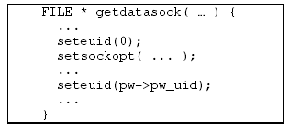
Code
Invoked when a user issues a data transfer command such at “get” or “put
Changes the EUID
Exploit
Cached copy of the User ID saved on the heap

Slide 15
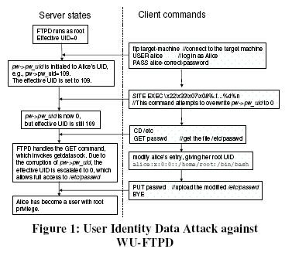

Slide 16
Heap Corruption Attacks against Configuration Data
Goal: to corrupt the CGI-BIN configuration string that will result in root compromise without executing any external code
Attacking the Null HTTPD daemon
  Server name: www.foo.com
  CGI-BIN Path: /usr/local/httpd/cgi-bin
  Request: http://www.foo.com/cgi-bin/bar
  Server executes:
/usr/local/httpd/cgi-bin
/bar
Notes:
-Memory corruption vulnerabilities on an HTTP daemon and a Telnet daemon allow configuration data attacks to succeed in getting root shells, if these daemons run as root.
Attacking the Null HTTPD
-Corrupting the CGI-BIN configuration string can result in root compromise without executing any external code.
-Remember, the CGI-BIN directive restricts users from executing programs outside the CGI-BIN
-A clients URL requesting the execution of a CGI program is always relative to the CGI-BIN configuration.
-Assume:
the path of server -> “www.foo.com is /usr/local/httpd/cgi-bin”
Request of URL -> “http://www.foo.com/cgi-bin/bar” is processed, the HTTP server prefixes CGI-BIN to bar and executes the file /usr/local/httpd/cgi-bin/bar on the servers file system
-Figure 2 shows the attack process, which overwrites CGI-BIN configuration so that the shell program /bin/sh can be started as a CGI program.

Slide 17
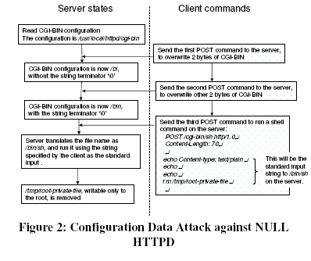
Heap corruption triggered with POST command
Notes:
The heap overflow is triggered when a special POST command is received by the server.
**Due to the nature of heap corruption vulnerability, an attacker usually can only precisely control the first two bytes in the corrupted word at a time to avoid segmentation faults.
-They issue TWO POST commands to overwrite 4 characters in the CGI-BIN configuration so that it is changed from:
“/usr/local/httpd/cgi-bin\0” -> “/bin\0”
-After this corruption they were able to start “/bin/sh” as a CGI program and send any shell command as the standard input to “/bin/sh”.
-Used example of running “rm /tmp/root-private-file”, which is only writable as root. This is the indicator that this attack did work.

Slide 18
Stack Buffer Overflow against User Input Data
Goal: To construct an attack that neither injects code nor alters the return address
HTTPD server : GHTTPD
  Stack buffer overflow in function log()
  Alter the backup value of ESI register to compromise validation checks
Notes:
-Another HTTPD server, GHTTPD, has a stack buffer overflow vulnerability in its logging function.
-The most popular way to exploit the stack buffer overflow is to use the stack-smashing method, which overwrites the return address.
-What the authors did was construct an attack that neither injects code nor alters the return address.
-The attacker only alters the backup value of a register in the function frame of the vulnerable function to compromise the security validation checks and eventually cause the root compromise.

Slide 19
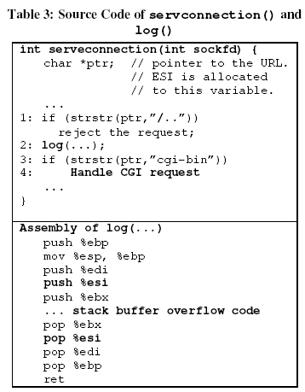
serveconnection() checks to see if “/..” is embedded in the URL
www.foo.com/cgi-bin/../bar
Change value of ESI register to point to URL containing “/..”
You can now run /bin/sh as a CGI program
Notes:
-The stack buffer overflow vulnerability is in the function, log(), where a long user input string can overrun a 200-byte stack buffer.
-They found 3 registers from the caller that were saved on the stack at the entry of function log() and restored before it returns.
-Register ESI -> holds the value of the variable “ptr” of the caller function “serveconnection()”.
-Variable “ptr” is a pointer to the text string of the URL requested by the remote client.
-Function “serveconnection()” checks if the substring “/..”(parent directory) is embedded in the requested URL.
-Without check, a client could execute” www.foo.com/cgi-bin/../bar”, an executable outside the restricted CGI-BIN directory.
-They observe that the function “log()” is called after “serveconnection()” checks the absence of “/..” in the URL, but before the CGI request is parsed and handled.
-This is another TOCTTOU attack.
-They first present a legit URL without “/..” to bypass the absence check, then they change the value of register ESI(value of ptr) to point to a URL containing “/..” before the CGI is processed.
Use the GET command of HTTP protocol to trigger the buffer overflow condition and force the server to run /bin/sh as a CGI program:
send the command GET AA..AA\xdc\....to the server.
-The server converts the command into a null terminated string pointed to by ptr in the function serveconnection().
-The string passes the “/..” absence check of serveconnection() on line 1.
-When a string is passed to log() fucntion in line 2, it overruns the buffer and changes the saved copy of register ESI on the stack frame of log() to 0xbfffd7dc, which is the address of the second part of the GET command.
-when log() returns, the value of the ptr points to this unchecked string, which is a CGI request containing “/..”.
-Succeeding in the check of line 3, the request eventually starts the execution of /bin/sh at line 4 under the root privilege.

Slide 20
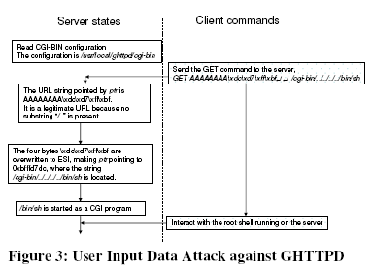
0xbfffd7dc
Notes:
Default configuration of GHTTPD: /usr/local/ghttpd/cgi-bin
Absolute path of /bin/sh on the server: /usr/local/ghttpd/cgi-bin/../../../../bin/sh

Slide 21
Integer Overflow Attack against Decision-Making Data
Goal: Overwrite Boolean variables to get access to target without using password
Attack on SSH server implementation
  SSH Communications Inc.
  OpenSSH.org
Notes:
-An attacker can exploit security vulnerabilities in a program to overwrite such BOOLEAN variables and get access to the target system.
-They study this attack in the context of SSH server implementation
-Integer vulnerability exists in multiple SSH server implementations.
What is Integer Overflow?
-The vulnerability is triggered when an extraordinary large encrypted SSH packet is sent to the server.
-Their goal is to corrupt non-control data in order to log in to the system as root without providing a correct password.

Slide 22
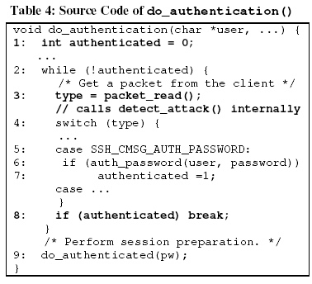
Boolean flag indicates FALSE
Send very large packet here
Integer Flow Vulnerability
Server fails but breaks out of loop
Boolean set to 1 (TRUE) and spawns a shell
Notes:
-Evaluation of the SSH server implementation shows that the integer flow vulnerability is in the function detect_attack().
-detect_attack() detects the CR32 compensation attack against the SSH1 protocol.
-This function is invoked whenever an encrypted packet arrives, including the encrypted user password packet.
-the server relies on do_authentication() to authenticate remote users.
-It uses a while loop to authenticate a user based on various authentication methods.
-The authentication succeeds if it passes one of these methods.
-A stack variable AUTHENTICATED is defined as a Boolean flag to indicate if the user passed the method.
The initial value is 0 (FALSE)
Line 3 then reads the input packet using packet_read(), which internally invokes the vulnerable function detect_attack().
Their attack is to corrupt the AUTHENTICATED flag and force the program to break out of the while loop and go to line 9, where a shell is started for the authenticated user.

Slide 23
However…
Current program does not calculate checksums
  Proof-of-concept attack
  SSH validation does packet checksums
To make attack complete:
  Understand DES cryptographic algorithms

Slide 24
Defenses
Categorized into two classes:
  1. Techniques to avoid having memory-safety bugs in software
  2. Techniques to defeat exploitations of these bugs
Failed Techniques
Better Techniques

Slide 25
Failed Defense Techniques
StackShield
  NCD: no address changes
Intrusion Detection Systems
  NCD: No invocation of system calls
Non-Executable-Memory Protections
  NCD: No code is injected

Slide 26
Techniques and Mitigation
StackGuard & Libsafe can still defeat stack buffer overflow unless it is in the same frame as the overflowing buffer like the GHTTPD example.
Minimize the lifetime of security critical data
  Period of “in between” time where code is changed then executed

Slide 27
Conclusion
The Applicability Claim is empirically validated
Experiments conducting non-control-data attacks against major network server applications
  Each attack exploits a different type of memory vulnerability to corrupt non-control data and gain privileges

Slide 28
Conclusion cont…
NCD are not as straightforward so they require semantic knowledge
  Harder to do so less do it
Control flow integrity may not be sufficient enough for security
Finding a generic solution for NCD attacks is still an open problem

Slide 29
Contribution
Increase awareness that NCD attacks are very important
Provide flaws in current defensive techniques
Offers suggestions to secure critical data better

Slide 30
Weakness / Improvement
Poor organization
Spent more time on their validations
Organize the paper to have a better flow
Explain the main real world tests more in depth
Offer modified code solutions for defensive techniques

