Slide 1

Automated Whitebox Fuzz Testing
P. Godefroid⁺, M. Levin⁺, and D. Molnar*
- Proc. of the NDSS 2008
Presented by
Mahadevan Vasudevan
⁺ Microsoft , *UC-Berkeley

Slide 2
Overview
Fuzz Testing
Whitebox fuzzing
Dynamic Test Generation
Generational Search
SAGE - Architecture
Contributions Summary
Positives
Limitations
Improvements
References

Slide 3
Fuzz Testing
Randomly mutate well-formed input
  blackbox random testing
Test program (software) – large applications
Quick & Cost-effective
Limitation
  Low code coverage
  (e.g. “if (x==10) then”, has only 2³² chance of being executed if x is a random 32-bit input value)

Slide 4
Whitebox Fuzzing
Systematic dynamic test generation (DTG)
Combine fuzz testing and DTG
  Start with a fixed input
  Symbolically execute the program
  Gather input constraints from conditional statements
  Create new inputs using the constraints

Slide 5
Whitebox Fuzzing
Why?
Full program path coverage
  Symbolic Execution
  (e.g. If input is x = 0, then the constraint x ≠ 10, so new input (negation) x = 10 – Path tested)
Automatic – discover & test corner cases

Slide 6
Dynamic Test Generation
void top(char input[4])
{
int cnt = 0;
if (input[0] == ‘b’) cnt++;
if (input[1] == ‘a’) cnt++;
if (input[2] == ‘d’) cnt++;
if (input[3] == ‘!’) cnt++;
if (cnt >= 3) crash();
}
input = “good”
Notes:
6

Slide 7
Dynamic Test Generation
void top(char input[4])
{
int cnt = 0;
if (input[0] == ‘b’) cnt++;
if (input[1] == ‘a’) cnt++;
if (input[2] == ‘d’) cnt++;
if (input[3] == ‘!’) cnt++;
if (cnt >= 3) crash();
}
input = “good”
I₀ != ‘b’
I₁ != ‘a’
I₂ != ‘d’
I₃ != ‘!’
Collect constraints from trace
Create new constraints
Solve new constraints → new input.
Notes:
7

Slide 8
Depth-First Search
void top(char input[4])
{
int cnt = 0;
if (input[0] == ‘b’) cnt++;
if (input[1] == ‘a’) cnt++;
if (input[2] == ‘d’) cnt++;
if (input[3] == ‘!’) cnt++;
if (cnt >= 3) crash();
}
I₀ != ‘b’
I₁ != ‘a’
I₂ != ‘d’
good
I₃ != ‘!’

Slide 9
Depth-First Search
void top(char input[4])
{
int cnt = 0;
if (input[0] == ‘b’) cnt++;
if (input[1] == ‘a’) cnt++;
if (input[2] == ‘d’) cnt++;
if (input[3] == ‘!’) cnt++;
if (cnt >= 3) crash();
}
I₀ != ‘b’
I₁ != ‘a’
I₂ != ‘d’
good
goo!
I₃ == ‘!’

Slide 10
Depth-First Search
void top(char input[4])
{
int cnt = 0;
if (input[0] == ‘b’) cnt++;
if (input[1] == ‘a’) cnt++;
if (input[2] == ‘d’) cnt++;
if (input[3] == ‘!’) cnt++;
if (cnt >= 3) crash();
}
I₀ != ‘b’
I₁ != ‘a’
I₂ == ‘d’
good
godd
I₃ != ‘!’

Slide 11
Key Idea: One Trace, Many Tests
Office 2007 application:
Time to gather constraints: 25m30s
Tainted branches/trace: ~1000
Time per branch to
solve,
generate new test,
check for crashes: ~1s
Therefore, solve+check all branches for each trace!

Slide 12
Whitebox Fuzzing
Limitations of DTG
  Path Explosion
    Does not scale
    Use of function summaries (still not feasible)
  Imperfect Symbolic Execution
    Calls to OS and library functions
    Divergence

Slide 13
Generational Search
bood
void top(char input[4])
{
int cnt = 0;
if (input[0] == ‘b’) cnt++;
if (input[1] == ‘a’) cnt++;
if (input[2] == ‘d’) cnt++;
if (input[3] == ‘!’) cnt++;
if (cnt >= 3) crash();
}
gaod
I₀ == ‘b’
godd
I₁ == ‘a’
I₂ == ‘d’
good
goo!
I₃ == ‘!’
“Generation 1” test cases

Slide 14
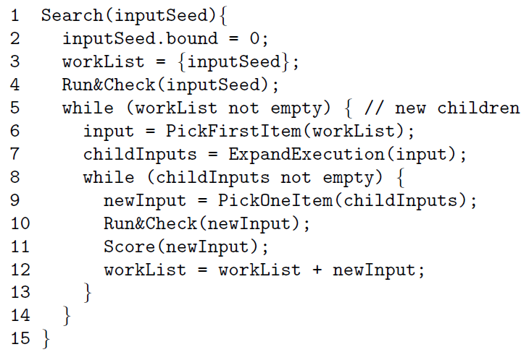
Generational Search

Slide 15
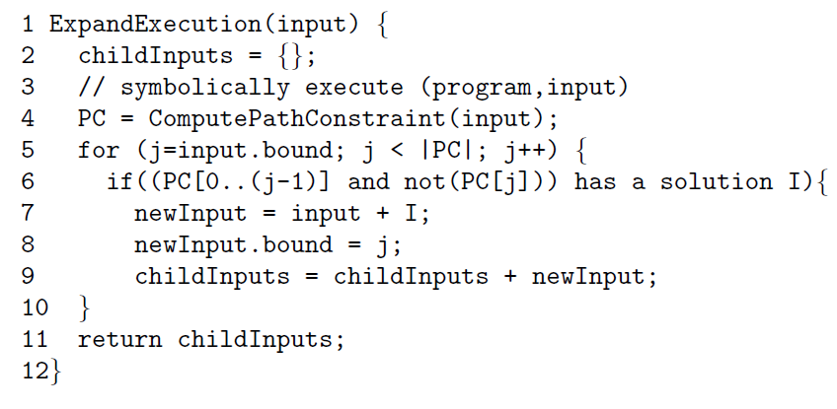
Generational Search

Slide 16
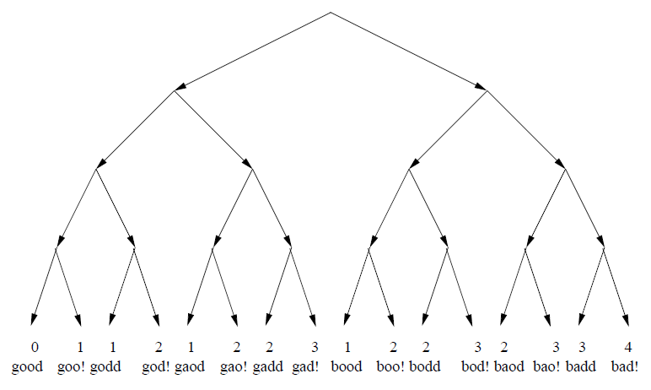
Generational Search

Slide 17
Key Features
Systematically explore state spaces of large applications
Maximize the number of new tests
Heuristics to maximize code coverage
  Best-First Search of EXE
  Picks the best from WorkList
Resilient to divergences

Slide 18
SAGE
Scalable Automated Guided Execution
File-reading programs (Windows)
Constraint Generation
  Trace-based
  Offline
x86 binary level – symbolic execution

Slide 19
Constraint Generation
Constraints are relations over symbolic variables
Example
  Symbolic tags input[0] … input[4]
  Variable x corresponding to input[4]
  Constraint x < 10

Slide 20
SAGE Architecture
Input0
Trace File
Constraints
TESTER
Check for
Crashes
(AppVerifier)‏
TRACER
Trace
Program
(Nirvana)‏
COVERAGE
COLLECTOR
Gather
Constraints
(Truscan)‏
SYMBOLIC
EXECUTOR
Solve
Constraints
(Disolver)
Input1
Input2
…
InputN

Slide 21
SAGE Constraint Generation
Why Trace-based?
  Multitude of source languages
  Compilation and post processing tools
  Unavailability of source
Why Offline?
  OS dependent binary component
  Non determinism in large targets

Slide 22
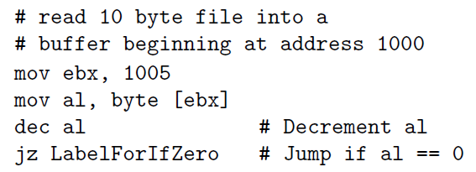
Example
System call to read 10 byte file into memory
Memory range 1000 – 1009

Slide 23
Important Result
Detects critical MS07-017 ANI vulnerability
MS SDL Policy Weblog fails to uncover the bug
Root cause:
  Failure to validate a size parameter – anih record
  Requires a test case with atleast 2 records

Slide 24
ANI Parsing - MS07-017
RIFF...ACONLIST
B...INFOINAM....
3D Blue Alternat
e v1.1..IART....
................
1996..anih$...$.
................
................
..rate..........
..........seq ..
................
..LIST....framic
on......... ..
RIFF...ACONB
B...INFOINAM....
3D Blue Alternat
e v1.1..IART....
................
1996..anih$...$.
................
................
..rate..........
..........seq ..
................
..anih....framic
on......... ..
Initial input
Crashing test case

Slide 25
ANI Parsing - MS07-017
RIFF...ACONLIST
B...INFOINAM....
3D Blue Alternat
e v1.1..IART....
................
1996..anih$...$.
................
................
..rate..........
..........seq ..
................
..LIST....framic
on......... ..
RIFF...ACONB
B...INFOINAM....
3D Blue Alternat
e v1.1..IART....
................
1996..anih$...$.
................
................
..rate..........
..........seq ..
................
..anih....framic
on......... ..
Only 1 in 2³² chance at random!
Initial input
Crashing test case

Slide 26
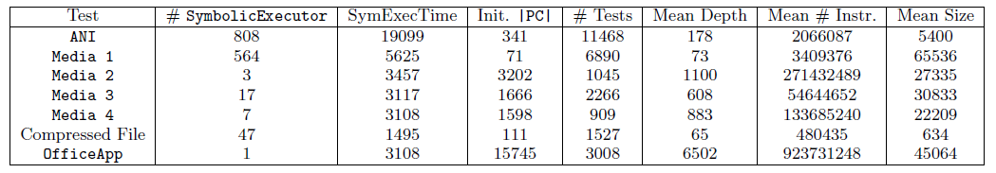
Results
ANI – ANI Parser for ANI format animated cursors
Media <#> - Media file parsers
OfficeApp – Office 2007 Application

Slide 27
Results & Observations
Symbolic Execution is slow
Divergences are common
Different files find different bugs
Bugs found are shallow
Effect of block coverage heuristic

Slide 28
Positives
Information about Tools
    (e.g. Disolver, TruScan, Nirvana, etc.)
No specific knowledge about the input format
Automated
Full program coverage
Extension to network-facing applications

Slide 29
Limitations
Well-formed inputs
SAGE - symbolic pointer dereferencing
SAGE – Online??
Symbolic executor and constraint solver
  Cost α Program
  Defect triage problem
    Remedy but no avoidance

Slide 30
Suggestions
Design limited to Windows based SAGE
Generalized to Linux based applications

Slide 31
References
P Godefroid, MY Levin, D Molnar, Automated Whitebox Fuzz Testing, NDSS, 2008.
www.truststc.org/pubs/366/15%20-%20Molnar.ppt
http://channel9.msdn.com/posts/Peli/Automated-Whitebox-Fuzz-Testing-with-SAGE/

