Slide 1
BLUEPRINT: Robust Prevention of Cross-Site Scripting Attacks for Existing Browsers
Appeared in 30th IEEE Symposium on Security and Privacy, May 2009.
Authors: Mike Ter Louw and V.N. Venkatakrishnan
Dept. of Computer Science: University of Illinois at Chicago
Presented by: Joey Thompson

Slide 2
Overview
Terms / Assumptions
Example of Cross-Site Scripting
XSS Defensive Approaches
Goal of BLUEPRINT
How BLUEPRINT Works
BLUEPRINT Implementation
Results of BLUEPRINT Testing
Contributions
Weaknesses
Questions?

Slide 3
Terms/Assumptions
XSS – Cross-Site Scripting (Malicious Attack)
CSS – Cascading Style Sheets (Styles that make standardizing multiple HTML Pages possible)
Trusted HTML – HTML content that makes up the web site or web application backend
Untrusted HTML – All content that is entered or can be edited by users

Slide 4
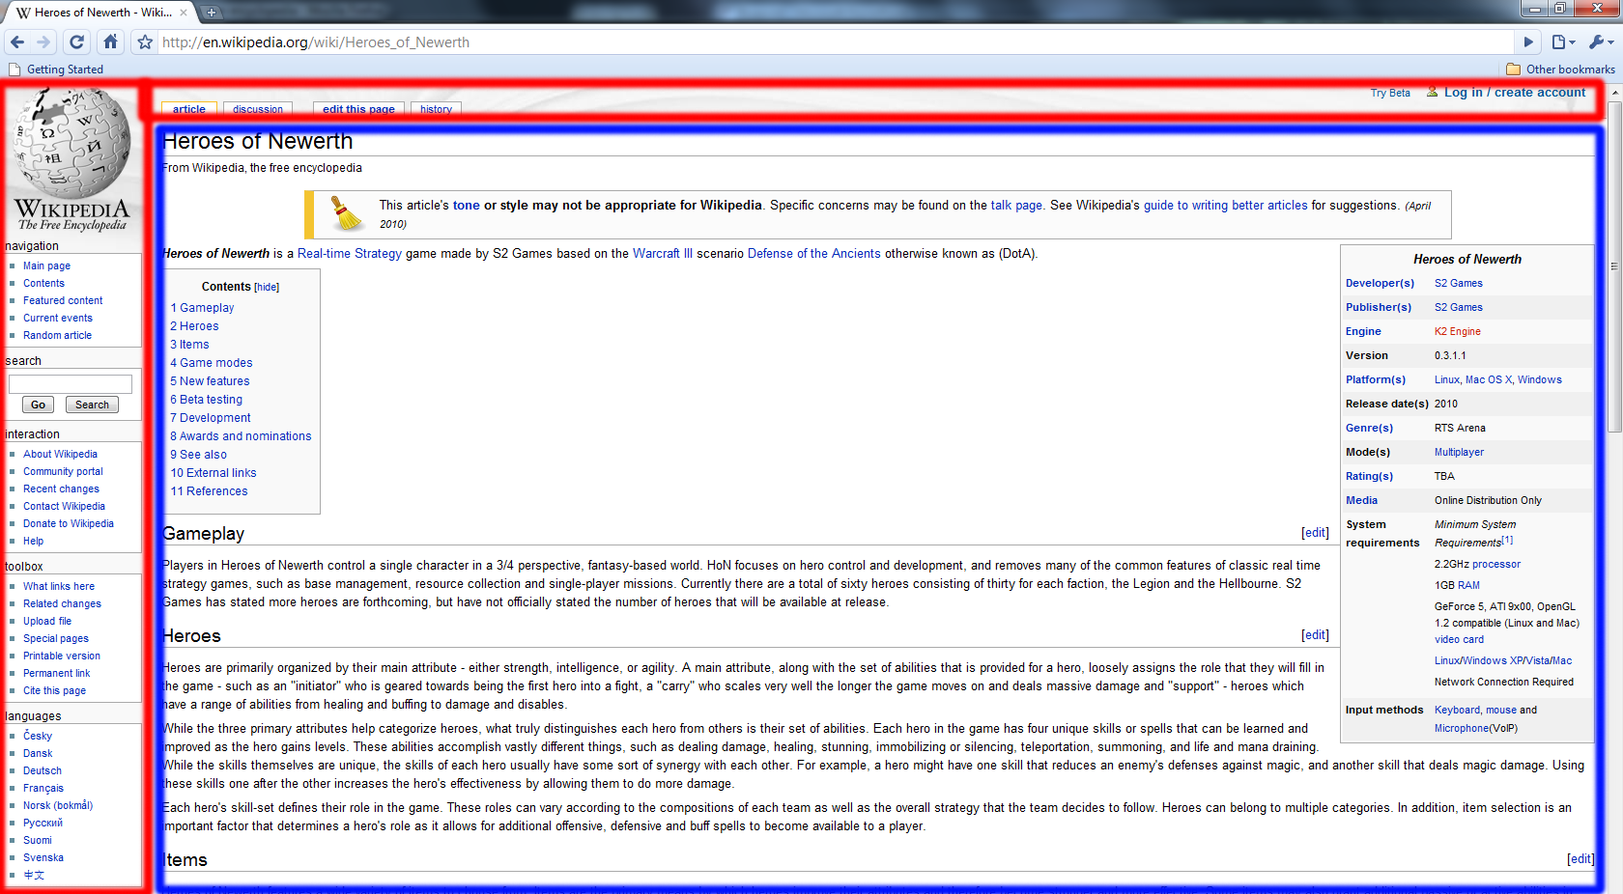
Trusted/Untrusted Example
Trusted HTML Content from Wikipedia / Untrusted HTML Content entered by users

Slide 5
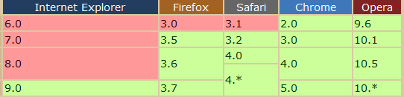
Terms/Assumptions
Browser Parser – How the browser translates and handles HTML content.
Browser Quirks – Old content on new browser, differences between browsers, how HTML is parsed, etc.
  Example: CSS3 Selectors
  Reference: www.deveria.com
DOM API – Document Object Model – Cross-platform convention for representing and interacting with HTML objects.

Slide 6
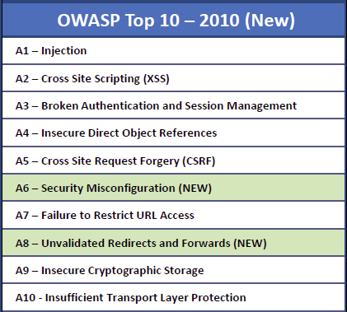
XSS Attack Risk
According to the Open Web Application Security Project (OWASP), XSS attacks are the #2 highest risk malicious attacks today

Slide 7
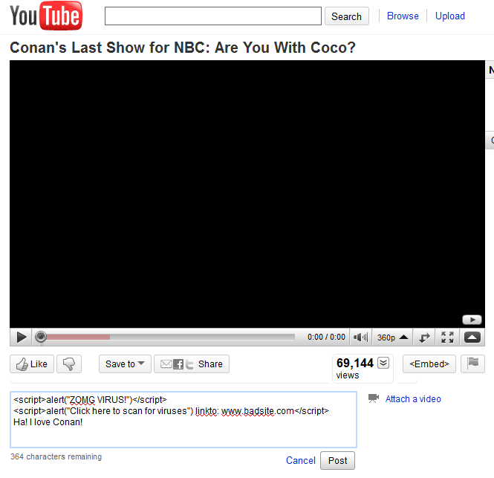
Example of XSS
XSS Goals:
  Hijack user sessions
  Deface web sites/apps
  Install malware
  Redirect to malicious sites
  Exploit web site weaknesses for profit

Slide 8
XSS Defense Approaches
Content Filtering (Sanitization) – Performed server-side where all untrusted HTML data must be scanned for scripts and removed before sending a page to a user’s browser.
Browser Collaboration – A trusted communication between browser and server is established where the server tells the browser which scripts are okay to run. All other scripts are ignored.

Slide 9
Goal of BLUEPRINT
Authors praised BEEP (Browser Collaboration Idea)
  Problems:
    Standards must be established
    Browsers/Servers updated
    Users must update and be informed
Goal: Provide temporary XSS defense that is robust against all attacks and compatible with current web browsers today without interfering with benign untrusted HTML.

Slide 10
How BLUEPRINT Works
Main idea: Close the gap between how a server thinks a browser will handle an HTML sequence and how the browser actually handles it.
Given the numerous browser quirks out there today, the only way to narrow this gap is to force the browser to understand the HTML sequence as intended by the server

Slide 11
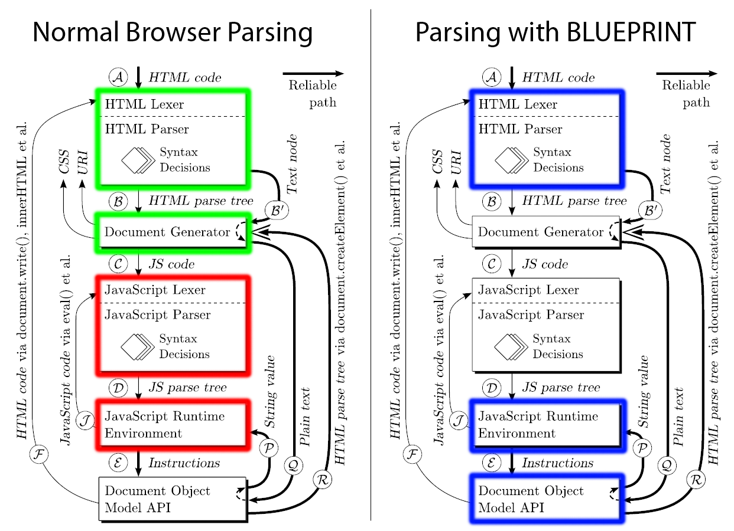
How BLUEPRINT Works

Slide 12
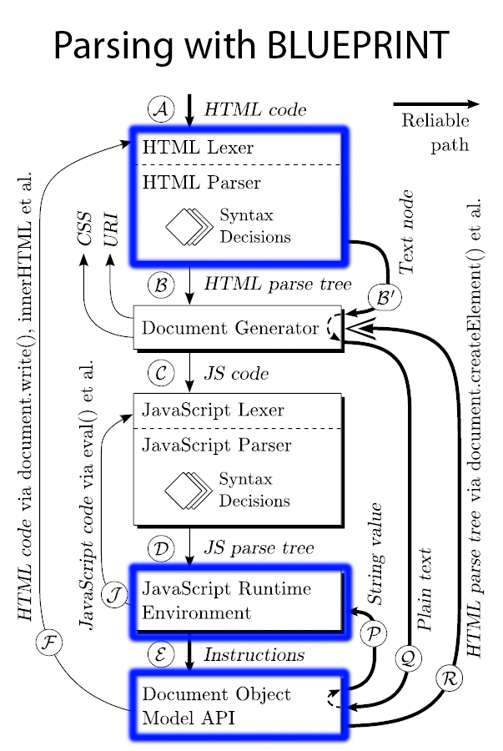
How BLUEPRINT Works
Skip unreliable path B.
Code untrusted HTML as syntactically inert text using “safe characters” and pass to DOM API
Recover code from text using JavaScript RE
ONLY use proven safe objects in DOM API that do not trigger any parsing
Use path R to send back to Document Generator

Slide 13
BLUEPRINT Implementation
Server-side: Untrusted HTML content is formed into Base64 Encoded strings.
Client-side: Strings are converted into only safe object models using the DOM API
Check objects according to their known schemes:
  Example: <a href> should start with http: https: or ftp:
  “White lists” are used to not allow characters such as /,?,$,#,<,> in objects that should never use them

Slide 14
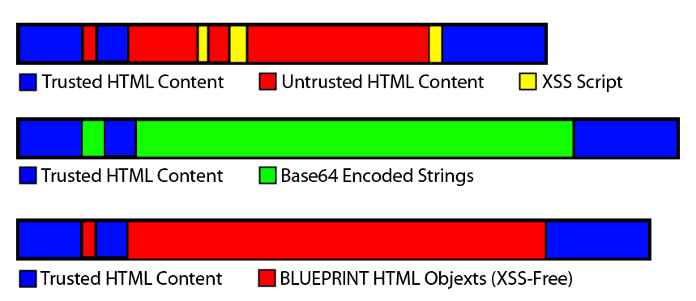
BLUEPRINT Implementation

Slide 15
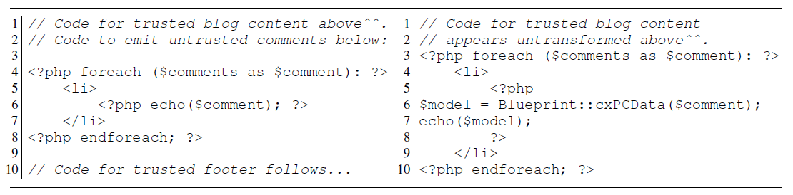
BLUEPRINT Integration
Server-side Integration: Written in PHP which has a natural integration with other PHP web apps. Also available as a separate process that communicates with web apps using local TCP/IP
Client-side: A library plug-in is prompted for download/installation on first use.

Slide 16
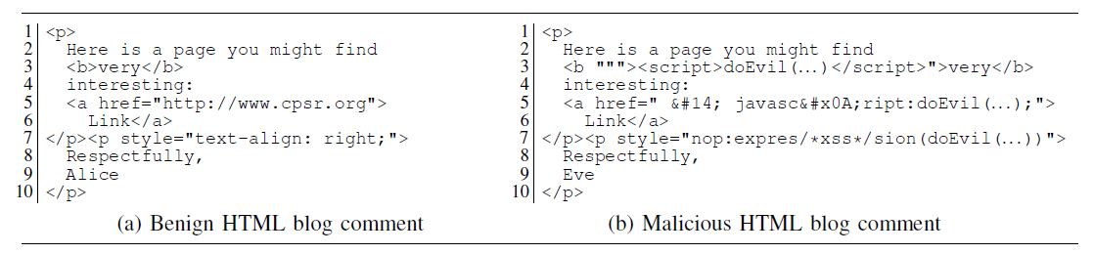
BLUEPRINT Evaluation
Tested on two highly untrusted types of HTML pages
  A Blog platform (modeled after WordPress)
  A Wiki platform (modeled after Wikipedia)
Tested against most common XSS attempts including HTML, link, and CSS attacks

Slide 17
BLUEPRINT Evaluation
Tested on Chrome 1.0, Firefox 2.0 and 3.0, IE 7 and 6, Opera 9.6, and Safari 3.1 and 3.2
Used XSS Cheat Sheet
  Praised for undermining real-world regular expression based defenses
  Contains 94 XSS attacks, 14 URI obfuscation attacks, 2 Cross-Site Request Forgery attacks, 1 server-side include attack, and 1 PHP command injection

Slide 18
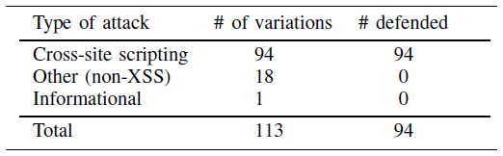
BLUEPRINT Evaluation
Server: Ubuntu 8.04 LTS Server running Apache 2.2.8
Client: Ubuntu 8.10 running Windows XP in VirtualBox
Across all browsers BLUEPRINT successfully blocked all XSS attacks, but did not stop non-XSS or Informational attacks that were included in XSS Cheat Sheet

Slide 19
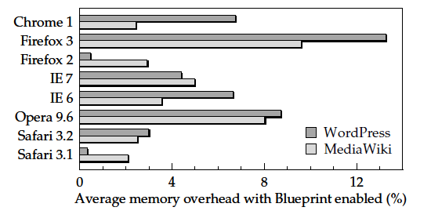
BLUEPRINT Evaluation
Additional memory overhead differed on each different browser for both cases.

Slide 20
BLUEPRINT Evaluation
Page overhead attributed to three factors:
  Per-model overhead due to embedding of model interpreter scripts
  Text size overhead due to Base64 encoding
  HTML markup size due to encoding of HTML elements, attributes, and CSS properties
Wordpress averaged 52.4% overhead.
Wiki layout averaged 13.9% overhead.
  Reason for higher overhead is due to format of WordPress comments. 534 models are used for 250 comments, whereas less models are used in Wiki.

Slide 21
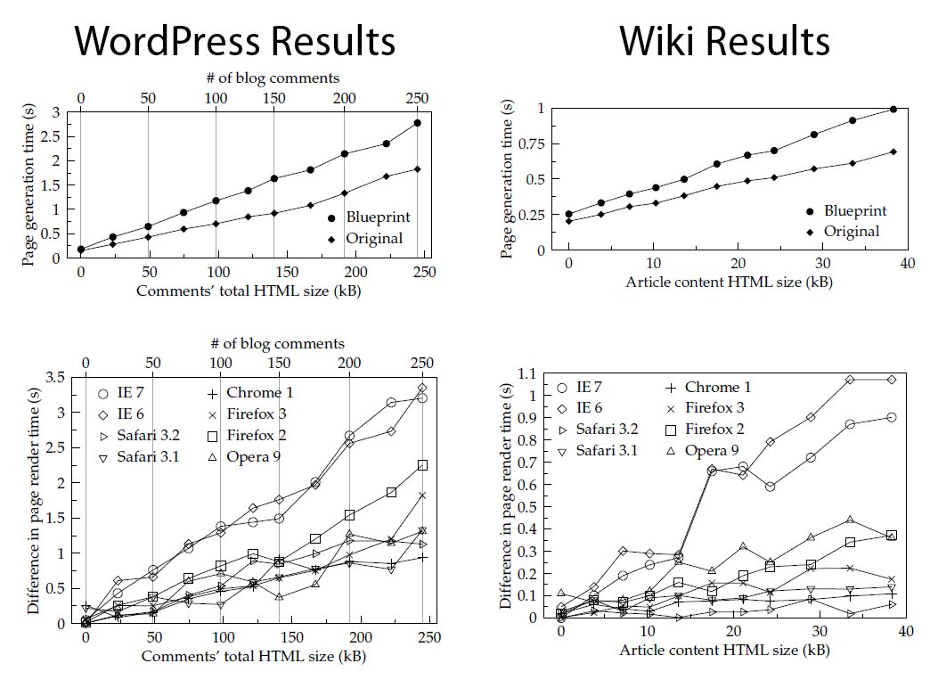
BLUEPRINT Evaluation

Slide 22
BLUEPRINT Evaluation
Very important statistic: Additional time required before user can access the page with the addition of BLUEPRINT on server and client-side
Worst WordPress Case: 3.4 seconds in IE6 (250 Comments)
Worst Wiki Layout Case: 1.05 seconds in IE6 (40kb Article)
If user reads from the top of the page down, no human could read 250 comments in 3.4 seconds or a large 40kb article in one second.

Slide 23
Contributions
Authors desire a browser collaboration method as a long term solution, but have provided a solid temporary defense system for XSS attacks today.
BLUEPRINT system:
  Reliably defends against all tested XSS attacks
  Supports benign structured HTML content
  Compatible with all current browsers today
  Protects with small enough overhead to be unperceivable to the human eye

Slide 24
Weaknesses
Could have more clearly defined trusted vs untrusted HTML content
Lack of specific example explaining browser parser
Lack of specific example explaining step by step BLUEPRINT parser
Lack of explanatory pictures. Excluding tables /graphs there were two, and one was pointless
No reference to the 19 attacks it was unable to stop or future ways to prevent them

Slide 25
The End
Questions / Comments?
References:
  BLUEPRINT: Robust Prevention of Cross-Site Scripting Attacks for Existing Browsers, Mike Ter Louw and V.N. Venkatakrishnan, University of Illinois at Chicago.
  Bowser Compatibility Comparison <http://www.deveria.com>
  OWASP Top 10 Risks <http://www.OWASP.com>
  XSS Chest Sheet <http://ha.ckers.org/xss.html>

