Slide 1
All Your iFRAMEs Point to Us
Niels provos ,Panayiotis mavrommatis - Google Inc
Moheeb Abu Rajab , Fabian Monrose - Johns Hopkins University
Google Technical Report 2008
Presented by
Vignesh Saravanaperumal

Slide 2
Outline
Terminologies
Infrastructure and methodology
Prevalence of Drive by Download
Malware Injection
Properties of the Malware Distribution Infrastructure
Post Infection Impact
Statistics
Conclusion
Drawbacks

Slide 3
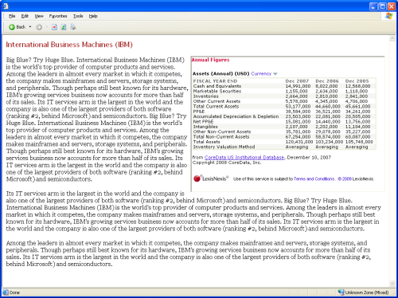
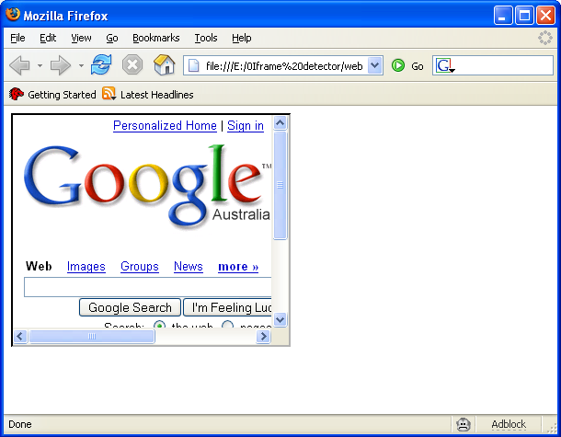
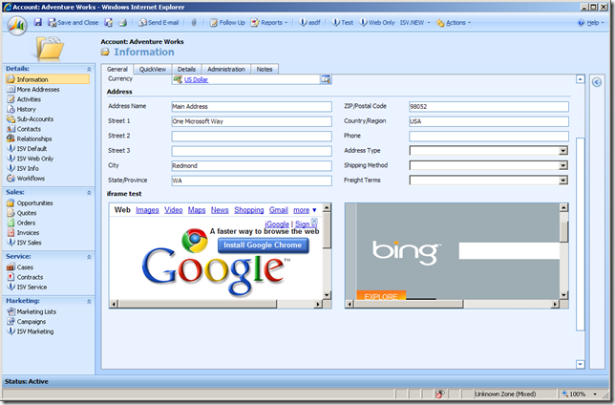
Terminologies
IFRAMEs:
The <iframe> tag allows you to create an "internal" frame inside a document. The internal frame can contain any HTML document, and clicking a link inside the <iframe> causes the target document to be loaded inside the internal frame as well.

Slide 4
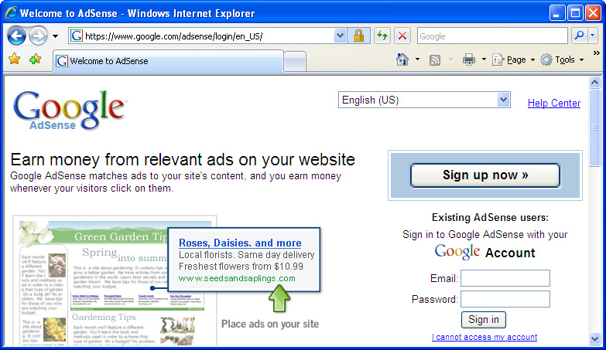
Terminologies
awglogin

Slide 5
Terminologies
Drive by download:
Silently installs Malware when web page is loaded
Sites owners are unaware that they are participating in an attack
Installed malware causes the system to
  Crash
  Steal personal Information's
  Join Botnet
Landing Pages:
The URLs that initiate drive-by downloads when users visit them
Distribution sites:
In many cases, the malicious payload is not hosted on the landing site, but instead loaded via an IFRAME or a SCRIPT from a remote site
The Remote site that hosts malicious payloads ( malware)

Slide 6
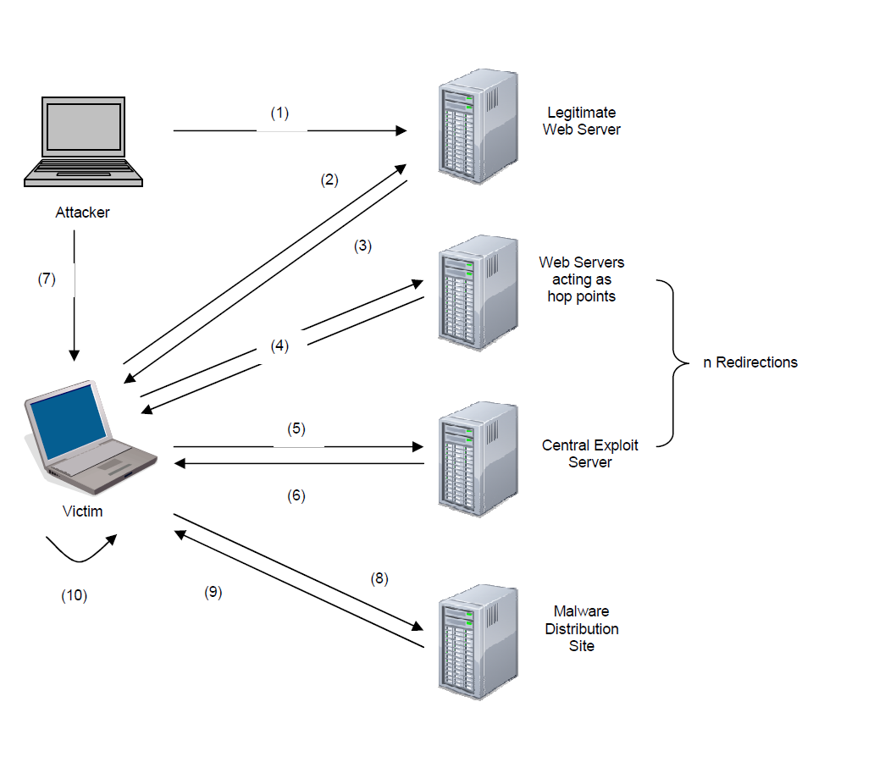
Example
The attacker compromises a legitimate web server and inserts a script in a web application.
The victim visits the web site that is compromised
The web server sends along with the requested page the script the attacker injected
A redirection starts from one web server to the other that actually play the part of hop points.
After following a number n of redirections the victim reaches the central exploit server.
The server sends the exploit script.
The attacker gains control over the victim’s system, after exploiting the vulnerability that was targeted.
The exploit instructs the browser to visit the malware distribution site. This is, actually, when the drive-by download starts.
Malware executables are downloaded.
The victim’s computer automatically installs and executes the malicious code

Slide 7
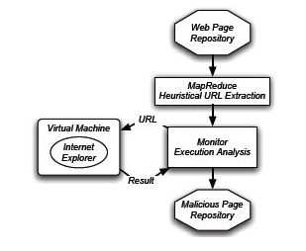
Infrastructure and Methodology

Slide 8
Infrastructure and Methodology
Pre-processing Phase:
Mapreduce framework processes billions of pages in parallel and look for features like out of place” IFRAMEs, obfuscated JavaScript, or IFRAMEs and apply machine learning algorithm to extract malicious WebPages.
They also take into account the reports given by the users
Notes:
Which machine learning algorithm?

Slide 9
Infrastructure and Methodology
Verification phase:
This phase aims to verify whether the extracted (Suspicious) URL from the pre-processing phase is malicious or not .
These URL are retrieved once again and run on a virtual machines for 2 minutes and the system behavior is monitored.
The final set of malicious URLs are decided by combining the observations from the system’s state changes and anti-virus scanners results on the incoming HTTP responses
Notes:
What about the false positive?

Slide 10
Infrastructure and Methodology
How to Construct a Malware Distribution Networks?
A malware delivery tree consists of the landing site, as the leaf node, and all nodes (i.e., web sites) that the browser visits until it contacts the malware distribution site (the root of the tree).

Slide 11
Infrastructure and Methodology
How to Construct a Malware Distribution Networks?
Inspecting the Referer header from the recorded successive HTTP requests the browser makes after visiting the landing page.
Interpret the HTML and JavaScript content of the pages fetched by the browser and extract all the URLs from the fetched pages.
Find the parent page.

Slide 12
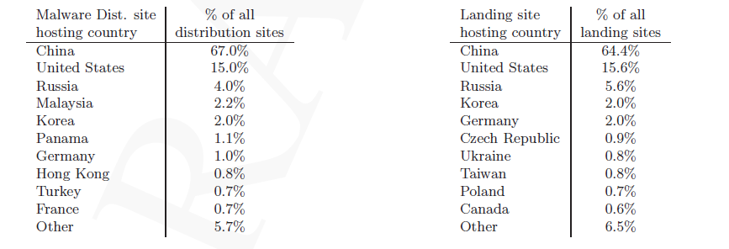
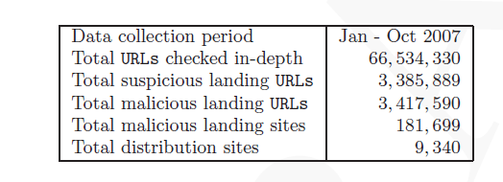
Prevalence of Drive by Download
Geographic locality:
Notes:
Jan 2007-oct 2007

Slide 13
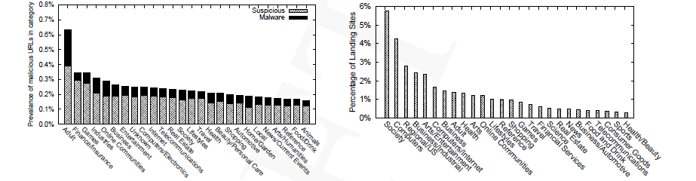
Prevalence of Drive by Download
Browsing Habits of the End user:
Notes:
Jan 2007-oct 2007

Slide 14
Malware Injection
There are different methods to inject malware
Web Server Security
User Contributed Content
Advertising
Third Party Widgets

Slide 15
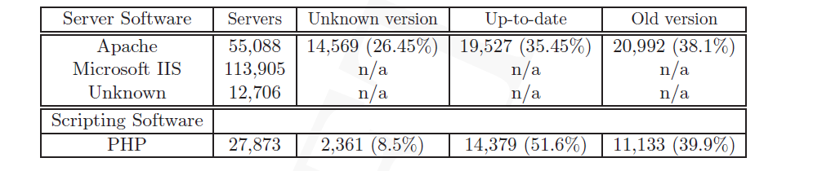
Malware Injection
Web Server Security
The software running on the web server that leads to the malware distribution sites seems to be unpatched and outdated.
Malicious content can be inserted as an entry in databases using SQL injection techniques or by taking advantage of vulnerabilities in scripting applications like PHP, ASP, Perl, Python.

Slide 16
Malware Injection
User Contributed Content
Many web sites contains forums, blogs, bulletin boards that allow users to contribute their own content in the form of comments reviews etc
The lack of input validation and checking allows every user to enter arbitrary HTML anywhere in the page user input is requested
Attackers can insert code including “iframe” or “script” tags and expose every user seeing the post to the exploit script containing malicious code.

Slide 17
Malware Injection
Advertising
Advertising is usually achieved by large advertising companies that provide a fixed piece of code to be inserted in web pages
This piece of code is not directly controlled by the administrator of the web site that displays the advertisement, which means that the company should be trusted for not providing malicious content
Adversaries find this as an attractive way to insert malicious content to popular web sites that display advertisements without making any effort to compromise the web server and search for vulnerabilities

Slide 18
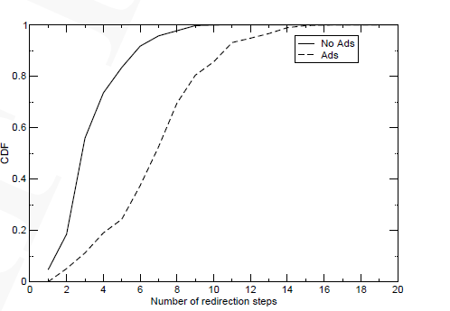
Malware Injection
Advertising
2% of the landing sites were delivering malware via advertisements.
Ad-delivered through drive-by down-loads appears in short-lived spikes.

Slide 19
Malware Injection
Third Party Widgets
Third-party widgets are scripts provided by third parties that are commonly used to provide extra functionality to a web site
Most of them are accessed through a link contained in an external JavaScript or iframe
The link leads to the web site that hosts the widget
What can go wrong in this case is that there is a possibility that adversary changes the code of the widget without the knowledge of the web master and serves malicious content

Slide 20
Properties of the Malware Distribution Infrastructure
Size of the Malware Distribution Networks
IP Space locality
Overlapping landing sites
Distribution of Malware Binaries Across Domains
Relationships Among Different Malware Distribution Networks

Slide 21




Properties of the Malware Distribution Infrastructure
Size of the Malware Distribution Networks:
There are 3 types of Malware Distribution Network
Landing site = Distribution Site
One Landing site and a Distribution Site.
Many Landing Site and a Distribution Site.
user
www.mal.com
user
School.com
Worm.com
Ab.com
Virus.com
user
Cdef.com

Slide 22
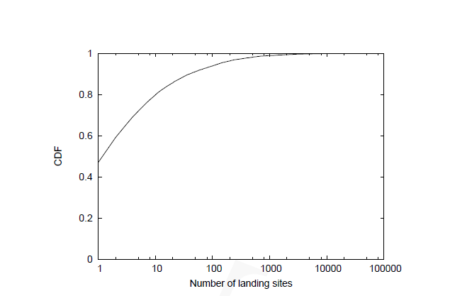
Properties of the Malware Distribution Infrastructure
Size of the Malware Distribution Networks:

Slide 23

Properties of the Malware Distribution Infrastructure
IP Space Locality:
About 70% of the malware distribution sites have IP addresses within 58.* -- 61.* and 209.* -- 221.* network ranges.
Overlapping landing sites:
Let I be a malware Distribution Network 1
Let Xi be the number of landing pages belonging to I
Let J be a malware Distribution Network 2
Let Xj be the number of landing pages belonging to J
Observations were made in which landing pages with multiple IFRAMEs linking to different malware distribution sites were found.

Slide 24
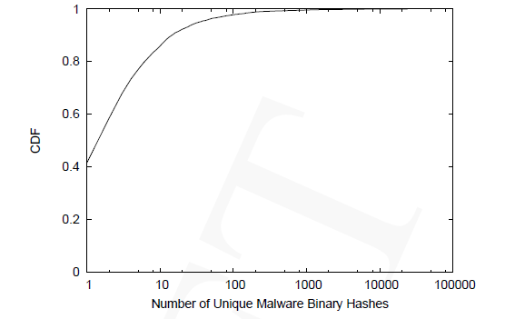
Properties of the Malware Distribution Infrastructure
The distribution of malware across domains:
42% of the distribution sites delivered a single malware binary(single Malware).
3% of the servers were hosting more than 100 binaries
A observation was made in which it was seen that there was a number of cases in which same hash was hosted on multiple distribution servers.

Slide 25
Properties of the Malware Distribution Infrastructure
Malware hosting infrastructure
9, 430 malware distribution sites were detected
90% of the sites was hosted on a single IP address
10% of the IP address hosted more than one Malware Distribution sites

Slide 26
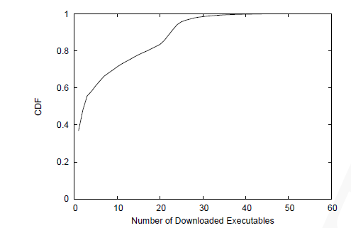
Post Infection Impact
They had given an overview of the collective changes that happen to the system after visiting a malicious URL

Slide 27

Post Infection Impact
REGISTRY CHANGES:
Whenever a malicious program is installed on a computer, it modifies some of the registry keys in order to gain some privileges on the system. These malicious modified and deleted registry entries can affect the computer’s operations and its performance and can, therefore, cause serious damage
BHO indicates that the malware installed a Browser Helper Object that can access privileged state in the browser
Preferences means that the browser homepage, default search engine or name server where changed by the malware;
Security indicates that malware changed firewall settings or even disabled automatic software updates
Startup indicates that the malware is trying to persist across reboots.
Process Monitor is a monitoring tool that shows real-time file system, registry and process/thread activity
Notes:
57.5% landing sites. these were carried out in virtual machines.

Slide 28
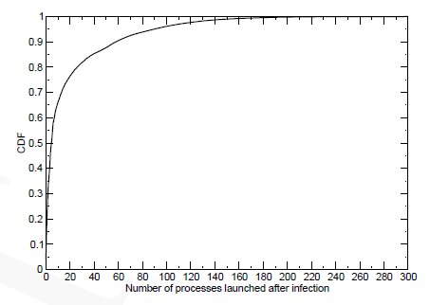
Post Infection Impact
RUNNING PROCESSES AND FILE ACTIVITY:
The automatic execution of binaries increases at once the number of running processes. In some cases it is increased in such a length that the system’s processor cannot handle the overhead and “crashes”
A common strategy malware follow is the replacement of critical files of the operating system, like Dynamic Link Library files (.dll files)
Malicious files masquerade as the original files aiming to inject themselves in running processes and change or manipulate their behavior and consequently the behavior of the linked programs.
HDF is a hard disk firewall that prevents malware infection. When activated it blocks unwanted software from storing to the computer

Slide 29
Post Infection Impact
3. NETWORK TRAFFIC:
An increased network activity is the result of visiting a malicious web page
One of the common tactic for malware to scan for other vulnerable systems in the LAN of the infected host and start sending numerous TCP and UDP packets in order to listen to open ports
Wireshark is a network protocol analyzer that enables live capture of network traffic and offline analysis

Slide 30
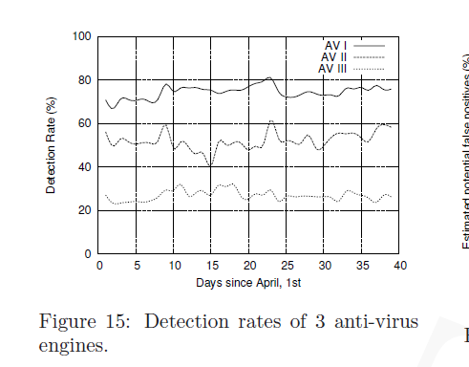
Post Infection Impact
Anti-virus Detection rate:
They did not trust the antivirus available in the market
Notes:
One month april 2007.

Slide 31
Post Infection Impact
  April 2007 June 2007
Malware binaries
Undetected Malware binaries
Antivirus Search Engine
Google Methodology
Resulting binaries were considered false positive
Antivirus search engine

Slide 32
Tools used for Malware Injection
Mpack: It is a which is used to hide iFRAMEs in compromised sites that redirect the user who visits it to the attacker’s malicious web site
El Fiesta: This tool is used for targeting exclusively Adobe PDF formats
Neosploit: With functionality similar to the Mpack, it is said to be responsible for injecting malicious code to more than 80000 legitimate web sites

Slide 33
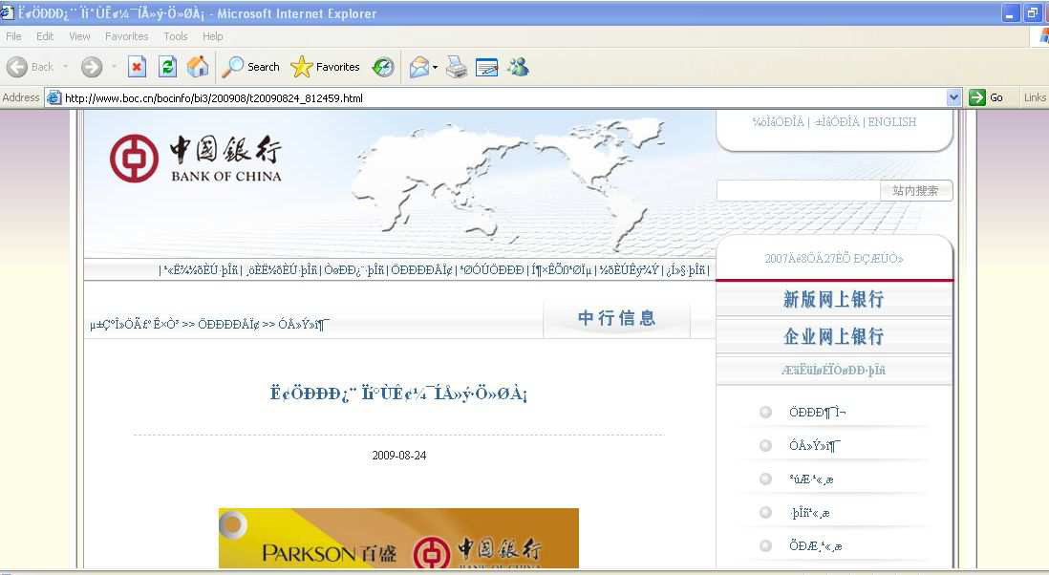
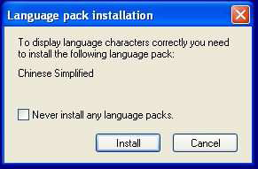
Real time Example
When you visit this url http://219.148.34.10/sss.exe, a malware called Downloader gets downloaded and its function is to connect to the Internet and download other malicious files like Trojan horses or adware.
Result: An Internet Explorer window gets opened and displays a Bank of China web page with URL
www.boc.cn/bocinfo/bi3/200908/t20090824_812459.html

Slide 34
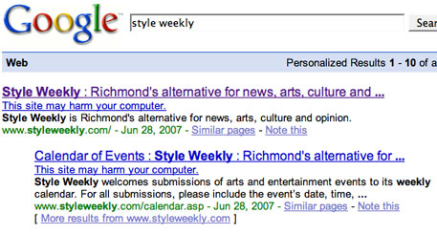
Statistics
1.3% of incoming search queries to Google Search engine returned atleast one url labeled as malicious in the result page
67% of the malware distribution servers and 64% of the websites that link to them are located in china

Slide 35
Conclusion
66 million url were analyzed in 10 month period
Malware Distribution Technique was discussed in detail
Relationship among several malware distribution networks
Internet is still unsafe for layman
Antivirus (even the latest versions) are not dependable

Slide 36
Drawbacks and comments
Classification of Malware was missing in anti-virus search results
How is the false positive calculated (Threshold Value)?
The lifetime of the Malware Distribution Network is not calculated?
Does Google contact the owner of the potentially affected host and let them know the findings?
Can Google remove such sites from search results that will stop visitors to visit such sites?

Slide 37
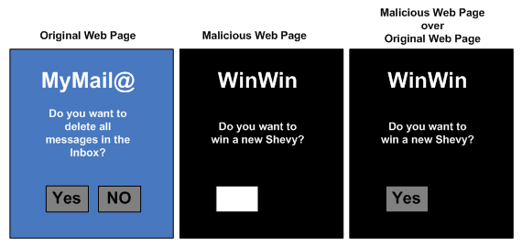
Example
Click Jacking and Iframe:

