Slide 1
A low cost attack on Microsoft CAPTCHA
Authors: Jeff Yan, Ahmad El Ahmad
Presented By: Abirami Poonkundran

Slide 2
Overview
Introduction to CAPTCHA
Segmentation Attack
  Pre-Processing
  Vertical Segmentation
  Color filling segmentation
  Thick arc removal
  Locating connected characters
  Segmenting connected characters
Results
Conclusion
Latest Implementation

Slide 3
Introduction
This paper presents a simple methodical way to break CAPTCHA systems, using Character Segmentation techniques

Slide 4
CAPTCHA
Completely Automated Public Turing test to tell Computers and Humans Apart
CAPTCHAs are widely used as standard security mechanism to defend against malicious bots from posting automated messages to blogs, forums, wikis etc.,
CAPTCHA server posts a challenge that humans can solve easily, but computers can’t solve easily
CAPTCHAs are usually used to ensure that the response is not generated by computers

Slide 5
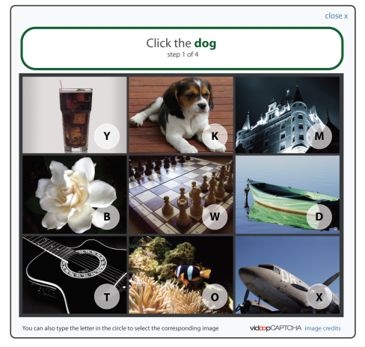
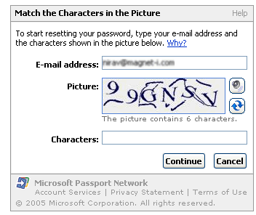
CAPTCHA
There are different types of CAPTCHAs:
  Text based
  Image based
  Audio based

Slide 6
Text based CAPTCHA
The most popular and widely used CAPTCHA scheme
Distort text images, and make them unrecognizable even for state of the art Pattern Recognition methods
Advantages:
  Intuitive
  Human friendly
  Easy to deploy
  <0.01% of success rate for automated attacks

Slide 7

CAPTCHA Properties
Computer recognition rate for individual characters are very high:
So position of the characters have to be unpredictable, and characters have to be connected:
Characters under typical distortions | Recognition rate
 | 100%
 | 98%

Slide 8
Challenge
Identifying the position of the characters in the right order (segmentation) is:
  Computationally expensive and
  Combinatorialy hard
Most of the current CAPTCHA implementations including MSN, Yahoo and Google, are Segmentation-Resistant
If a CAPTCHA can be segmented it can be easily broken
This paper presents a novel segmentation attack

Slide 9
MSN CAPTCHA
8 Characters in each challenge
Only Upper case letters and digits
Blue foreground and Gray background
Thick foreground arcs
Thin foreground and background arcs
Character distortion

Slide 10
Segmentation Attack
Identify and remove random arcs
Identify all character locations and divide it in to 8 segments, each containing one character
Steps:
  Pre-Processing
  Vertical Segmentation
  Color filling segmentation
  Thick arc removal
  Locating connected characters
  Segmenting connected characters

Slide 11



Pre-Processing
Convert rich-color CAPTCHA image to black and white image, using a threshold
Fix mistakenly broken foreground pixels (T)
Original Image:
Binarized Image:
After fixing:

Slide 12
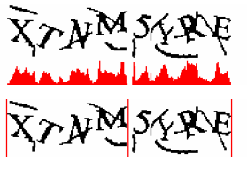
Vertical Segmentation
Create histograms with number of foreground pixels per column
Cut the image to chunks where there are no foreground pixels in a column
Blank
Column
Histogram
Chunks after segmentation

Slide 13
Color Filling Segmentation
Detect a foreground pixel, and trace all the foreground pixels connected to it
Color this connected component(object) with a distinct color
Number of colors gives the number of objects(N) in a chunk
Chunks after segmentation

Slide 14

Color Filling Segmentation
Objects could be a single character, connected character, an arc, connected arcs or a character and an arc
11 objects

Slide 15
Thick arc removal
Look for objects:
  Far away from base line (ie above or below the characters)
  Small pixel count (less than 50)
  Doesn’t form a circle or have a closed loop(A, B, D, P, O,Q, R, 4, 6, 8, 9)
  If total number of objects >8, then smallest size object could be arc
base line

Slide 16

Vertical Segmentation
After thick arc removal pass the image for another vertical segmentation
7 objects
Chunks

Slide 17
Locating Connected Characters
If N<8 then there are some connected characters
Analysis shows if an object is wider than 35 pixels, then it could have more than one character
Based on number of chunks and number of objects in each chunk, we can narrow down to the chunk with connected characters

Slide 18
Locating Connected Characters
We have 4 chunks and 7 objects
And we know there have to be 8 characters
Possibilities:
  Four chunks, each having two characters [2,2,2,2]
  One chunk has three characters and two additional chunks each having two characters [3,2,2,1]
  One chunk has four characters and another two characters [4,2,1,1]
  There are two chunks each having three characters [3,3,1,1]
  One chunk has five characters [5,1,1,1]
[1, 3, 2, 2]

Slide 19
Locating Connected Characters
Chunks 2, 3, and 4 are wider than 35 pixels
And we know chunk 1 has only one character (it has only 1 object, which is < 35 pixels)
  [2,2,2,2]
  [3,2,2,1]
  [4,2,1,1]
  [3,3,1,1]
  [5,1,1,1]
[1, >1, >1, >1]
This possibility matches our profile

Slide 20
Locating Connected Characters
Since Chunk 2 is wider than other chunks, the algorithm identifies that
  First chunk has 1 character
  Second chunk has 3 characters
  Third chunk has 2 characters
  Fourth chunk has 2 characters
Identified as [1, 3, 2, 2]

Slide 21

Segmenting Connected Characters
Identify the width of each chunk and do an even cut, based on the number of characters it has
Passing these 8 characters to a character recognition algorithm would easily identify them
We identified all 8 characters

Slide 22
Results
Segmenting Success rate: 91%
Attack Speed : 80 ms
Image Recognition Success Rate: Ideally 95%, but in our case it was less because some characters had some thin arcs left
Overall Success rate(both Segmentation and Recognition): 61%

Slide 23



Testing with Yahoo & Google Captcha
Microsoft Style: 91%
Yahoo Style: random angled connecting lines.
77%
Google Style: crowding characters together
12%

Slide 24


Conclusion
Improvements to Prevent Segmentation
  Variable number of characters
  Random width for each character
  Crowding characters together
  Adding random arcs
cl or ch or d
HZKA8S or HKA8S

Slide 25



Current Implementation
Microsoft Style:
Gmail Style :
Yahoo Style :

